Slide 1
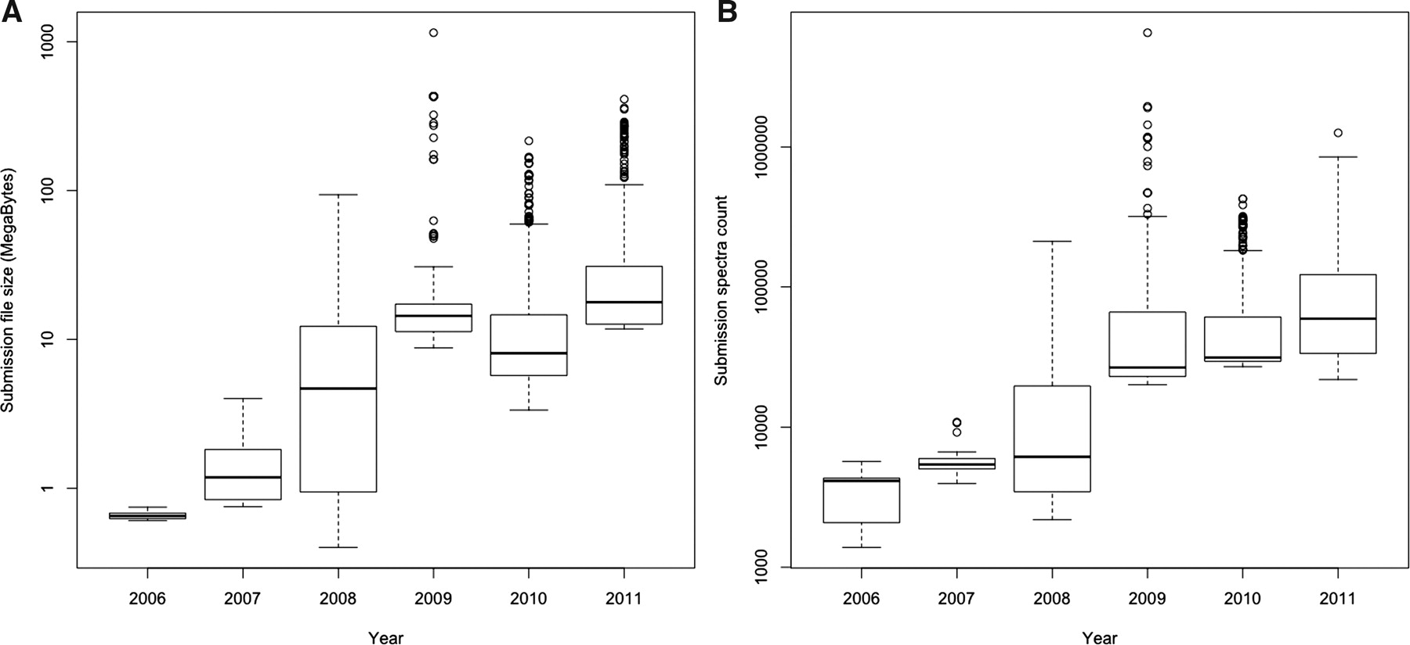
Figure 1. (A) Top 20% largest submission file sizes and (B) top 20% highest spectra count per submission file over ...
Notes:
Figure 1. (A) Top 20% largest submission file sizes and (B) top 20% highest spectra count per submission file over time. The top 20% percentage of the submitted files is shown in order to reflect to the state of the art methodology and MS machines applied. The figure shows that there was at least one order of magnitude increase in file sizes and about two orders of magnitude increase in spectra counts from 2006 to 2011.
Unless provided in the caption above, the following copyright applies to the content of this slide: © The Author(s) 2012. Published by Oxford University Press.This is an Open Access article distributed under the terms of the Creative Commons Attribution Non-Commercial License (http://creativecommons.org/licenses/by-nc/3.0), which permits unrestricted non-commercial use, distribution, and reproduction in any medium, provided the original work is properly cited.

Slide 2
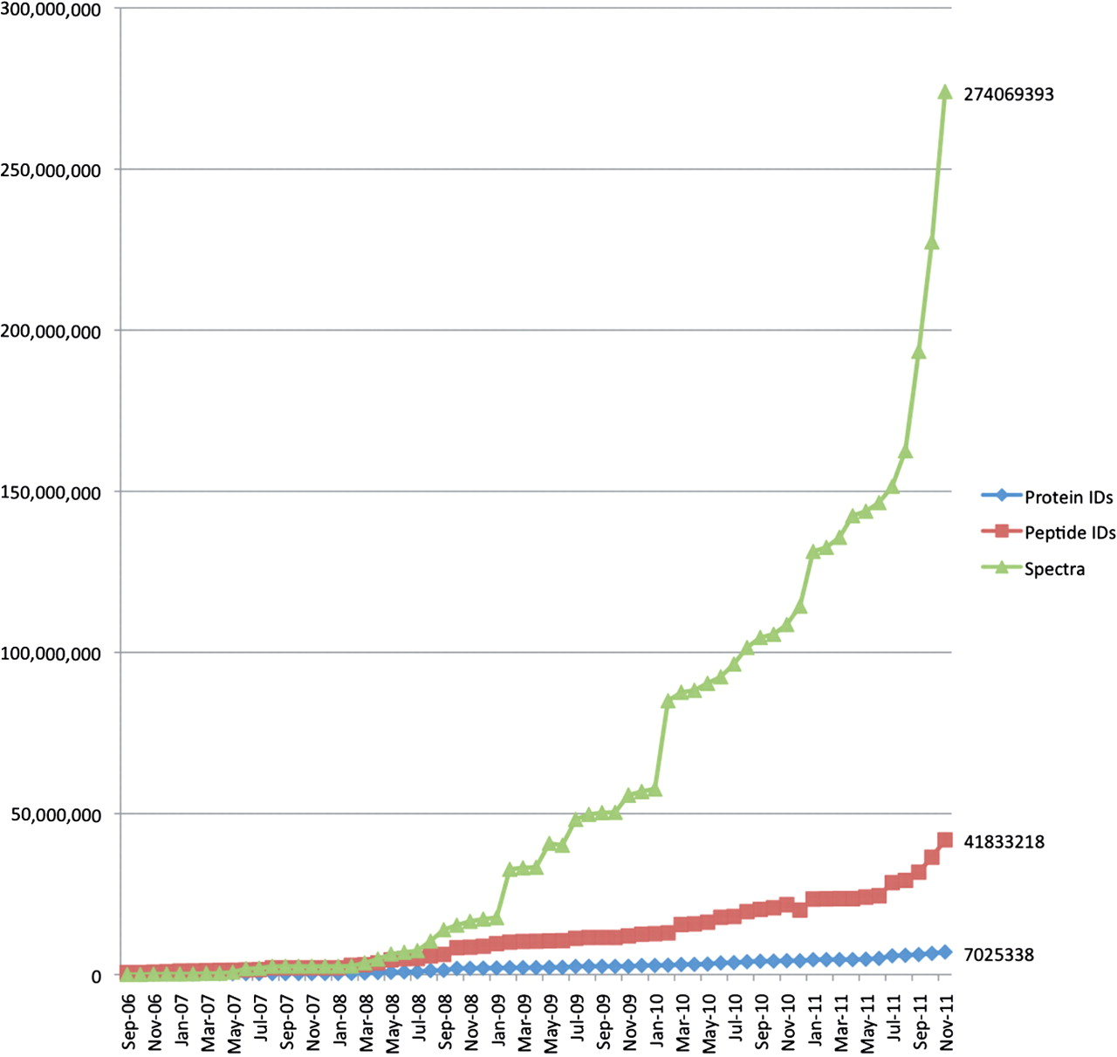
Figure 2. The overall growth of peptide and protein identifications, and mass spectra at PRIDE over time. The increase ...
Notes:
Figure 2. The overall growth of peptide and protein identifications, and mass spectra at PRIDE over time. The increase in data content of three core types of information stored at PRIDE: peptide and protein identifications and mass spectra, from 2006 to November 2011.
Unless provided in the caption above, the following copyright applies to the content of this slide: © The Author(s) 2012. Published by Oxford University Press.This is an Open Access article distributed under the terms of the Creative Commons Attribution Non-Commercial License (http://creativecommons.org/licenses/by-nc/3.0), which permits unrestricted non-commercial use, distribution, and reproduction in any medium, provided the original work is properly cited.

Slide 3
Figure 3. The PRIDE submission workflow. Search engine results containing identifications and spectra files are ...
Notes:
Figure 3. The PRIDE submission workflow. Search engine results containing identifications and spectra files are converted into PRIDE XML files by PRIDE Converter. Initial assessment and visualization of the data are done with PRIDE Inspector. This part is highlighted because that is where the bulk of the curation is happening. Finally the files are submitted to the PRIDE database.
Unless provided in the caption above, the following copyright applies to the content of this slide: © The Author(s) 2012. Published by Oxford University Press.This is an Open Access article distributed under the terms of the Creative Commons Attribution Non-Commercial License (http://creativecommons.org/licenses/by-nc/3.0), which permits unrestricted non-commercial use, distribution, and reproduction in any medium, provided the original work is properly cited.

Slide 4
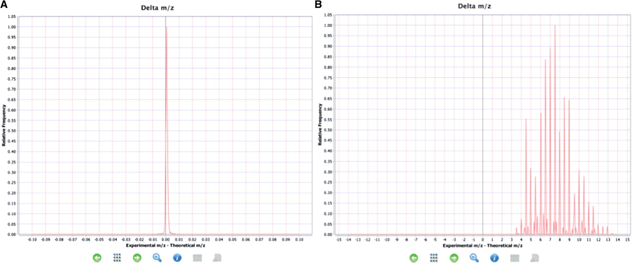
Figure 4. Examples of expected and unexpected delta m/z value distributions. (A) An expected delta m/z distribution ...
Notes:
Figure 4. Examples of expected and unexpected delta m/z value distributions. (A) An expected delta m/z distribution where the value are within the −4.0, +4.0 m/z units range. (B) Unexpected distribution of delta m/z values where most of the values are outside of the −4.0, +4.0 m/z units range indicating a potential problem.
Unless provided in the caption above, the following copyright applies to the content of this slide: © The Author(s) 2012. Published by Oxford University Press.This is an Open Access article distributed under the terms of the Creative Commons Attribution Non-Commercial License (http://creativecommons.org/licenses/by-nc/3.0), which permits unrestricted non-commercial use, distribution, and reproduction in any medium, provided the original work is properly cited.

Slide 5
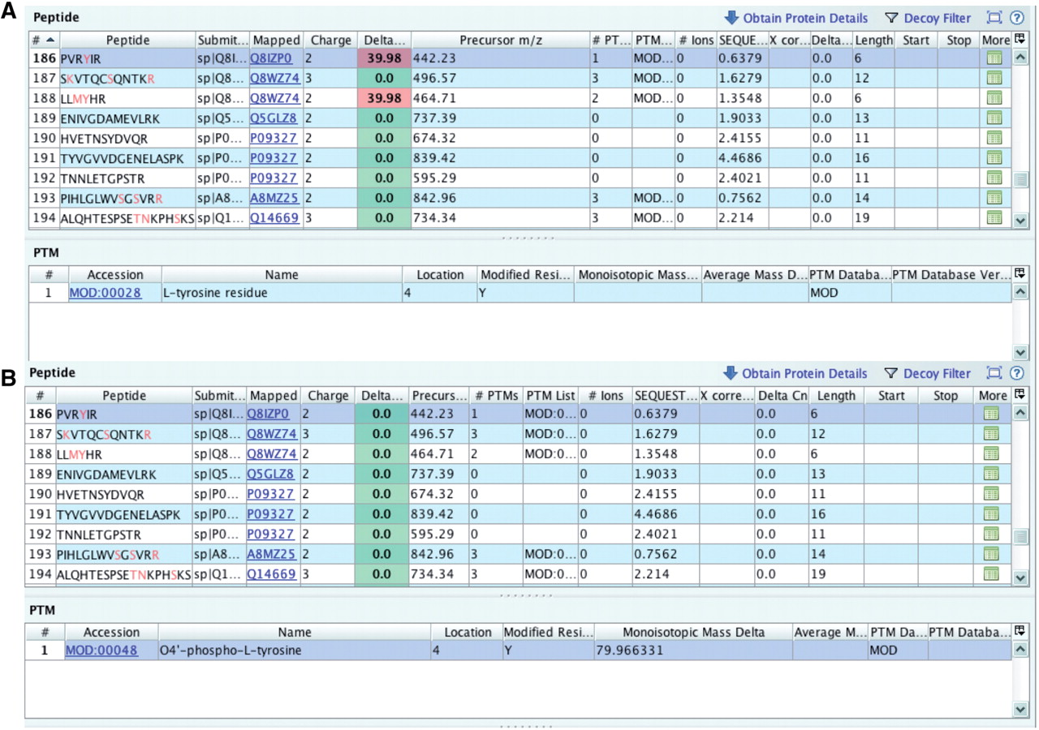
Figure 5. Checking delta m/z values with PRIDE Inspector peptide view: Example 1: misreported modification (A) outlier ...
Notes:
Figure 5. Checking delta m/z values with PRIDE Inspector peptide view: Example 1: misreported modification (A) outlier delta m/z value highlighted in red indicates a potential problem with the assigned protein modification. (B) protein modification replaced with the proper PSI-MOD term with a delta mass that gives an expected delta m/z value.
Unless provided in the caption above, the following copyright applies to the content of this slide: © The Author(s) 2012. Published by Oxford University Press.This is an Open Access article distributed under the terms of the Creative Commons Attribution Non-Commercial License (http://creativecommons.org/licenses/by-nc/3.0), which permits unrestricted non-commercial use, distribution, and reproduction in any medium, provided the original work is properly cited.

Slide 6
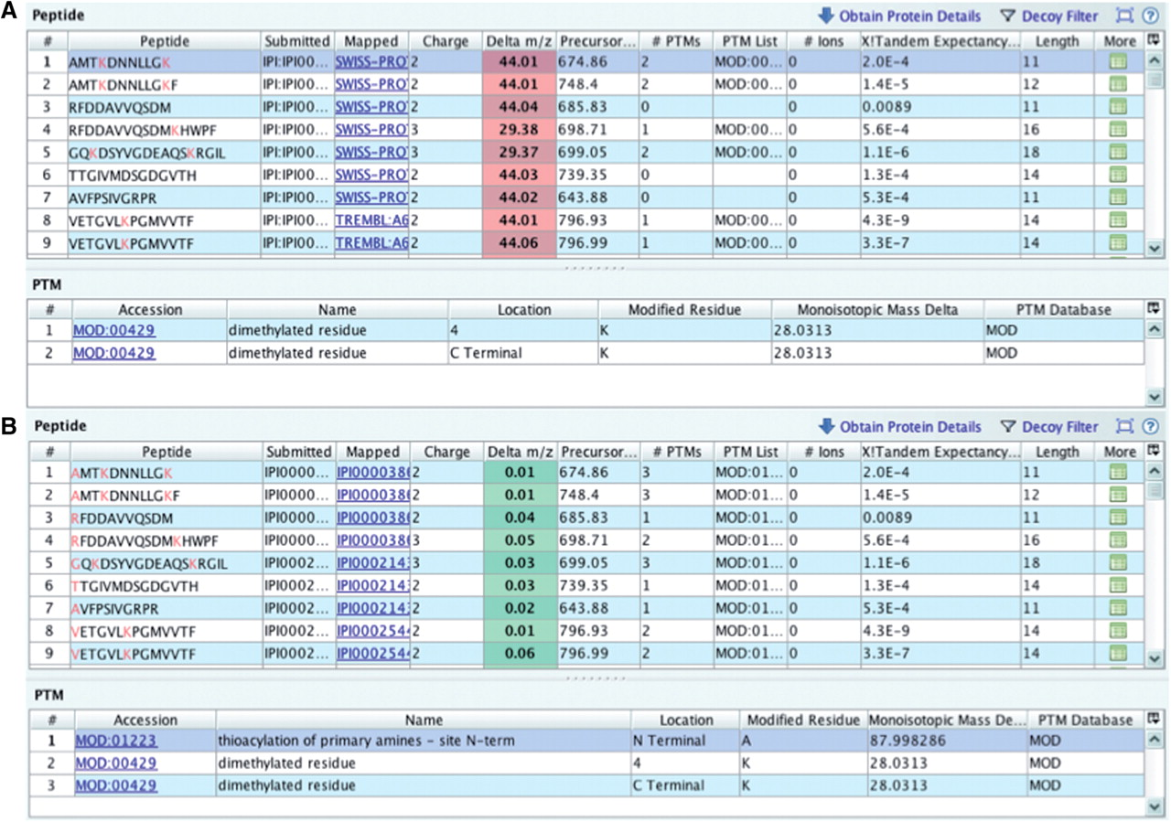
Figure 6. Checking delta m/z values with PRIDE Inspector peptide view: Example 2: missing modification (A) systematic ...
Notes:
Figure 6. Checking delta m/z values with PRIDE Inspector peptide view: Example 2: missing modification (A) systematic outlier delta m/z values highlighted in red indicates a potential problem due to the lack of a fixed protein modification. (B) A PSI-MOD term was added that gives the expected delta m/z values for all peptides.
Unless provided in the caption above, the following copyright applies to the content of this slide: © The Author(s) 2012. Published by Oxford University Press.This is an Open Access article distributed under the terms of the Creative Commons Attribution Non-Commercial License (http://creativecommons.org/licenses/by-nc/3.0), which permits unrestricted non-commercial use, distribution, and reproduction in any medium, provided the original work is properly cited.

