Slide 1
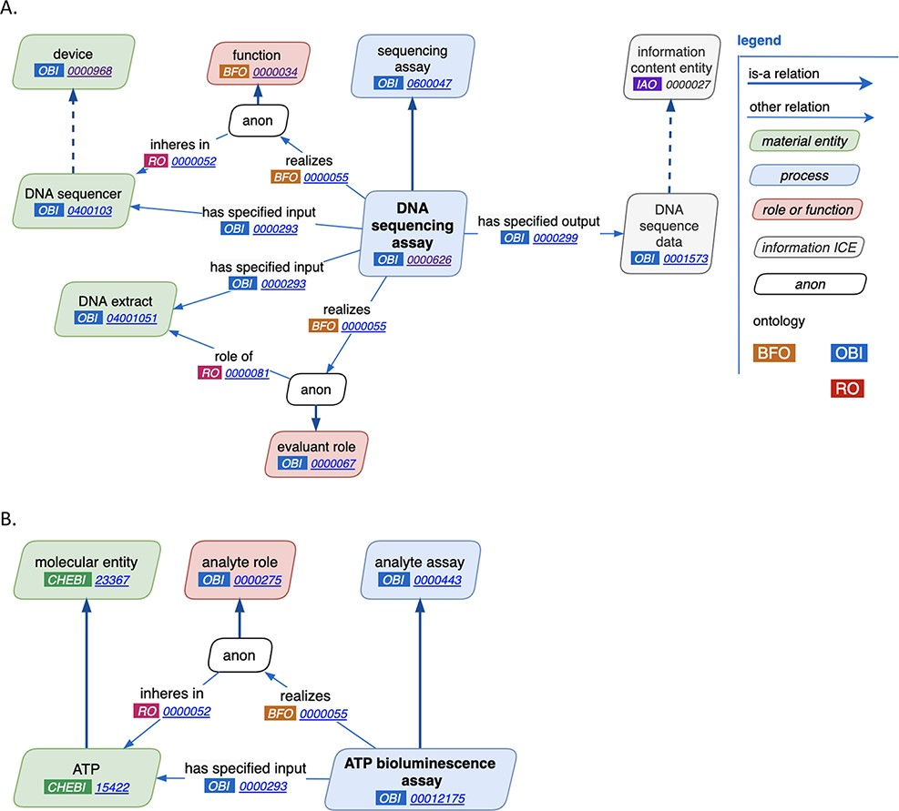
Figure 2. New assay patterns. (A). The general assay pattern logically connects the most commonly needed assay ...
Notes:
Figure 2. New assay patterns. (A). The general assay pattern logically connects the most commonly needed assay annotations. (B). The analyte assay pattern is distinguished by always including a specific ‘material entity’ playing the ‘analyte’ role. Note that ‘anon’ stands for ‘anonymous node’, which represents a multi-component axiom that a given class is a subclass of.
Unless provided in the caption above, the following copyright applies to the content of this slide: © The Author(s) 2021. Published by Oxford University Press.This is an Open Access article distributed under the terms of the Creative Commons Attribution License (http://creativecommons.org/licenses/by/4.0/), which permits unrestricted reuse, distribution, and reproduction in any medium, provided the original work is properly cited.

