Slide 1
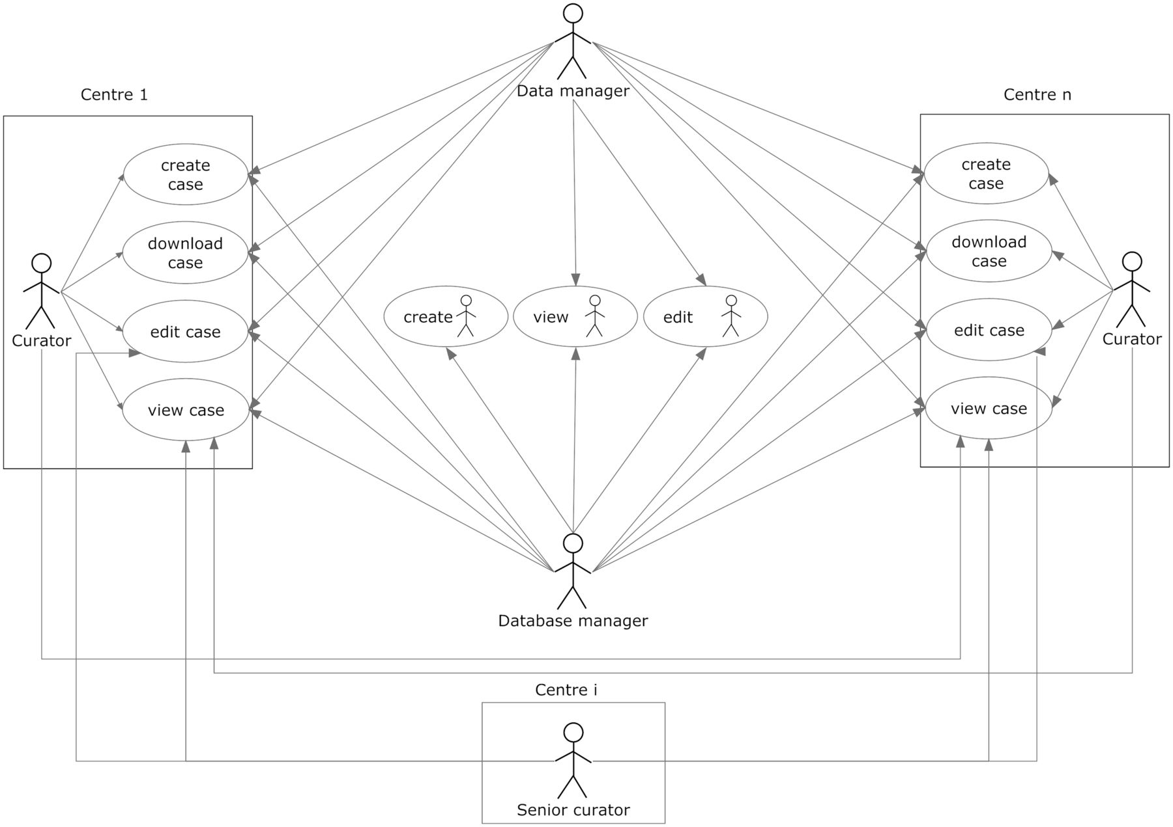
Figure 3 User roles and their permissions. Permissions to perform the different tasks are stored within the database ...
Notes:
Figure 3 User roles and their permissions. Permissions to perform the different tasks are stored within the database and are based on the centre the user belongs to.
Unless provided in the caption above, the following copyright applies to the content of this slide: © The Author(s) 2012. Published by Oxford University Press.This is an Open Access article distributed under the terms of the Creative Commons Attribution License (http://creativecommons.org/licenses/by-nc/3.0/), which permits non-commercial reuse, distribution, and reproduction in any medium, provided the original work is properly cited. For commercial re-use, please contact journals.permissions@oup.com.

