Slide 1
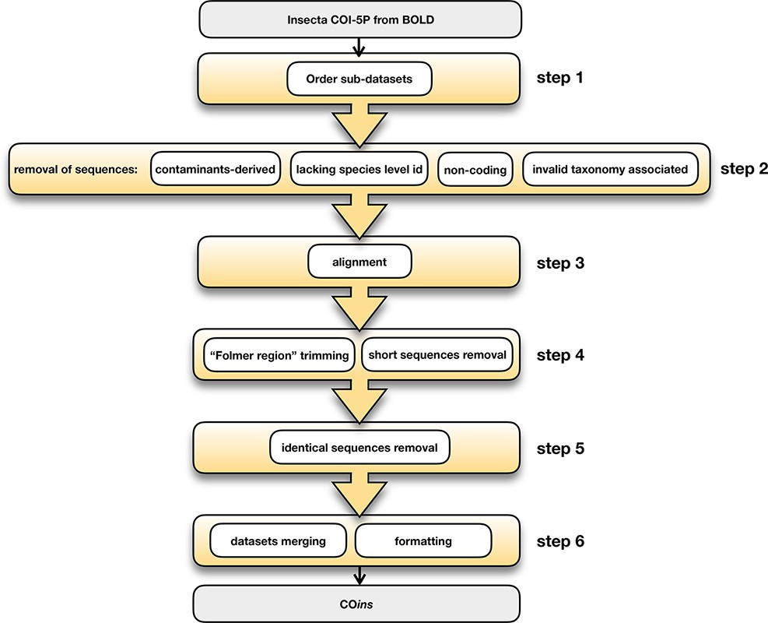
Figure 1. COins database development steps.
Notes:
Figure 1. COins database development steps.
Unless provided in the caption above, the following copyright applies to the content of this slide: © The Author(s) 2022. Published by Oxford University Press.This is an Open Access article distributed under the terms of the Creative Commons Attribution-NonCommercial License (https://creativecommons.org/licenses/by-nc/4.0/), which permits non-commercial re-use, distribution, and reproduction in any medium, provided the original work is properly cited. For commercial re-use, please contact journals.permissions@oup.com

Slide 2
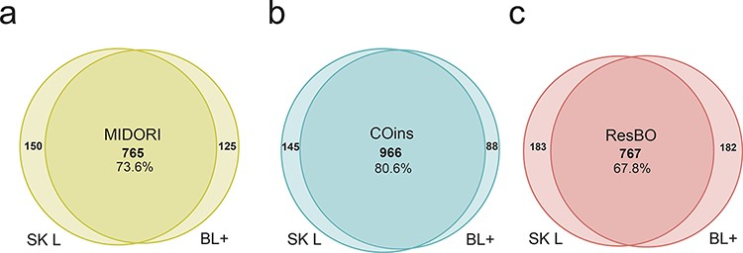
Figure 2. Number of ASVs identified by the two taxonomic assignment algorithms adopted in this study, i.e. the machine ...
Notes:
Figure 2. Number of ASVs identified by the two taxonomic assignment algorithms adopted in this study, i.e. the machine learning-based algorithm fit-classifier sklearn (SK L) and the BLAST+ (BL+) algorithm, using each database: (a) MIDORI database, (b) COins database and (c) ResBO database. Numbers of common identifications between the two algorithms are also expressed in percentages.
Unless provided in the caption above, the following copyright applies to the content of this slide: © The Author(s) 2022. Published by Oxford University Press.This is an Open Access article distributed under the terms of the Creative Commons Attribution-NonCommercial License (https://creativecommons.org/licenses/by-nc/4.0/), which permits non-commercial re-use, distribution, and reproduction in any medium, provided the original work is properly cited. For commercial re-use, please contact journals.permissions@oup.com

Slide 3
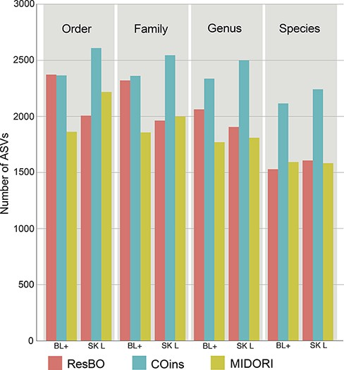
Figure 3. Number of ASVs assigned to the different taxonomic levels (from order to species) when using ResBO, COins and ...
Notes:
Figure 3. Number of ASVs assigned to the different taxonomic levels (from order to species) when using ResBO, COins and MIDORI as reference. Numbers of assignments obtained using the BLAST+ (BL+) and fit-classifier sklearn (SK L) algorithms are specified too.
Unless provided in the caption above, the following copyright applies to the content of this slide: © The Author(s) 2022. Published by Oxford University Press.This is an Open Access article distributed under the terms of the Creative Commons Attribution-NonCommercial License (https://creativecommons.org/licenses/by-nc/4.0/), which permits non-commercial re-use, distribution, and reproduction in any medium, provided the original work is properly cited. For commercial re-use, please contact journals.permissions@oup.com

Slide 4
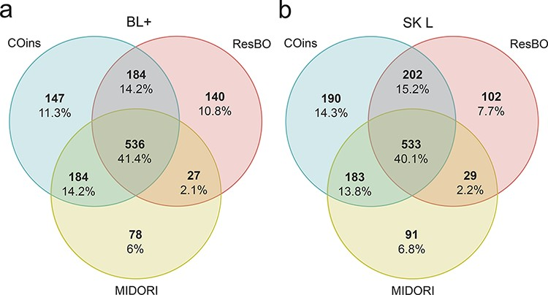
Figure 4. Number of species identified using each database MIDORI, COins and ResBO. (a) Number of species identified ...
Notes:
Figure 4. Number of species identified using each database MIDORI, COins and ResBO. (a) Number of species identified adopting the BLAST+ algorithm (BL+). (b) Number of species identified adopting fit-classifier sklearn algorithm (SK L). All values are also reported as percentages.
Unless provided in the caption above, the following copyright applies to the content of this slide: © The Author(s) 2022. Published by Oxford University Press.This is an Open Access article distributed under the terms of the Creative Commons Attribution-NonCommercial License (https://creativecommons.org/licenses/by-nc/4.0/), which permits non-commercial re-use, distribution, and reproduction in any medium, provided the original work is properly cited. For commercial re-use, please contact journals.permissions@oup.com

