Slide 1
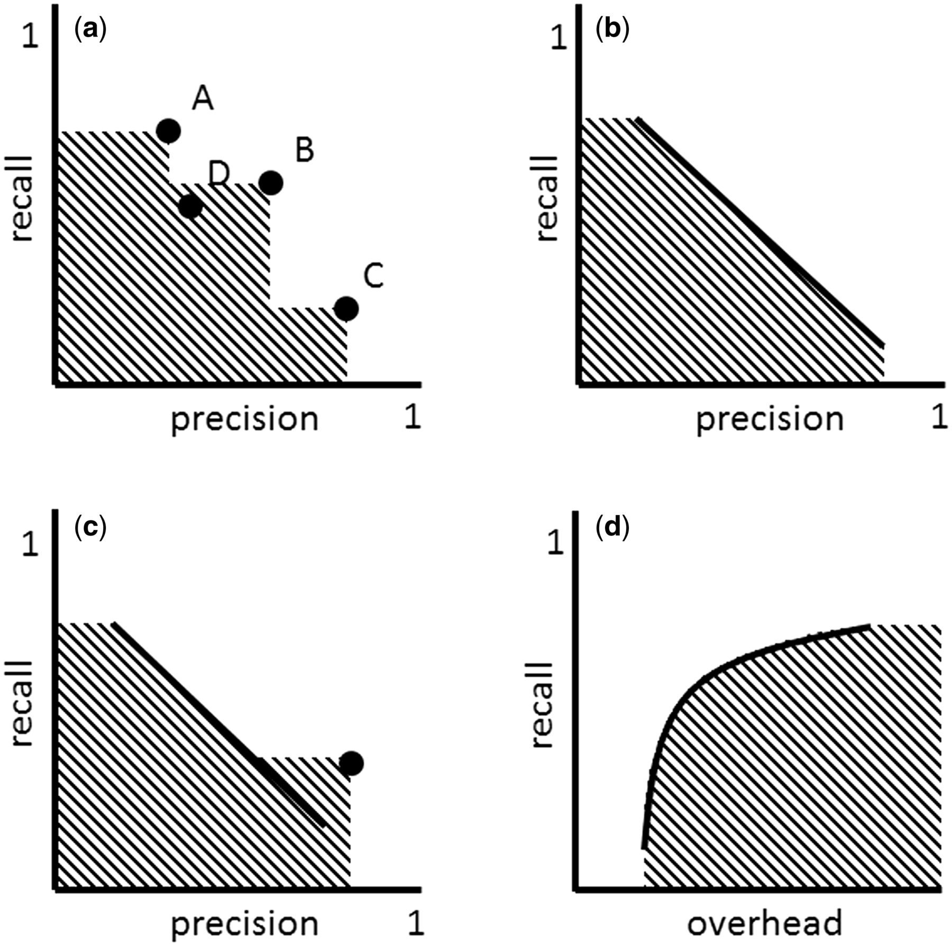
Figure 2 ( a ) ‘Multiple strategies’ approach in the precision-recall space. Strategy A can take the role of ‘high ...
Notes:
Figure 2 ( a ) ‘Multiple strategies’ approach in the precision-recall space. Strategy A can take the role of ‘high recall’ strategy, while C that of ‘high precision’ and B that of ‘compromise.’ A new strategy D is inferior to the set of strategies A, B and C, because it falls into the area covered (AC) by these strategies. ( b ) Adjustable strategy. ( c ) ‘Multiple strategies’ approach involving an adjustable strategy (defined by the line) and a non-adjustable strategy (defined by the dot). ( d ) Adjustable strategy in the overhead-recall space.
Unless provided in the caption above, the following copyright applies to the content of this slide: © The Author(s) 2015. Published by Oxford University Press. This is an Open Access article distributed under the terms of the Creative Commons Attribution License ( http://creativecommons.org/licenses/by/4.0/ ), which permits unrestricted reuse, distribution, and reproduction in any medium, provided the original work is properly cited.

