Slide 1
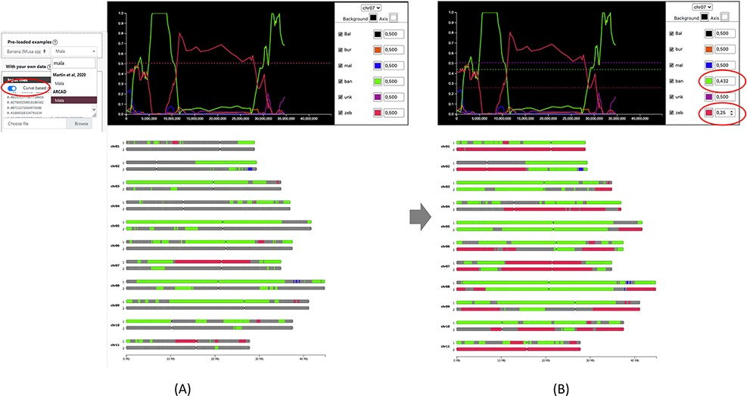
Figure 2. Comparison of genome ancestry mosaic results before (A) and after (B) curation in GeMo. In A, the genome ...
Notes:
Figure 2. Comparison of genome ancestry mosaic results before (A) and after (B) curation in GeMo. In A, the genome ancestry mosaic is not well resolved (dark gray for undefined origin) with default parameters (0.5 for diploid). Once the curve-based mode is activated, an interactive graph facilitates threshold adjustment. In B, the genome ancestry mosaic is better resolved after reducing expected thresholds for the two curves with the main ratios (as indicated in circles).
Unless provided in the caption above, the following copyright applies to the content of this slide: © The Author(s) 2022. Published by Oxford University Press.This is an Open Access article distributed under the terms of the Creative Commons Attribution-NonCommercial License (https://creativecommons.org/licenses/by-nc/4.0/), which permits non-commercial re-use, distribution, and reproduction in any medium, provided the original work is properly cited. For commercial re-use, please contact journals.permissions@oup.com

