Slide 1
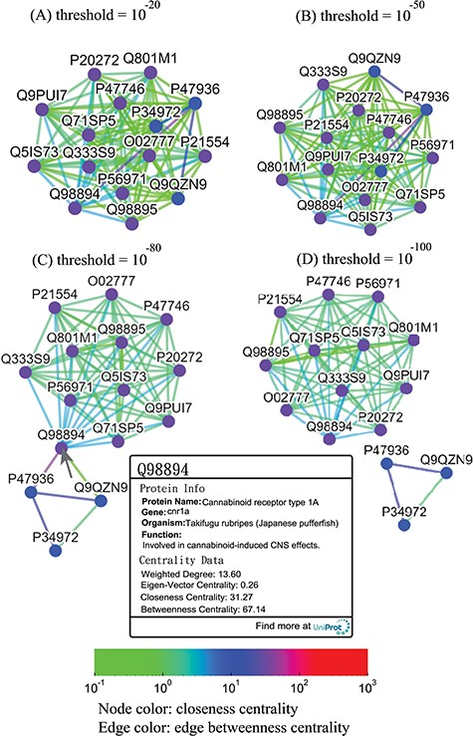
Figure 7 Thresholded sequence similarity network graphs of the cannabinoid receptor family with threshold distances of ...
Notes:
Figure 7 Thresholded sequence similarity network graphs of the cannabinoid receptor family with threshold distances of 10−20 (A), 10−50 (B), 10−80 (C) and 10−100 (D). Nodes and edges are colored by the values of their closeness and betweenness centralities, respectively, according to the legend. Upon clicking on a node such as Q98894, the user is presented with a modal box showing both the protein information and the centrality data of the node.
Unless provided in the caption above, the following copyright applies to the content of this slide: © The Author(s) 2019. Published by Oxford University Press.This is an Open Access article distributed under the terms of the Creative Commons Attribution License (http://creativecommons.org/licenses/by/4.0/), which permits unrestricted reuse, distribution, and reproduction in any medium, provided the original work is properly cited.

