Slide 1
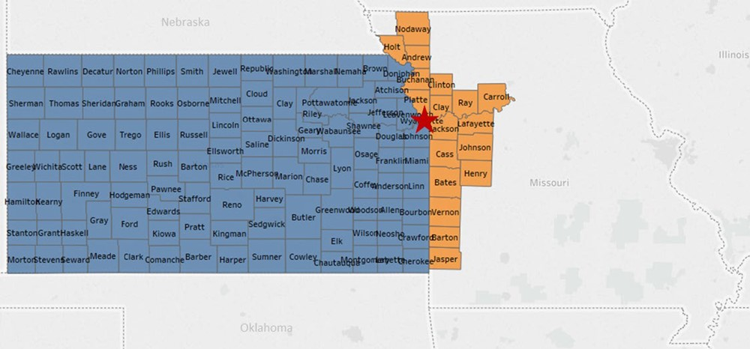
Figure 2 The University of Kansas Cancer Center catchment area. The red star designates the location of the University ...
Notes:
Figure 2 The University of Kansas Cancer Center catchment area. The red star designates the location of the University of Kansas Medical Center in Kansas City, Kansas, Wyandotte County.
Unless provided in the caption above, the following copyright applies to the content of this slide: © The Author(s) 2020. Published by Oxford University Press.This is an Open Access article distributed under the terms of the Creative Commons Attribution License (http://creativecommons.org/licenses/by/4.0/), which permits unrestricted reuse, distribution, and reproduction in any medium, provided the original work is properly cited.

