Slide 1
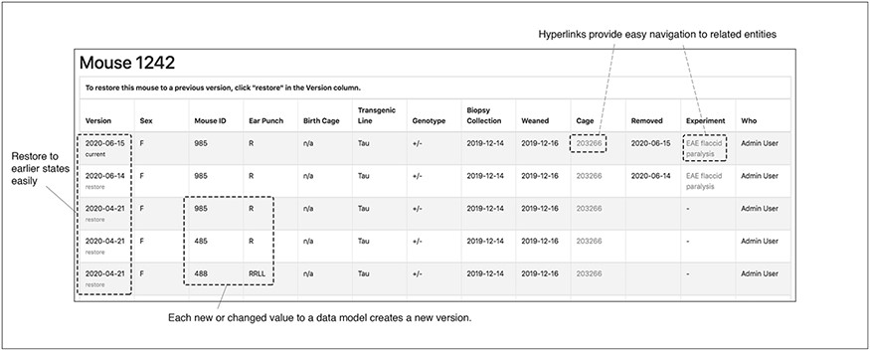
Figure 8. The audit interface records all the modifications submitted for each mouse in TopoDB in chronological order. ...
Notes:
Figure 8. The audit interface records all the modifications submitted for each mouse in TopoDB in chronological order. This feature allows the easy identification of incorrectly input data and the efficient recovery of the correct information from previous versions stored in the database.
Unless provided in the caption above, the following copyright applies to the content of this slide: © The Author(s) 2020. Published by Oxford University Press.This is an Open Access article distributed under the terms of the Creative Commons Attribution License (http://creativecommons.org/licenses/by/4.0/), which permits unrestricted reuse, distribution, and reproduction in any medium, provided the original work is properly cited.

