Slide 1
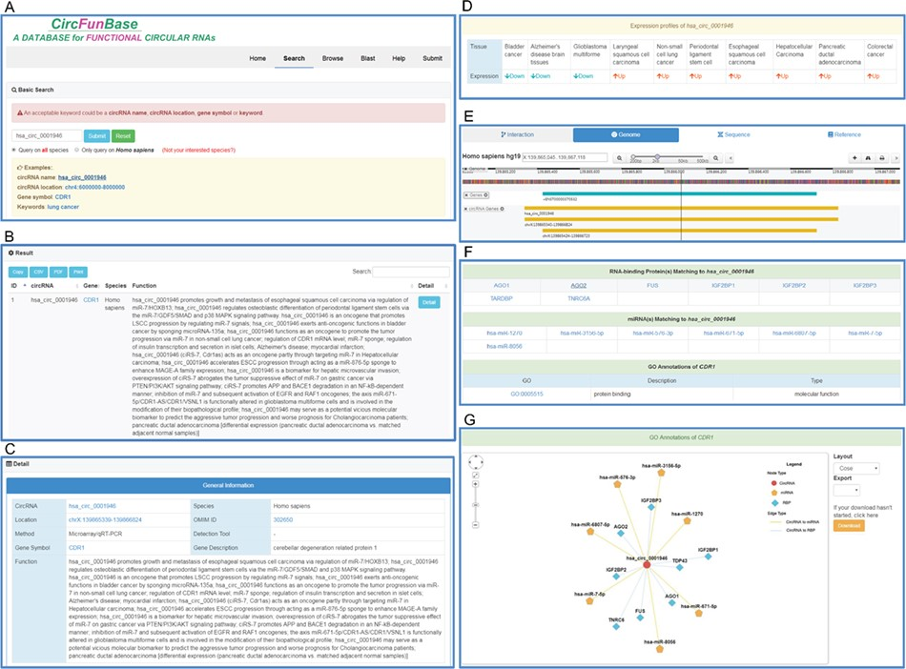
Figure 1 An overview of the user interface of CircFunBase. (A) The search page of CircFunBase. (B) Hsa_circ_0001946 as ...
Notes:
Figure 1 An overview of the user interface of CircFunBase. (A) The search page of CircFunBase. (B) Hsa_circ_0001946 as an example of input and the search result. (C) Detailed information of hsa_circ_0001946. (D) The expression pattern of hsa_circ_0001946. (E) Visualization of the circRNA genome location. (F) CircRNA-associated interactions and GO annotations of parent genes. (G) Visualization of circRNA-associated interactions.
Unless provided in the caption above, the following copyright applies to the content of this slide: © The Author(s) 2019. Published by Oxford University Press.This is an Open Access article distributed under the terms of the Creative Commons Attribution License (http://creativecommons.org/licenses/by/4.0/), which permits unrestricted reuse, distribution, and reproduction in any medium, provided the original work is properly cited.

Slide 2
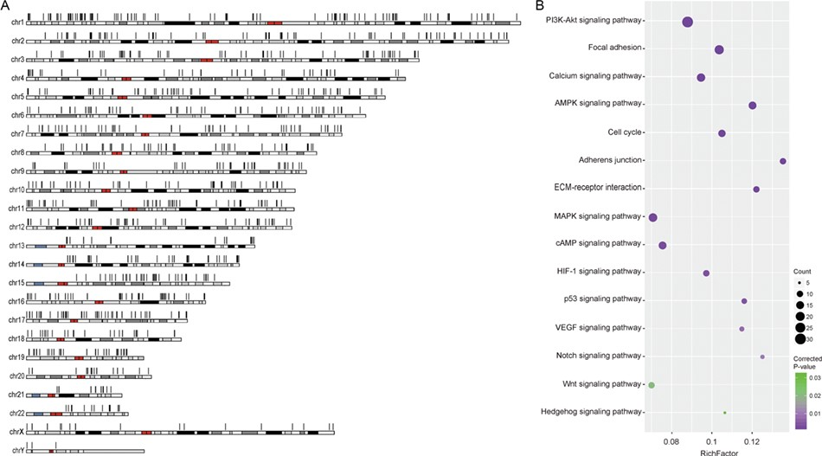
Figure 2 Human cancer circRNAs. (A) Genomic distribution of human cancer circRNAs. (B) Enriched KEGG pathways of ...
Notes:
Figure 2 Human cancer circRNAs. (A) Genomic distribution of human cancer circRNAs. (B) Enriched KEGG pathways of parent genes of cancer circRNAs.
Unless provided in the caption above, the following copyright applies to the content of this slide: © The Author(s) 2019. Published by Oxford University Press.This is an Open Access article distributed under the terms of the Creative Commons Attribution License (http://creativecommons.org/licenses/by/4.0/), which permits unrestricted reuse, distribution, and reproduction in any medium, provided the original work is properly cited.

