Slide 1
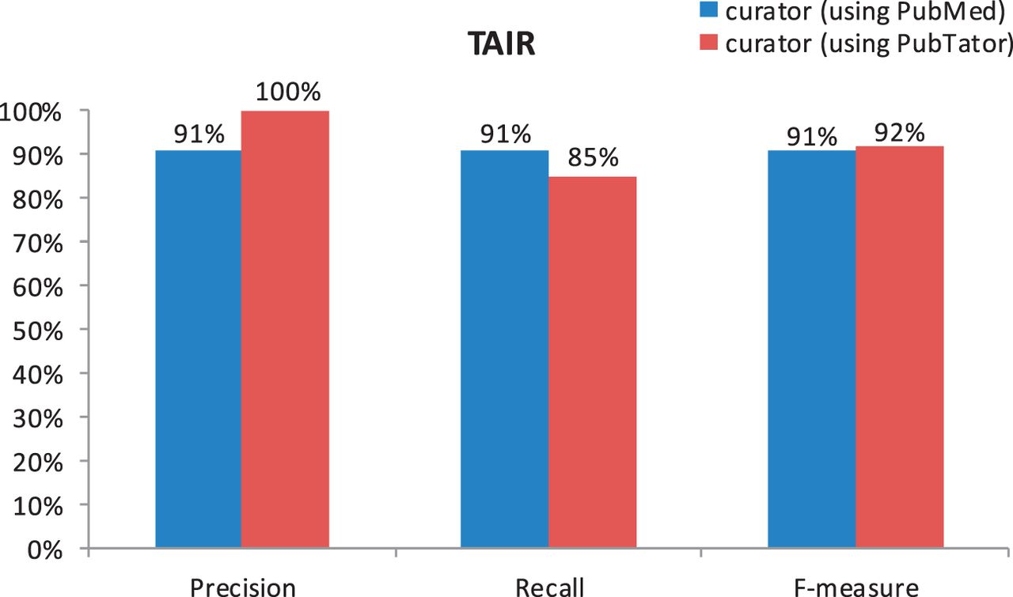
Figure 2 Comparison of human curation accuracy for the document triage task by using PubMed versus PubTator (TAIR).
Notes:
Figure 2 Comparison of human curation accuracy for the document triage task by using PubMed versus PubTator (TAIR).
Unless provided in the caption above, the following copyright applies to the content of this slide: Published by Oxford University Press.This is an Open Access article distributed under the terms of the Creative Commons Attribution License (http://creativecommons.org/licenses/by-nc/3.0/), which permits non-commercial reuse, distribution, and reproduction in any medium, provided the original work is properly cited. For commercial re-use, please contact journals.permissions@oup.com.

