Slide 1
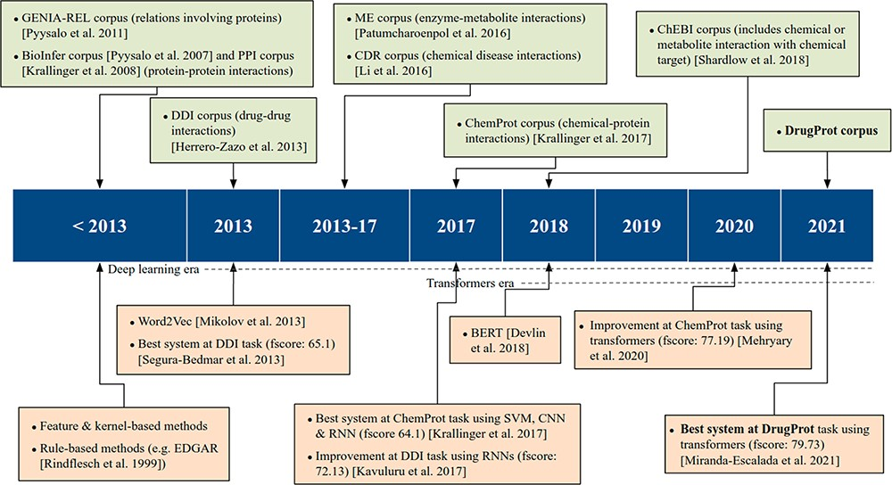
Figure 1. An overview of relevant RE corpora and technologies.
Notes:
Figure 1. An overview of relevant RE corpora and technologies.
Unless provided in the caption above, the following copyright applies to the content of this slide: © The Author(s) 2023. Published by Oxford University Press.This is an Open Access article distributed under the terms of the Creative Commons Attribution License (https://creativecommons.org/licenses/by/4.0/), which permits unrestricted reuse, distribution, and reproduction in any medium, provided the original work is properly cited.

Slide 2
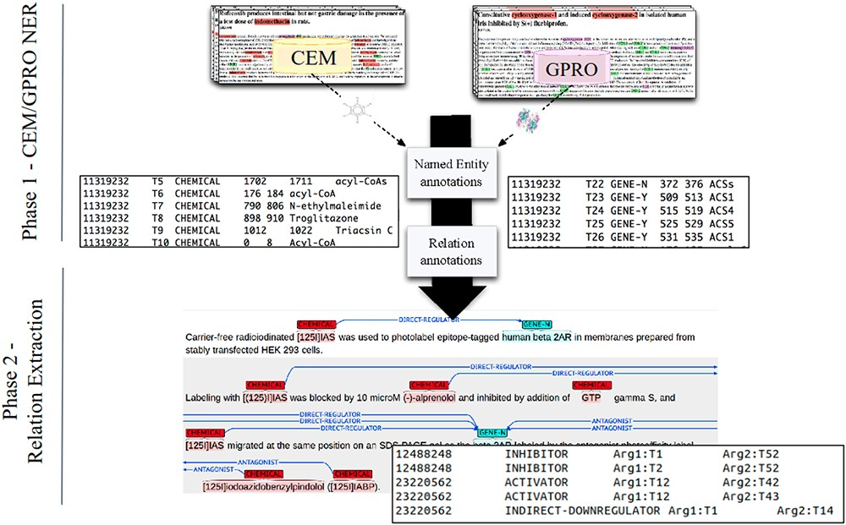
Figure 2. A DrugProt corpus annotation scheme in three independent phases: (1.1) CEM annotation, (1.2) GPRO annotation ...
Notes:
Figure 2. A DrugProt corpus annotation scheme in three independent phases: (1.1) CEM annotation, (1.2) GPRO annotation and (2) RE annotation. An example of the output of the annotation is visualized in Brat at the bottom of the figure.
Unless provided in the caption above, the following copyright applies to the content of this slide: © The Author(s) 2023. Published by Oxford University Press.This is an Open Access article distributed under the terms of the Creative Commons Attribution License (https://creativecommons.org/licenses/by/4.0/), which permits unrestricted reuse, distribution, and reproduction in any medium, provided the original work is properly cited.

Slide 3
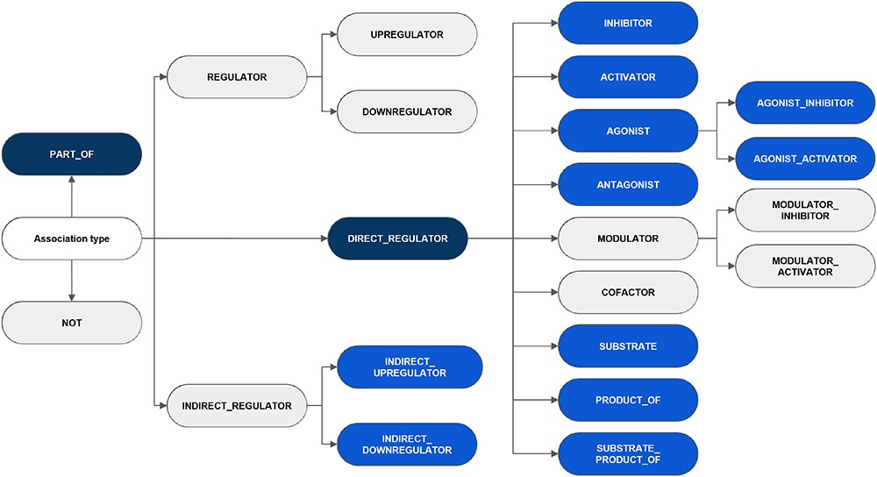
Figure 3. An overview of the hierarchy of DrugProt relation types and classification considered in annotation ...
Notes:
Figure 3. An overview of the hierarchy of DrugProt relation types and classification considered in annotation guidelines. The elements in blue represent those chosen for the DrugProt task, with dark-blue indicating the classes and light-blue representing the subclasses. They were selected based on their impact, the number of annotated instances, the internal consistency of the relation tree and the prediction performance determined by a baseline system (37).
Unless provided in the caption above, the following copyright applies to the content of this slide: © The Author(s) 2023. Published by Oxford University Press.This is an Open Access article distributed under the terms of the Creative Commons Attribution License (https://creativecommons.org/licenses/by/4.0/), which permits unrestricted reuse, distribution, and reproduction in any medium, provided the original work is properly cited.

Slide 4
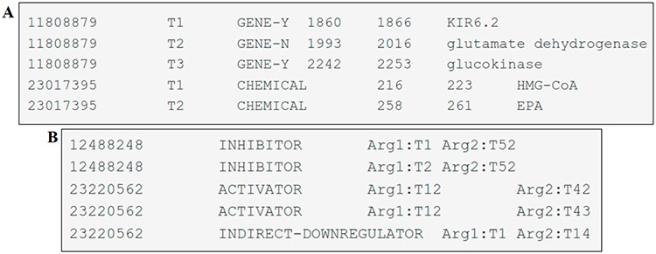
Figure 4. Examples of DrugProt (A) entity annotation and (B) relation annotation.
Notes:
Figure 4. Examples of DrugProt (A) entity annotation and (B) relation annotation.
Unless provided in the caption above, the following copyright applies to the content of this slide: © The Author(s) 2023. Published by Oxford University Press.This is an Open Access article distributed under the terms of the Creative Commons Attribution License (https://creativecommons.org/licenses/by/4.0/), which permits unrestricted reuse, distribution, and reproduction in any medium, provided the original work is properly cited.

Slide 5
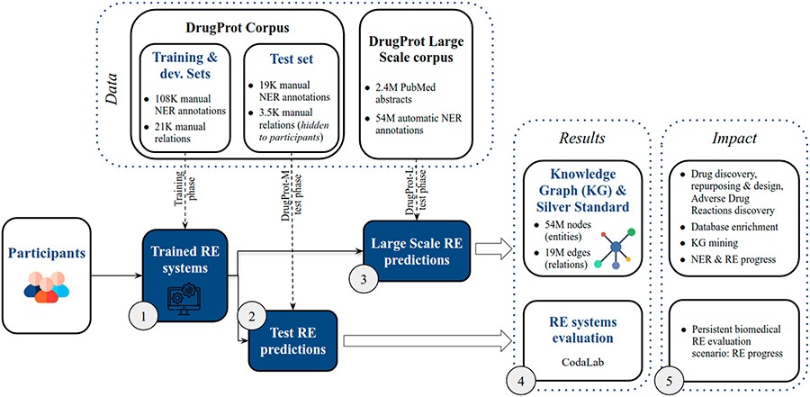
Figure 5. DrugProt shared task overview. Training phase (1), test phase (2,3), results (4) and impact (5).
Notes:
Figure 5. DrugProt shared task overview. Training phase (1), test phase (2,3), results (4) and impact (5).
Unless provided in the caption above, the following copyright applies to the content of this slide: © The Author(s) 2023. Published by Oxford University Press.This is an Open Access article distributed under the terms of the Creative Commons Attribution License (https://creativecommons.org/licenses/by/4.0/), which permits unrestricted reuse, distribution, and reproduction in any medium, provided the original work is properly cited.

Slide 6
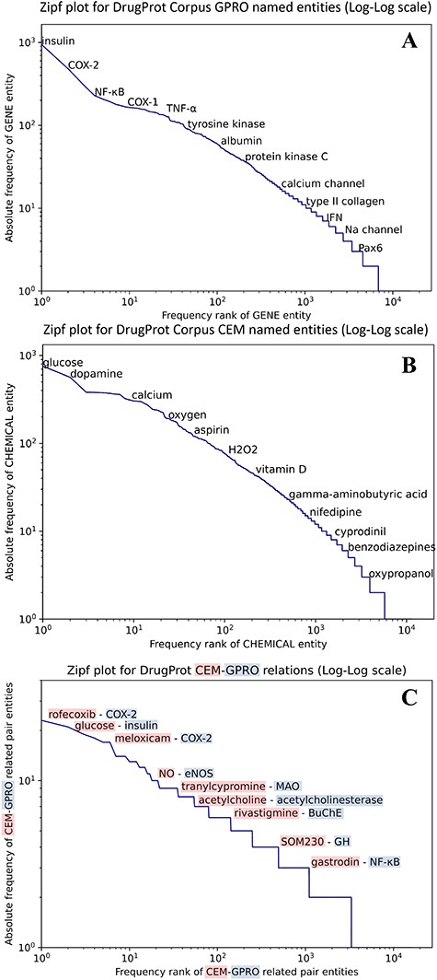
Figure 6. (A) Zipfs plot of all DrugProt GPRO entities, (B) all DrugProt CEM entities from GS and (C) Zipf plot of ...
Notes:
Figure 6. (A) Zipfs plot of all DrugProt GPRO entities, (B) all DrugProt CEM entities from GS and (C) Zipf plot of CEM–GPRO related pairs in the DrugProt corpus.
Unless provided in the caption above, the following copyright applies to the content of this slide: © The Author(s) 2023. Published by Oxford University Press.This is an Open Access article distributed under the terms of the Creative Commons Attribution License (https://creativecommons.org/licenses/by/4.0/), which permits unrestricted reuse, distribution, and reproduction in any medium, provided the original work is properly cited.

Slide 7
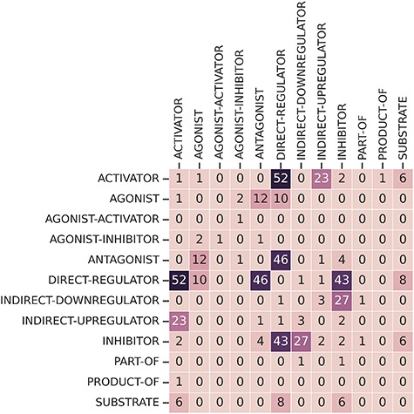
Figure 7. Frequency overlap between different relation types.
Notes:
Figure 7. Frequency overlap between different relation types.
Unless provided in the caption above, the following copyright applies to the content of this slide: © The Author(s) 2023. Published by Oxford University Press.This is an Open Access article distributed under the terms of the Creative Commons Attribution License (https://creativecommons.org/licenses/by/4.0/), which permits unrestricted reuse, distribution, and reproduction in any medium, provided the original work is properly cited.

Slide 8
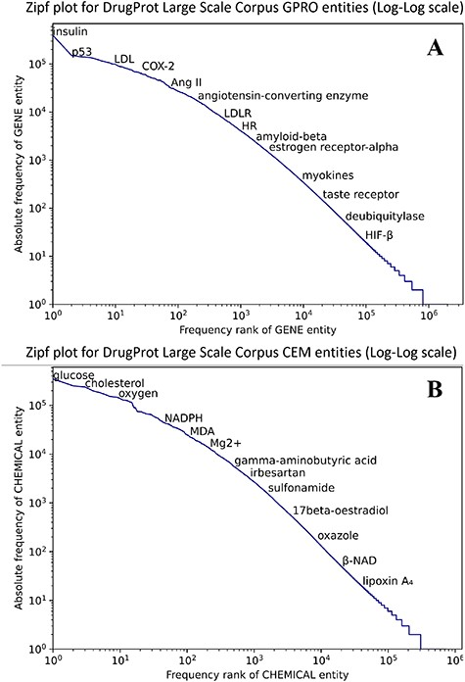
Figure 8. Zipf plot of GPRO (A) and CEM (B) entities in the DrugProt Large Scale corpus.
Notes:
Figure 8. Zipf plot of GPRO (A) and CEM (B) entities in the DrugProt Large Scale corpus.
Unless provided in the caption above, the following copyright applies to the content of this slide: © The Author(s) 2023. Published by Oxford University Press.This is an Open Access article distributed under the terms of the Creative Commons Attribution License (https://creativecommons.org/licenses/by/4.0/), which permits unrestricted reuse, distribution, and reproduction in any medium, provided the original work is properly cited.

Slide 9
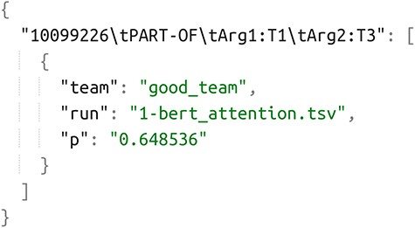
Figure 9. Example of JSON annotation of DrugProt Silver Standard corpus.
Notes:
Figure 9. Example of JSON annotation of DrugProt Silver Standard corpus.
Unless provided in the caption above, the following copyright applies to the content of this slide: © The Author(s) 2023. Published by Oxford University Press.This is an Open Access article distributed under the terms of the Creative Commons Attribution License (https://creativecommons.org/licenses/by/4.0/), which permits unrestricted reuse, distribution, and reproduction in any medium, provided the original work is properly cited.

Slide 10
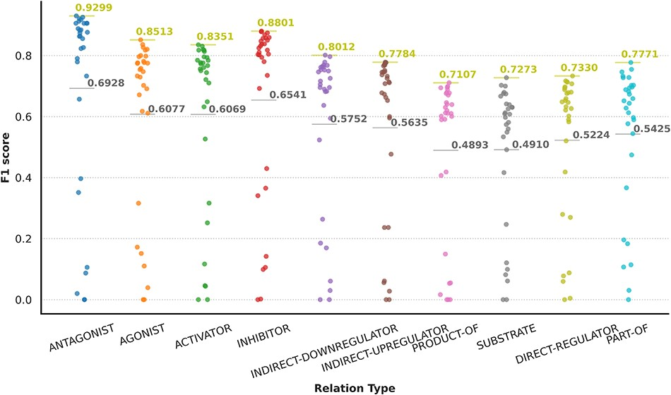
Figure 10. Graphical representation of participants’ results in granular format for the DrugProt-M track.
Notes:
Figure 10. Graphical representation of participants’ results in granular format for the DrugProt-M track.
Unless provided in the caption above, the following copyright applies to the content of this slide: © The Author(s) 2023. Published by Oxford University Press.This is an Open Access article distributed under the terms of the Creative Commons Attribution License (https://creativecommons.org/licenses/by/4.0/), which permits unrestricted reuse, distribution, and reproduction in any medium, provided the original work is properly cited.

Slide 11
Figure 11. An overview of NLP components used by DrugProt participants: there is no information about team 16.
Notes:
Figure 11. An overview of NLP components used by DrugProt participants: there is no information about team 16.
Unless provided in the caption above, the following copyright applies to the content of this slide: © The Author(s) 2023. Published by Oxford University Press.This is an Open Access article distributed under the terms of the Creative Commons Attribution License (https://creativecommons.org/licenses/by/4.0/), which permits unrestricted reuse, distribution, and reproduction in any medium, provided the original work is properly cited.

Slide 12
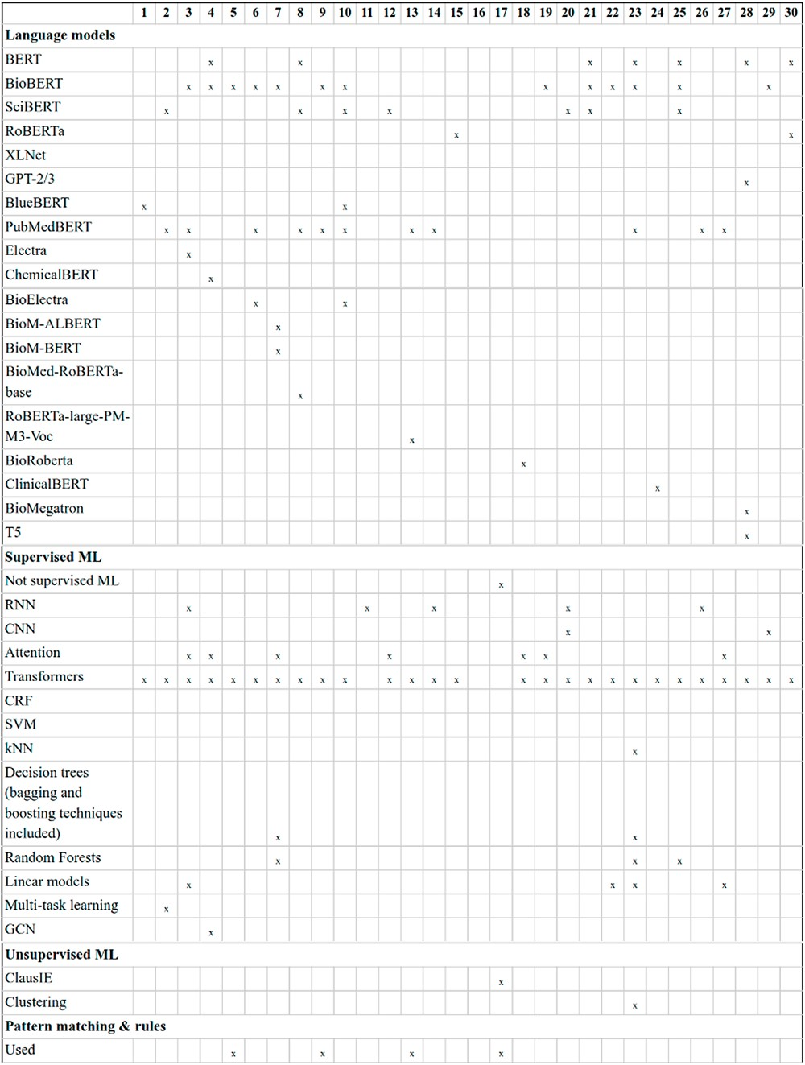
Figure 12. An overview of NLP systems used by DrugProt participants (part I): there is no information about team 16.
Notes:
Figure 12. An overview of NLP systems used by DrugProt participants (part I): there is no information about team 16.
Unless provided in the caption above, the following copyright applies to the content of this slide: © The Author(s) 2023. Published by Oxford University Press.This is an Open Access article distributed under the terms of the Creative Commons Attribution License (https://creativecommons.org/licenses/by/4.0/), which permits unrestricted reuse, distribution, and reproduction in any medium, provided the original work is properly cited.

Slide 13
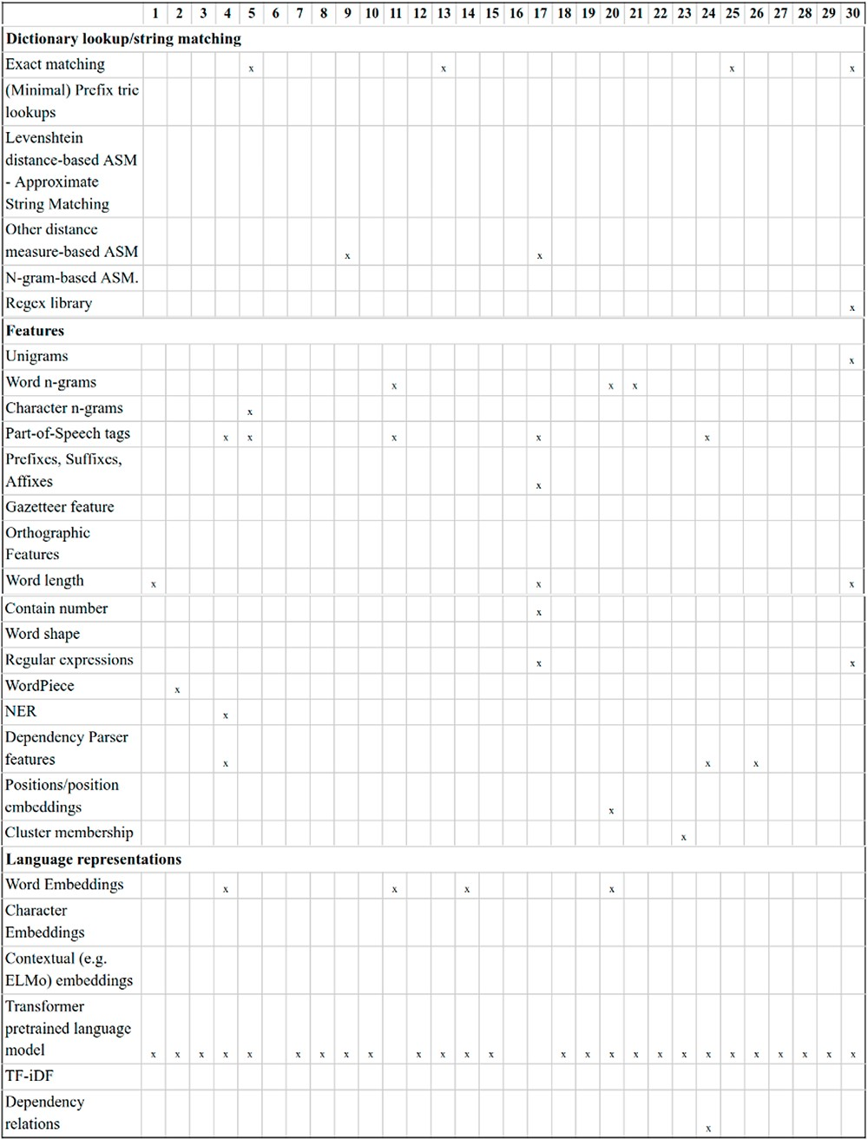
Figure 13. An overview of NLP systems used by DrugProt participants (part II): there is no information about team 16.
Notes:
Figure 13. An overview of NLP systems used by DrugProt participants (part II): there is no information about team 16.
Unless provided in the caption above, the following copyright applies to the content of this slide: © The Author(s) 2023. Published by Oxford University Press.This is an Open Access article distributed under the terms of the Creative Commons Attribution License (https://creativecommons.org/licenses/by/4.0/), which permits unrestricted reuse, distribution, and reproduction in any medium, provided the original work is properly cited.

Slide 14
Figure 14. An overview of training information and datasets used by DrugProt participants: there is no information about ...
Notes:
Figure 14. An overview of training information and datasets used by DrugProt participants: there is no information about team 16.
Unless provided in the caption above, the following copyright applies to the content of this slide: © The Author(s) 2023. Published by Oxford University Press.This is an Open Access article distributed under the terms of the Creative Commons Attribution License (https://creativecommons.org/licenses/by/4.0/), which permits unrestricted reuse, distribution, and reproduction in any medium, provided the original work is properly cited.

Slide 15
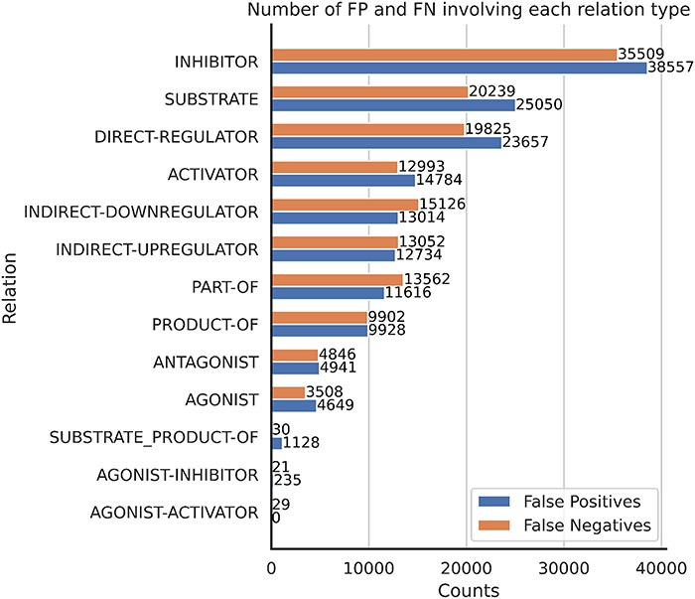
Figure 15. The number of FP and FN predictions for each relation type.
Notes:
Figure 15. The number of FP and FN predictions for each relation type.
Unless provided in the caption above, the following copyright applies to the content of this slide: © The Author(s) 2023. Published by Oxford University Press.This is an Open Access article distributed under the terms of the Creative Commons Attribution License (https://creativecommons.org/licenses/by/4.0/), which permits unrestricted reuse, distribution, and reproduction in any medium, provided the original work is properly cited.

Slide 16
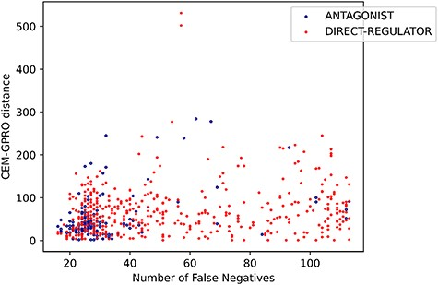
Figure 16. Relation between the FNs and the distance between the CEM and GPRO entities for antagonist and ...
Notes:
Figure 16. Relation between the FNs and the distance between the CEM and GPRO entities for antagonist and direct-regulator relations.
Unless provided in the caption above, the following copyright applies to the content of this slide: © The Author(s) 2023. Published by Oxford University Press.This is an Open Access article distributed under the terms of the Creative Commons Attribution License (https://creativecommons.org/licenses/by/4.0/), which permits unrestricted reuse, distribution, and reproduction in any medium, provided the original work is properly cited.

Slide 17
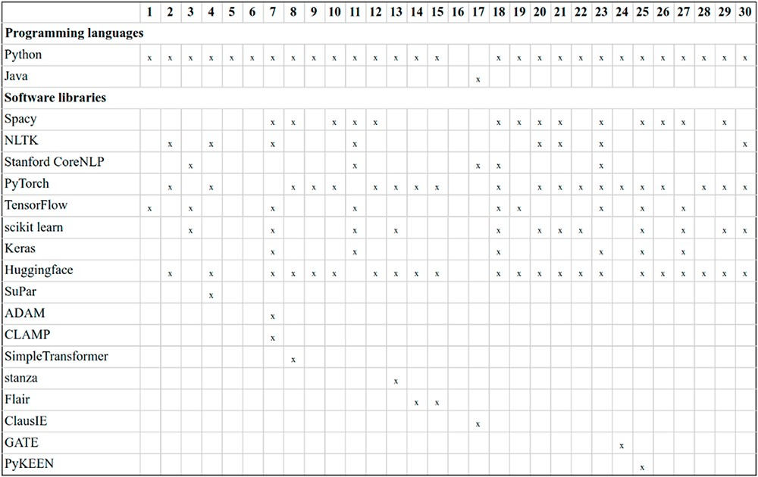
Figure 17. Description of the software used by DrugProt participants: there is no information about team 16.
Notes:
Figure 17. Description of the software used by DrugProt participants: there is no information about team 16.
Unless provided in the caption above, the following copyright applies to the content of this slide: © The Author(s) 2023. Published by Oxford University Press.This is an Open Access article distributed under the terms of the Creative Commons Attribution License (https://creativecommons.org/licenses/by/4.0/), which permits unrestricted reuse, distribution, and reproduction in any medium, provided the original work is properly cited.

Slide 18
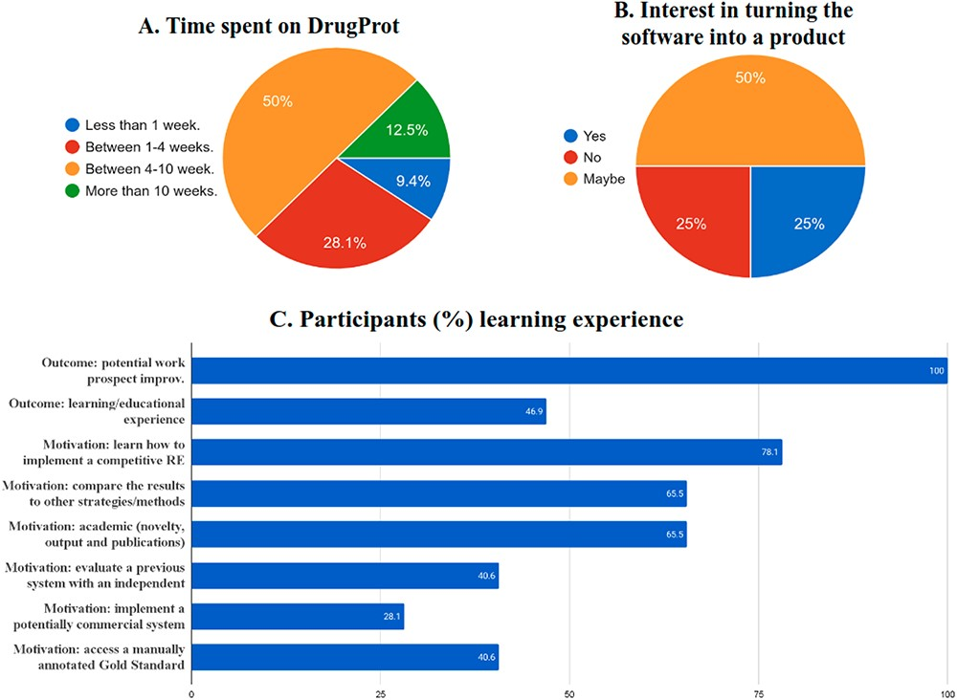
Figure 18. Survey results on the (A) time spent, (B), commercial interest and (C) motivation and outcomes of DrugProt ...
Notes:
Figure 18. Survey results on the (A) time spent, (B), commercial interest and (C) motivation and outcomes of DrugProt participants.
Unless provided in the caption above, the following copyright applies to the content of this slide: © The Author(s) 2023. Published by Oxford University Press.This is an Open Access article distributed under the terms of the Creative Commons Attribution License (https://creativecommons.org/licenses/by/4.0/), which permits unrestricted reuse, distribution, and reproduction in any medium, provided the original work is properly cited.

Slide 19
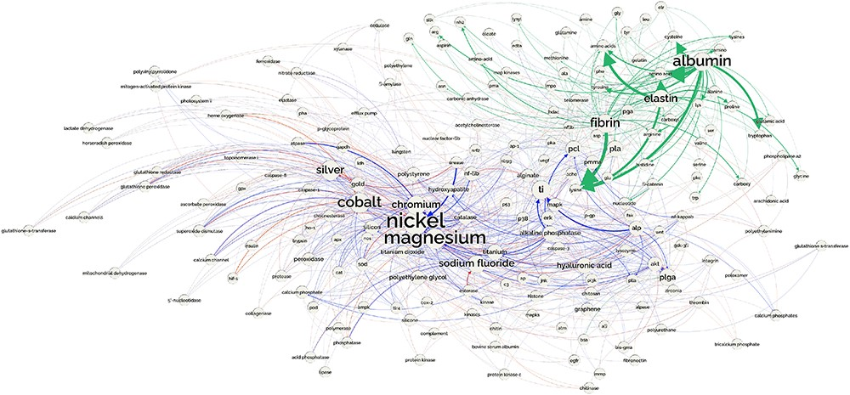
Figure 19. Network showing the part of the CEM–GPRO relations related to biomaterials extracted from the PubMed ...
Notes:
Figure 19. Network showing the part of the CEM–GPRO relations related to biomaterials extracted from the PubMed knowledge graph. part-of relations are shown in green, inhibitor in blue and activator in red.
Unless provided in the caption above, the following copyright applies to the content of this slide: © The Author(s) 2023. Published by Oxford University Press.This is an Open Access article distributed under the terms of the Creative Commons Attribution License (https://creativecommons.org/licenses/by/4.0/), which permits unrestricted reuse, distribution, and reproduction in any medium, provided the original work is properly cited.

