Slide 1
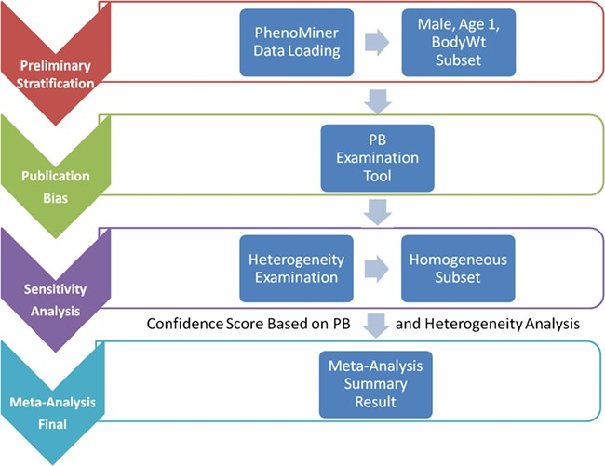
Figure 1 System pipeline for meta-analysis. (1) Preliminary stratification: Choose a subset of phenotype measurements ...
Notes:
Figure 1 System pipeline for meta-analysis. (1) Preliminary stratification: Choose a subset of phenotype measurements based on preliminary stratification, which included strain (including similar strains inbred at different locations and substrains), sex, age group and phenotype measurement methods. (2) Publication bias: One key concern is publication bias, which arises because experiments with negative findings are less likely to be published than those that highlight results which support hypotheses. We used funnel plot to examine any publication bias. (3) Sensitivity analysis: Data with poor quality for non-systematic reasons are often an issue in meta-analysis so selection, inclusion and integration (or population stratification) of data are an important factors for consideration, which can be completed through sensitivity analysis. (4) Meta-analysis result summary: Results will be displayed in a forest plot. The x-axis is the value of measurement or effect size. Each datum is shown as a blob or square. The size of the blob or square is proportional to the sample size. A horizontal line representing 95% confidence interval is drawn through the center of each study’s square to represent the uncertainty of the measurement.
Unless provided in the caption above, the following copyright applies to the content of this slide: © The Author(s) 2019. Published by Oxford University Press.This is an Open Access article distributed under the terms of the Creative Commons Attribution License (http://creativecommons.org/licenses/by/4.0/), which permits unrestricted reuse, distribution, and reproduction in any medium, provided the original work is properly cited.

Slide 2
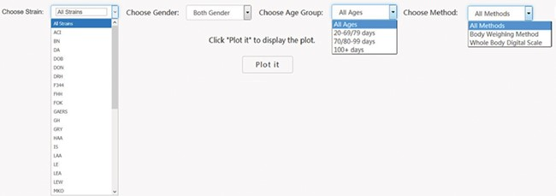
Figure 2 PhenoMiner preliminary stratification for body weight. Interface was created to dynamically conduct the ...
Notes:
Figure 2 PhenoMiner preliminary stratification for body weight. Interface was created to dynamically conduct the preliminary stratification step. Options for strain and phenotype measurement methods depend on the major phenotype under analysis. Age group divisions were decided by expert heuristic definitions of young, adult and old rats. Age group division can be different. For example, for body weight, 20–79 and 80–99 days might be a good way to divide young and adult rats, but for other cardiovascular phenotypes, 20–69 and 70–99 days are a good way to divide young and adult rats.
Unless provided in the caption above, the following copyright applies to the content of this slide: © The Author(s) 2019. Published by Oxford University Press.This is an Open Access article distributed under the terms of the Creative Commons Attribution License (http://creativecommons.org/licenses/by/4.0/), which permits unrestricted reuse, distribution, and reproduction in any medium, provided the original work is properly cited.

Slide 3
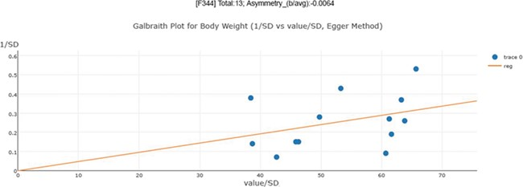
Figure 3 Publication bias examination demonstrations for body weight. The regression test is a linear regression of ...
Notes:
Figure 3 Publication bias examination demonstrations for body weight. The regression test is a linear regression of normalized effect size estimate (value/SD) against precision(1/SD). When the regression line runs through the origin, it indicates a symmetrical funnel plot. An asymmetry score is calculated as the ratio of intercept for the regression line to average value for the measurements in the group under analysis.
Unless provided in the caption above, the following copyright applies to the content of this slide: © The Author(s) 2019. Published by Oxford University Press.This is an Open Access article distributed under the terms of the Creative Commons Attribution License (http://creativecommons.org/licenses/by/4.0/), which permits unrestricted reuse, distribution, and reproduction in any medium, provided the original work is properly cited.

Slide 4
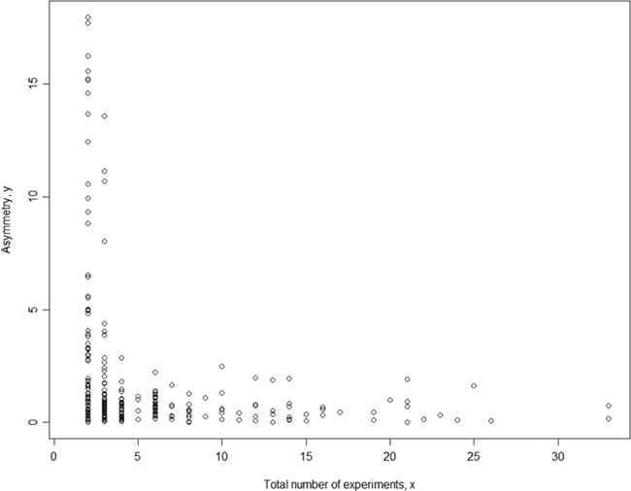
Figure 4 Relationship between asymmetry score and total number of experiments for body weight. While each ...
Notes:
Figure 4 Relationship between asymmetry score and total number of experiments for body weight. While each meta-analysis is based on a unique phenotype-strain pair, for different phenotype-strain pairs, the total number of experiments can vary significantly. The result above shows that the asymmetry score (Asy) was reduced significantly with four or more experiments in one meta-analysis.
Unless provided in the caption above, the following copyright applies to the content of this slide: © The Author(s) 2019. Published by Oxford University Press.This is an Open Access article distributed under the terms of the Creative Commons Attribution License (http://creativecommons.org/licenses/by/4.0/), which permits unrestricted reuse, distribution, and reproduction in any medium, provided the original work is properly cited.

Slide 5
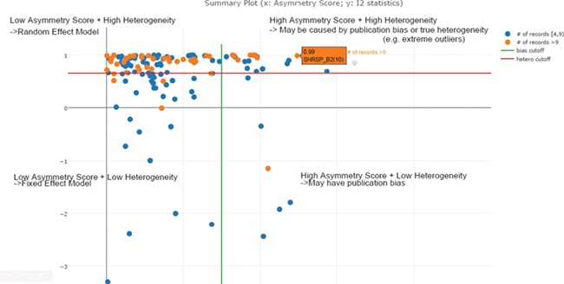
Figure 5 Scatter plot of asymmetry score and I2 statistics for different meta-analysis results for body weight data ...
Notes:
Figure 5 Scatter plot of asymmetry score and I2 statistics for different meta-analysis results for body weight data (x: asymmetry score; y: I2 statistics). The four quadrants represent different characteristics of datasets for each meta-analysis task. Quadrant 1 (top right) represents a high asymmetry score and high heterogeneity, which may be caused by publication bias or true heterogeneity (e.g. extreme outliers). Quadrant 2 represents a high asymmetry score and low heterogeneity, which may indicate true publication bias. Quadrant 3 represents a low asymmetry score and low heterogeneity, which indicates that we should choose the fixed-effect model. Quadrant 4 represents a low asymmetry score and high heterogeneity, which indicates that we should choose the random-effect model. From this summary plot, we can determine that I2 = 0. 85 (represented by the red line) is an optimal cut-off threshold to separate high and low heterogeneity datasets.
Unless provided in the caption above, the following copyright applies to the content of this slide: © The Author(s) 2019. Published by Oxford University Press.This is an Open Access article distributed under the terms of the Creative Commons Attribution License (http://creativecommons.org/licenses/by/4.0/), which permits unrestricted reuse, distribution, and reproduction in any medium, provided the original work is properly cited.

Slide 6
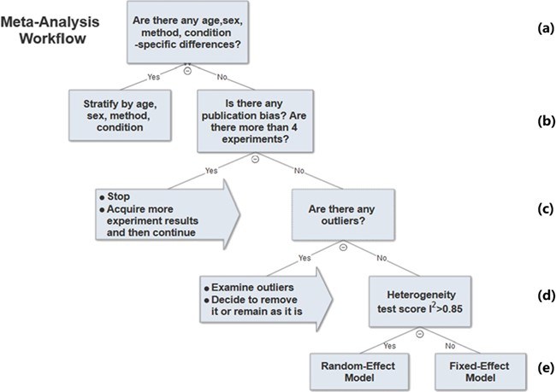
Figure 6 Meta-analysis workflow. In summary, our workflow is composed of the following key steps: (a) Preliminary ...
Notes:
Figure 6 Meta-analysis workflow. In summary, our workflow is composed of the following key steps: (a) Preliminary stratification by age, sex, method and experimental condition. (b) Perform exploratory analysis to examine publication bias and total number of experiments. (c) Perform exploratory analysis to determine inclusion/exclusion of individual study/observation in the meta-analysis. (d) Examination of heterogeneity using Cochrane’s Q, a statistic based on the χ2 test and the I2 statistic. (e) The fixed-effect and random-effect model choice threshold is set to I2 = 0.85, which is considered the optimal threshold to distinguish heterogeneity caused by a limited number of records or true inter-study variance. (f) All the summary values for the phenotype under analysis are displayed in a summary forest plot.
Unless provided in the caption above, the following copyright applies to the content of this slide: © The Author(s) 2019. Published by Oxford University Press.This is an Open Access article distributed under the terms of the Creative Commons Attribution License (http://creativecommons.org/licenses/by/4.0/), which permits unrestricted reuse, distribution, and reproduction in any medium, provided the original work is properly cited.

Slide 7
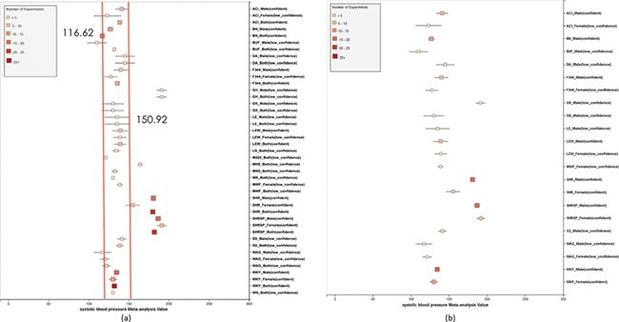
Figure 7 (a) Forest plot of meta-analysis summary for `Systolic Blood Pressure’. The center of the box represents the ...
Notes:
Figure 7 (a) Forest plot of meta-analysis summary for `Systolic Blood Pressure’. The center of the box represents the meta-analysis mean and the range determined by one standard deviation above and below the meta-analysis value. The color of the boxes showed the total number of experiments that made up of the meta-analysis range. It is a sign of confidence for the resulting phenotype range. On the right side, the legend shows the strain and sex of which the range is representing. In the bracket, we also noted the confidence level of analysis considering the total number of experiments (<4, low_confidence; ≥, 4 confident). (b) Forest plot with different indicator shapes for different genders. Users will have the option to choose display between (a) and (b).
Unless provided in the caption above, the following copyright applies to the content of this slide: © The Author(s) 2019. Published by Oxford University Press.This is an Open Access article distributed under the terms of the Creative Commons Attribution License (http://creativecommons.org/licenses/by/4.0/), which permits unrestricted reuse, distribution, and reproduction in any medium, provided the original work is properly cited.

Slide 8
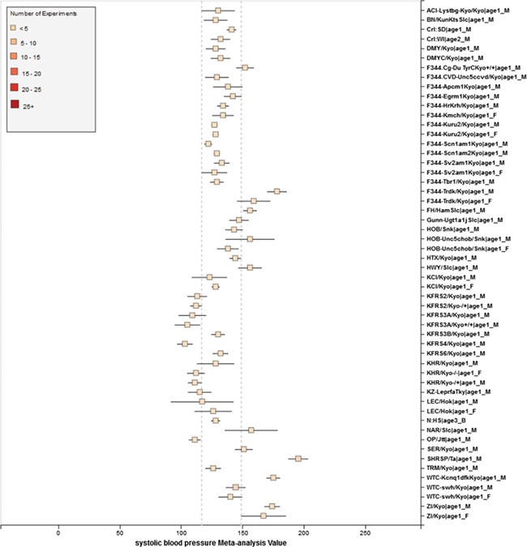
Figure 8 RGD phenotype expected ranges for `Systolic Blood Pressure’ for outbred and mutant strains under naïve ...
Notes:
Figure 8 RGD phenotype expected ranges for `Systolic Blood Pressure’ for outbred and mutant strains under naïve control conditions. The dotted lines represent the expected range for the `Control Strain Group’ based on 14 inbred strains used as controls for this phenotype.
Unless provided in the caption above, the following copyright applies to the content of this slide: © The Author(s) 2019. Published by Oxford University Press.This is an Open Access article distributed under the terms of the Creative Commons Attribution License (http://creativecommons.org/licenses/by/4.0/), which permits unrestricted reuse, distribution, and reproduction in any medium, provided the original work is properly cited.

Slide 9
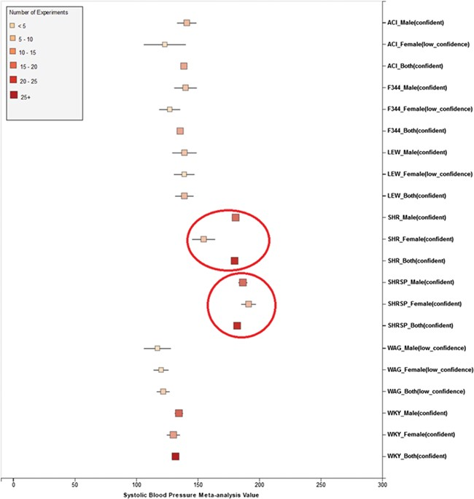
Figure 9 Summary for `Systolic Blood Pressure’ shows sex pattern does not always hold true: the sex specific pattern ...
Notes:
Figure 9 Summary for `Systolic Blood Pressure’ shows sex pattern does not always hold true: the sex specific pattern for SHRSP is opposite of the common pattern as female SHRSP rates have higher blood pressure. On the other hand, SHR exhibits the common pattern.
Unless provided in the caption above, the following copyright applies to the content of this slide: © The Author(s) 2019. Published by Oxford University Press.This is an Open Access article distributed under the terms of the Creative Commons Attribution License (http://creativecommons.org/licenses/by/4.0/), which permits unrestricted reuse, distribution, and reproduction in any medium, provided the original work is properly cited.

