Slide 1
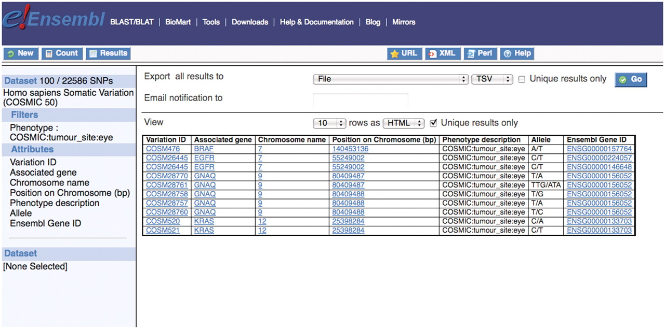
Figure 3. Shows that there are 100 single nucleotide polymorphisms in the human somatic variation data set associated ...
Notes:
Figure 3. Shows that there are 100 single nucleotide polymorphisms in the human somatic variation data set associated with tumors in the eye and the list of Ensembl gene IDs containing these variations can be downloaded for further study or one can click on an entry in the Ensembl Gene ID column on the interface which links to the main Ensembl website.
Unless provided in the caption above, the following copyright applies to the content of this slide: © The Author(s) 2011. Published by Oxford University Press.This is Open Access article distributed under the terms of the Creative Commons Attribution Non-Commercial License (http://creativecommons.org/licenses/by-nc/2.5), which permits unrestricted non-commercial use, distribution, and reproduction in any medium, provided the original work is properly cited.

