Slide 1
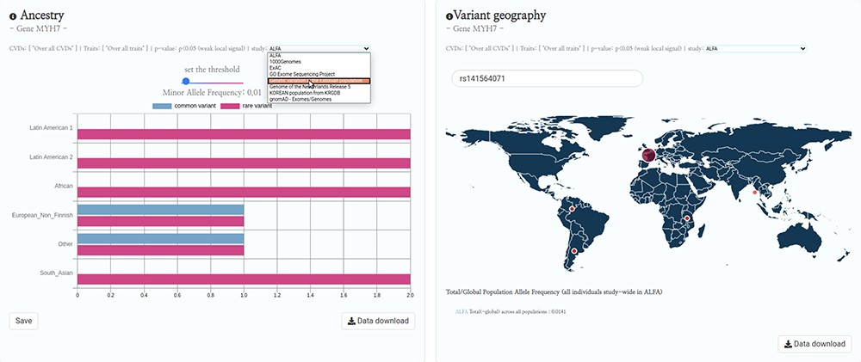
Figure 4. HeartBioPortal2.0’s genetic ancestry and variant geography feature. CVD-relevant exome/genome population ...
Notes:
Figure 4. HeartBioPortal2.0’s genetic ancestry and variant geography feature. CVD-relevant exome/genome population allele frequency data displayed in the Ancestry and Variant Geography maps from dozens of studies/cohorts ranging from gnomAD to ‘Genome of the Netherlands Release 5’ to ‘Korean population from KRGDB’ among many others. In total, 54 diverse subpopulations across 27 new studies/cohorts have been added, relative to gnomAD alone in HeartBioPortal’s initial debut in May 2019. Users can now search individual mutations (rsID accession identifiers) as well as toggle a Minor Allele Frequency (MAF) slider bar that interactively displays the proportion of rare vs. common variants at user-selected MAF thresholds.
Unless provided in the caption above, the following copyright applies to the content of this slide: © The Author(s) 2020. Published by Oxford University Press.This is an Open Access article distributed under the terms of the Creative Commons Attribution License (http://creativecommons.org/licenses/by/4.0/), which permits unrestricted reuse, distribution, and reproduction in any medium, provided the original work is properly cited.

Slide 2
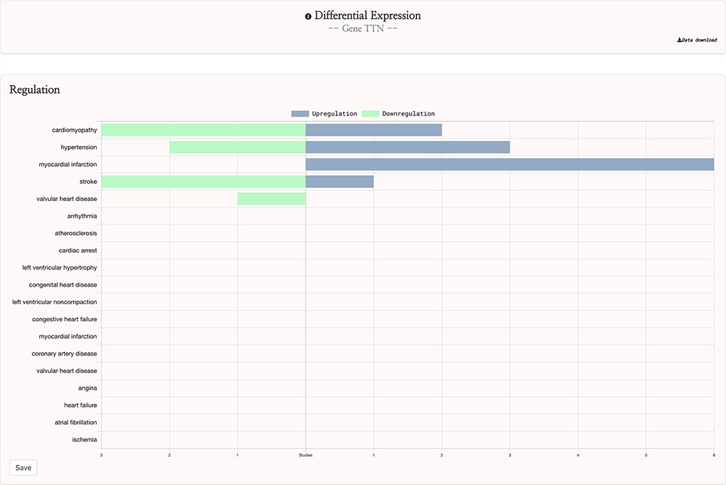
Figure 3. HeartBioPortal2.0’s differential gene expression feature. Users can visually explore the landscape of up- and ...
Notes:
Figure 3. HeartBioPortal2.0’s differential gene expression feature. Users can visually explore the landscape of up- and downregulation of any gene across a variety of CVD-relevant phenotypes from GEO studies that have been further manually curated and harmonized for HeartBioPortal inclusion via a uniform data-processing pipeline (as described in Methods section). In addition, the Data Download button provides actionable metadata such as FDR adjusted P-value, fold change (presented as logFC) and PMID to facilitate exploratory data analyses.
Unless provided in the caption above, the following copyright applies to the content of this slide: © The Author(s) 2020. Published by Oxford University Press.This is an Open Access article distributed under the terms of the Creative Commons Attribution License (http://creativecommons.org/licenses/by/4.0/), which permits unrestricted reuse, distribution, and reproduction in any medium, provided the original work is properly cited.

Slide 3
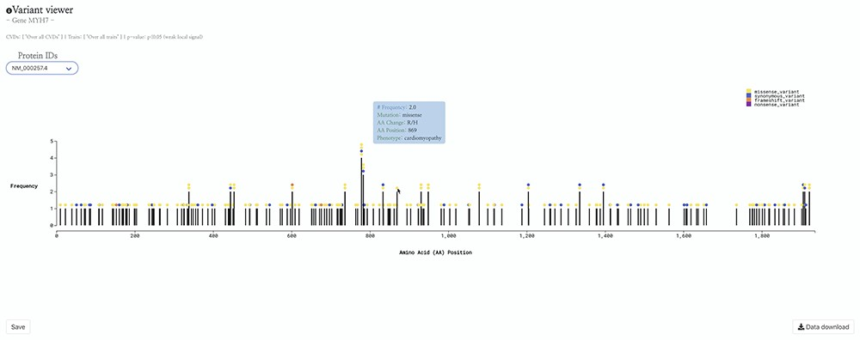
Figure 2. HeartBioPortal2.0’s variant viewer chart feature. The gene MYH7 is known to be associated with ...
Notes:
Figure 2. HeartBioPortal2.0’s variant viewer chart feature. The gene MYH7 is known to be associated with cardiomyopathy—here we see an interactive lollipop plot showing all known clinical genetic variants in MYH7 across multiple biological databases such as ClinVar, NHGRI-EBI GWAS Catalog, Ensembl, gnomAD, etc. The user can learn more information about any variant by hovering over the circles to display, e.g. the MYH7:p.Arg869His variant in this newly updated variant viewer chart. In addition, HeartBioPortal2.0 users can save their chart (for figures/diagrams in publications, seminars, etc.) and press the data download button to obtain additional details/metadata presented in a tidy .csv format amenable to additional follow-up data analyses. There are often multiple accession identifiers present in the dropdown menu of the variant viewer plot (e.g. for the gene DSP or TTN) to display variants found in both the canonical transcript of the gene as well as its alternative splice isoforms. Therefore, the variant viewer plot depicts variants found in all transcripts that have a known protein product associated with the respective CVD phenotype.
Unless provided in the caption above, the following copyright applies to the content of this slide: © The Author(s) 2020. Published by Oxford University Press.This is an Open Access article distributed under the terms of the Creative Commons Attribution License (http://creativecommons.org/licenses/by/4.0/), which permits unrestricted reuse, distribution, and reproduction in any medium, provided the original work is properly cited.

Slide 4
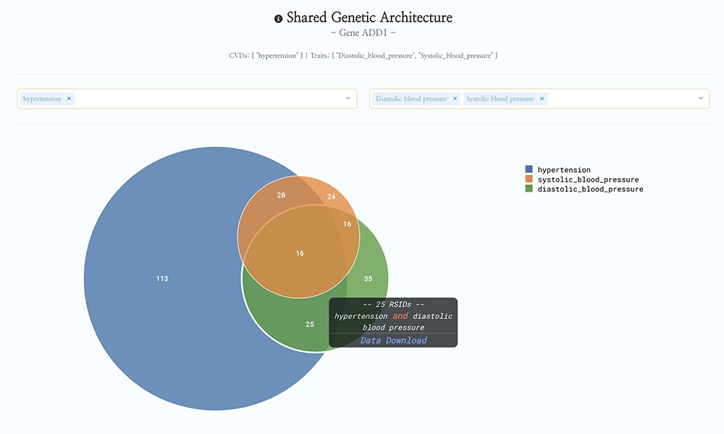
Figure 1. HeartBioPortal2.0’s shared genetic architecture feature. The gene ADD1 is known to be associated with ...
Notes:
Figure 1. HeartBioPortal2.0’s shared genetic architecture feature. The gene ADD1 is known to be associated with salt-sensitive essential hypertension—here we see the shared genetic architecture of that gene’s variants (represented as unique reference SNP ID number (rsID) accession identifiers) across the continuous cardiometabolic spectrum from health (systolic and diastolic blood pressure) to disease (hypertension), facilitating the understanding of CVD trait genetics underlying health-to-disease transitions and endophenotypes. HeartBioPortal’s frontend design philosophy has always been to keep the user interface clean and minimalistic to ensure viewer comprehension and avoid potential confusion; therefore, additional details can be acquired from the hyperlinked data download, which is presented in a tidy .csv format amenable to follow-up analyses.
Unless provided in the caption above, the following copyright applies to the content of this slide: © The Author(s) 2020. Published by Oxford University Press.This is an Open Access article distributed under the terms of the Creative Commons Attribution License (http://creativecommons.org/licenses/by/4.0/), which permits unrestricted reuse, distribution, and reproduction in any medium, provided the original work is properly cited.

