Slide 1
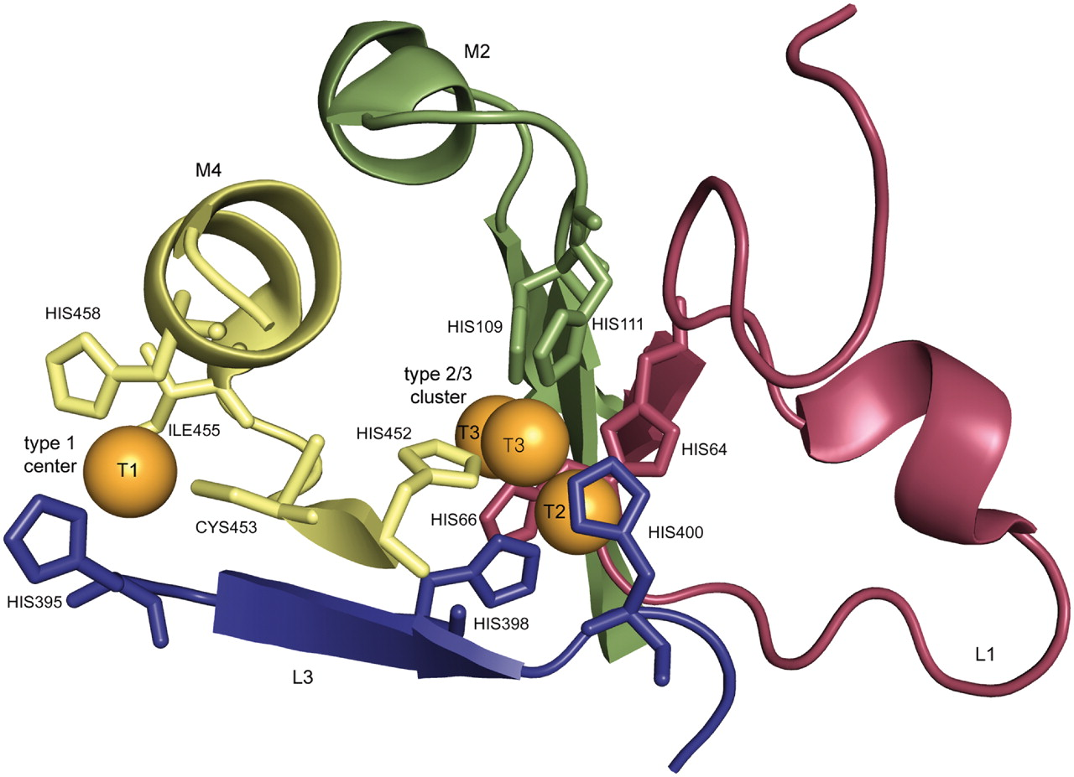
Figure 2. Copper binding residues of laccase from Trametes versicolor [PDB entry 1GYC, (39)].The copper centers are ...
Notes:
Figure 2. Copper binding residues of laccase from Trametes versicolor [PDB entry 1GYC, (39)].The copper centers are shown in orange, the residues that match the defined pattern L1, M2, L3, M4 are colored in red, green, blue, and yellow, respectively [visualization by PyMOL (40)].
Unless provided in the caption above, the following copyright applies to the content of this slide: © The Author(s) 2011. Published by Oxford University Press.This is Open Access article distributed under the terms of the Creative Commons Attribution Non-Commercial License (http://creativecommons.org/licenses/by-nc/2.5), which permits unrestricted non-commercial use, distribution, and reproduction in any medium, provided the original work is properly cited.

