Slide 1
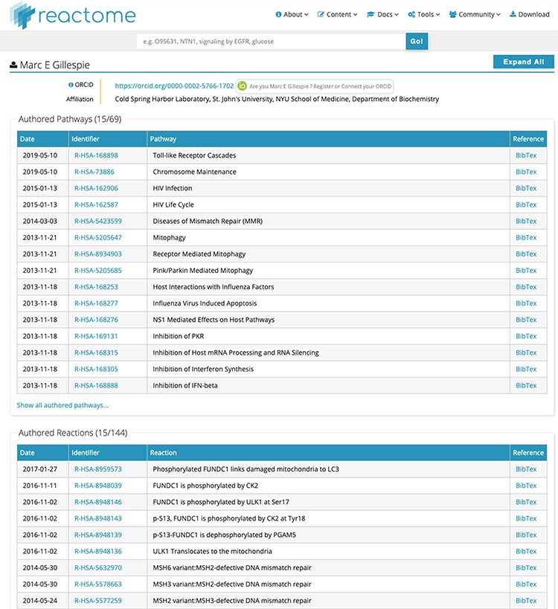
Figure 2 Detailed list of contributions for ‘Marc E Gillespie’. Unique identifiers in the ‘Identifier’ column directly ...
Notes:
Figure 2 Detailed list of contributions for ‘Marc E Gillespie’. Unique identifiers in the ‘Identifier’ column directly link to the relevant pathway/reaction. BibTex records can be downloaded for each data object if desired. After ORCID authentication at the top of the page, all contributions can be claimed to the contributor’s ORCID record with a single click, or individual data object can be claimed for finer granularity.
Unless provided in the caption above, the following copyright applies to the content of this slide: © The Author(s) 2019. Published by Oxford University Press.This is an Open Access article distributed under the terms of the Creative Commons Attribution License (http://creativecommons.org/licenses/by/4.0/), which permits unrestricted reuse, distribution, and reproduction in any medium, provided the original work is properly cited.

