Slide 1
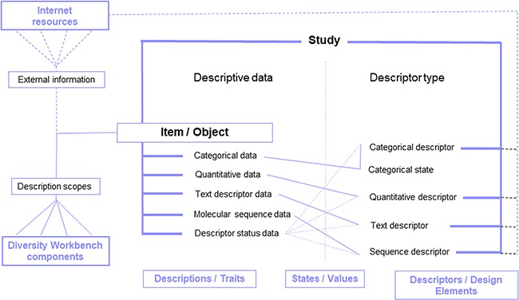
Figure 4 DiversityDescriptions enabling free definition of descriptors and descriptor states for the representation of ...
Notes:
Figure 4 DiversityDescriptions enabling free definition of descriptors and descriptor states for the representation of descriptive data of a study item based on various basic data types and enrichment via ‘description scopes’ by linking Diversity Workbench modules and external web resources.
Unless provided in the caption above, the following copyright applies to the content of this slide: © The Author(s) 2020. Published by Oxford University Press.This is an Open Access article distributed under the terms of the Creative Commons Attribution License (http://creativecommons.org/licenses/by/4.0/), which permits unrestricted reuse, distribution, and reproduction in any medium, provided the original work is properly cited.

