Slide 1
Figure 1 Example of a BEL statement extracted from the sentence ‘IL-1β caused a time-dependent increase in Caco-2 ...
Notes:
Figure 1 Example of a BEL statement extracted from the sentence ‘IL-1β caused a time-dependent increase in Caco-2 ATF-2 phosphorylation, starting at 10 min of treatment (Fig. 3A).’ (46) (PMID: 23656735) (BEL:201720027; identifier in BEL corpus). The BEL statement consists of two protein abundances [p (HGNC:IL1B) and p (HGNC:ATF2)], one protein modification function representing a phosphorylation event [pmod(P)] and a relationship type (increases).
Unless provided in the caption above, the following copyright applies to the content of this slide: © The Author(s) 2019. Published by Oxford University Press.This is an Open Access article distributed under the terms of the Creative Commons Attribution License (http://creativecommons.org/licenses/by/4.0/), which permits unrestricted reuse, distribution, and reproduction in any medium, provided the original work is properly cited.

Slide 2
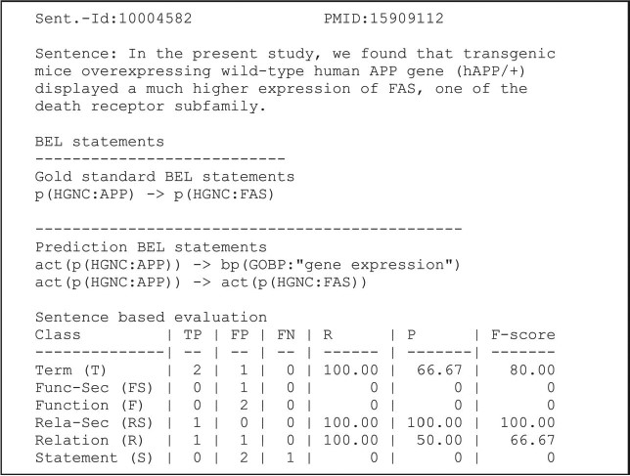
Figure 2 An example of a candidate evaluation. The example shows the candidate sentence, the gold standard and ...
Notes:
Figure 2 An example of a candidate evaluation. The example shows the candidate sentence, the gold standard and predicted statements. The scores are provided for all primary and secondary levels (8). Abbreviations: PMID (PubMed identifier), true positive (TP), false positive (FP), false negative (FN), recall (R), precision (P). Adapted and reprinted with permission from Fluck et al. (7).
Unless provided in the caption above, the following copyright applies to the content of this slide: © The Author(s) 2019. Published by Oxford University Press.This is an Open Access article distributed under the terms of the Creative Commons Attribution License (http://creativecommons.org/licenses/by/4.0/), which permits unrestricted reuse, distribution, and reproduction in any medium, provided the original work is properly cited.

Slide 3
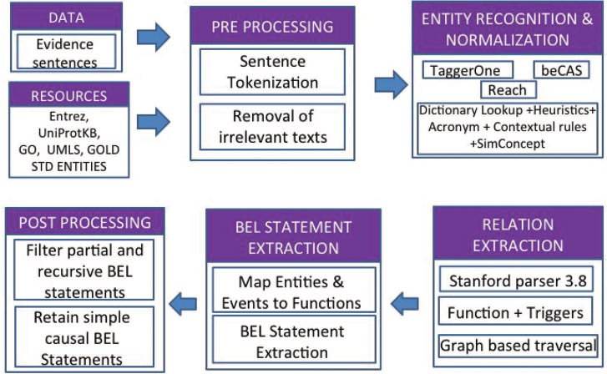
Figure 3 BELMiner 2.0 architecture.
Notes:
Figure 3 BELMiner 2.0 architecture.
Unless provided in the caption above, the following copyright applies to the content of this slide: © The Author(s) 2019. Published by Oxford University Press.This is an Open Access article distributed under the terms of the Creative Commons Attribution License (http://creativecommons.org/licenses/by/4.0/), which permits unrestricted reuse, distribution, and reproduction in any medium, provided the original work is properly cited.

Slide 4
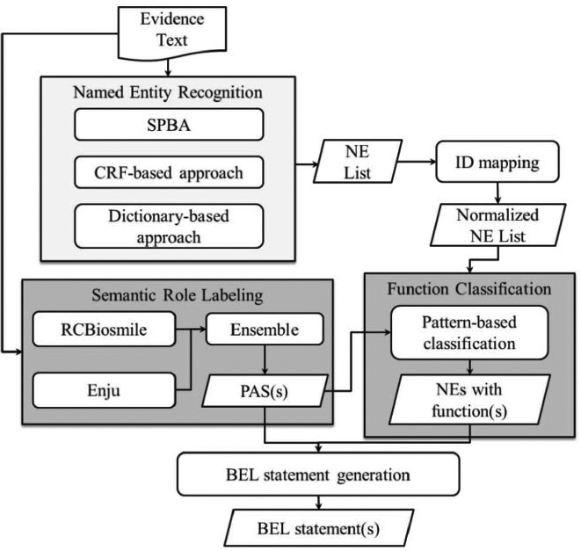
Figure 4 BelSmile workflow.
Notes:
Figure 4 BelSmile workflow.
Unless provided in the caption above, the following copyright applies to the content of this slide: © The Author(s) 2019. Published by Oxford University Press.This is an Open Access article distributed under the terms of the Creative Commons Attribution License (http://creativecommons.org/licenses/by/4.0/), which permits unrestricted reuse, distribution, and reproduction in any medium, provided the original work is properly cited.

Slide 5
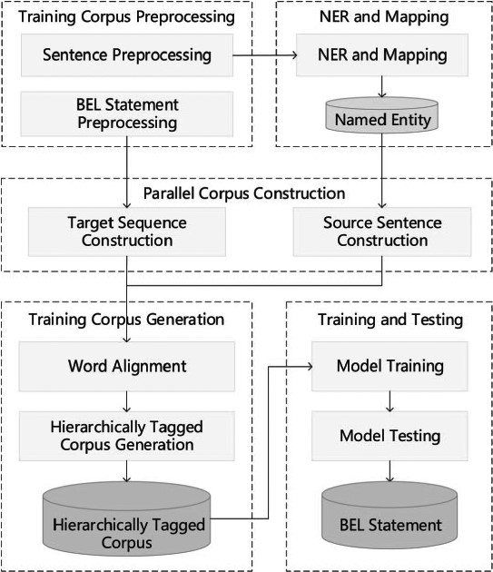
Figure 5 Hierarchical sequence labeling system pipeline.
Notes:
Figure 5 Hierarchical sequence labeling system pipeline.
Unless provided in the caption above, the following copyright applies to the content of this slide: © The Author(s) 2019. Published by Oxford University Press.This is an Open Access article distributed under the terms of the Creative Commons Attribution License (http://creativecommons.org/licenses/by/4.0/), which permits unrestricted reuse, distribution, and reproduction in any medium, provided the original work is properly cited.

Slide 6
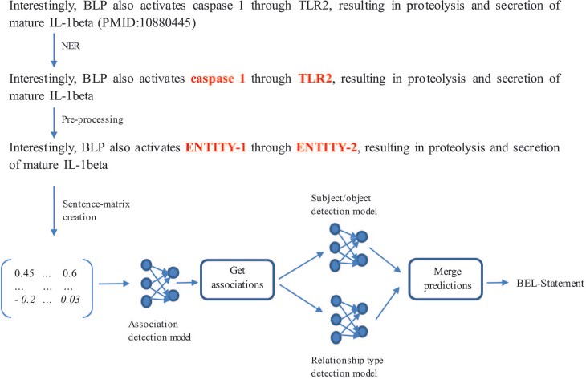
Figure 6 Architecture of the neural network-based system.
Notes:
Figure 6 Architecture of the neural network-based system.
Unless provided in the caption above, the following copyright applies to the content of this slide: © The Author(s) 2019. Published by Oxford University Press.This is an Open Access article distributed under the terms of the Creative Commons Attribution License (http://creativecommons.org/licenses/by/4.0/), which permits unrestricted reuse, distribution, and reproduction in any medium, provided the original work is properly cited.

Slide 7
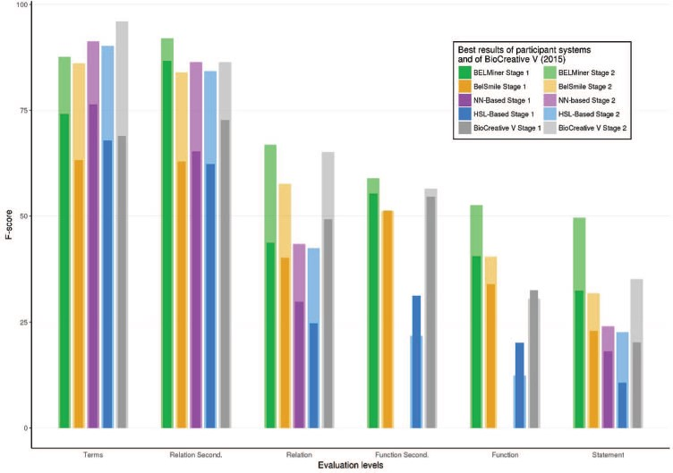
Figure 7 Best results of each system of BioCreative VI (2017) and BioCreative V (2015) in each structured level of ...
Notes:
Figure 7 Best results of each system of BioCreative VI (2017) and BioCreative V (2015) in each structured level of task 1.
Unless provided in the caption above, the following copyright applies to the content of this slide: © The Author(s) 2019. Published by Oxford University Press.This is an Open Access article distributed under the terms of the Creative Commons Attribution License (http://creativecommons.org/licenses/by/4.0/), which permits unrestricted reuse, distribution, and reproduction in any medium, provided the original work is properly cited.

Slide 8
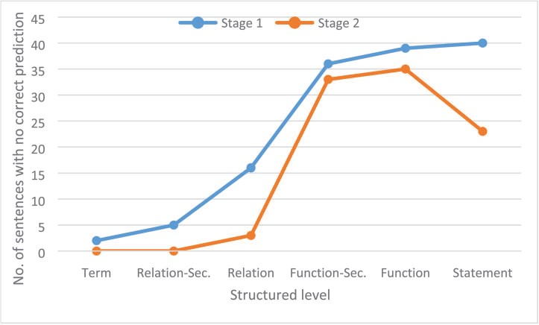
Figure 8 Number of sentences for each structured level on each stage for which no correct prediction was produced by ...
Notes:
Figure 8 Number of sentences for each structured level on each stage for which no correct prediction was produced by any run of any participant system.
Unless provided in the caption above, the following copyright applies to the content of this slide: © The Author(s) 2019. Published by Oxford University Press.This is an Open Access article distributed under the terms of the Creative Commons Attribution License (http://creativecommons.org/licenses/by/4.0/), which permits unrestricted reuse, distribution, and reproduction in any medium, provided the original work is properly cited.

