Slide 1
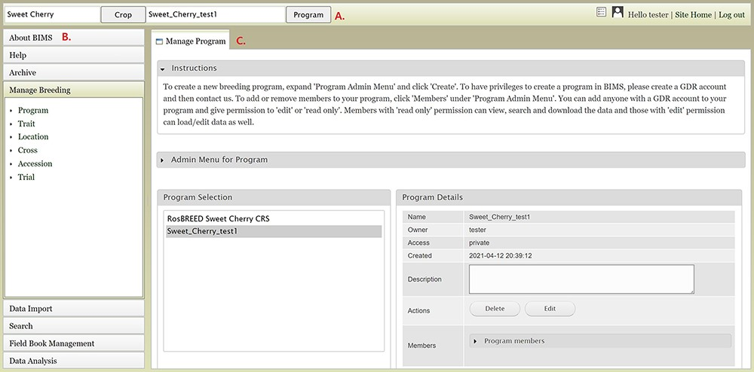
Figure 1. Main areas of the BIMS interface. A. The header region that displays the current crop and program on the left ...
Notes:
Figure 1. Main areas of the BIMS interface. A. The header region that displays the current crop and program on the left and links to configuration page, account page and home page on the right along with the user name. B. The accordion menu on the left that allows users to switch between various sections of the BIMS C. The tab region where users primarily interact with BIMS.
Unless provided in the caption above, the following copyright applies to the content of this slide: © The Author(s) 2021. Published by Oxford University Press.This is an Open Access article distributed under the terms of the Creative Commons Attribution License (http://creativecommons.org/licenses/by/4.0/), which permits unrestricted reuse, distribution, and reproduction in any medium, provided the original work is properly cited.

