Slide 1
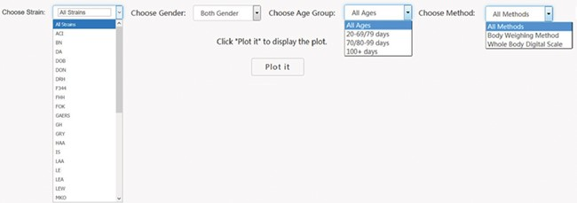
Figure 2 PhenoMiner preliminary stratification for body weight. Interface was created to dynamically conduct the ...
Notes:
Figure 2 PhenoMiner preliminary stratification for body weight. Interface was created to dynamically conduct the preliminary stratification step. Options for strain and phenotype measurement methods depend on the major phenotype under analysis. Age group divisions were decided by expert heuristic definitions of young, adult and old rats. Age group division can be different. For example, for body weight, 20–79 and 80–99 days might be a good way to divide young and adult rats, but for other cardiovascular phenotypes, 20–69 and 70–99 days are a good way to divide young and adult rats.
Unless provided in the caption above, the following copyright applies to the content of this slide: © The Author(s) 2019. Published by Oxford University Press.This is an Open Access article distributed under the terms of the Creative Commons Attribution License (http://creativecommons.org/licenses/by/4.0/), which permits unrestricted reuse, distribution, and reproduction in any medium, provided the original work is properly cited.

