Slide 1
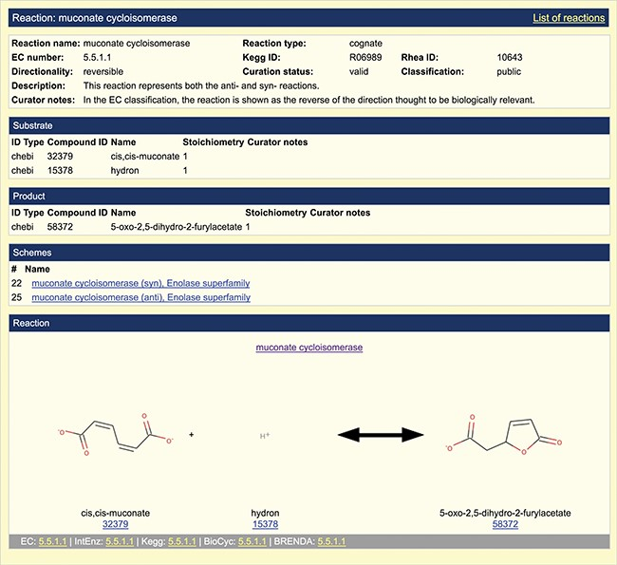
Figure 2 Representation of overall reaction. A screenshot of the default reaction view available in the SFLD archive ...
Notes:
Figure 2 Representation of overall reaction. A screenshot of the default reaction view available in the SFLD archive following incorporation of the EMO into the SFLD resource is shown. The muconate cycloisomerase (EC 5.5.1.1) reaction (enolase superfamily) is shown as an example.
Unless provided in the caption above, the following copyright applies to the content of this slide: © The Author(s) 2020. Published by Oxford University Press.This is an Open Access article distributed under the terms of the Creative Commons Attribution License (http://creativecommons.org/licenses/by/4.0/), which permits unrestricted reuse, distribution, and reproduction in any medium, provided the original work is properly cited.

