Slide 1
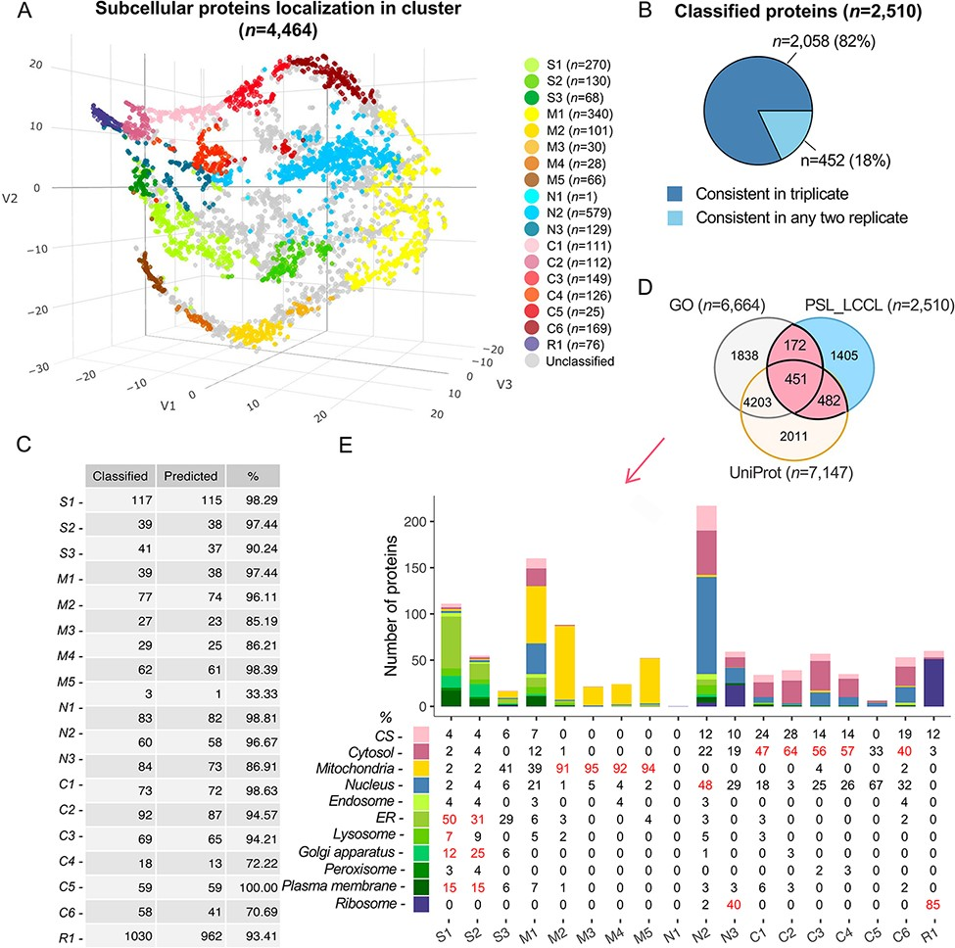
Figure 3. Subcellular localization of all identified proteins (n = 4464) at the cluster level. (A) The t-SNE ...
Notes:
Figure 3. Subcellular localization of all identified proteins (n = 4464) at the cluster level. (A) The t-SNE classification for all proteins in a three-dimensional space. (B) The consistency of the classified proteins in replicate. (C) The classification accuracy of marker proteins at the cluster level. Classified: the number of marker proteins retained at each cluster level after filtering by threshold; predicted: the number of marker proteins correctly predicted. (D) The overlap of proteins classified with single cluster and proteins annotated with a single location in GO and UniProt. (E) Evaluation of single-cluster-classified proteins against proteins with single subcellular localization annotation from GO or UniProt.
Unless provided in the caption above, the following copyright applies to the content of this slide: © The Author(s) 2022. Published by Oxford University Press.This is an Open Access article distributed under the terms of the Creative Commons Attribution License (https://creativecommons.org/licenses/by/4.0/), which permits unrestricted reuse, distribution, and reproduction in any medium, provided the original work is properly cited.

