Slide 1
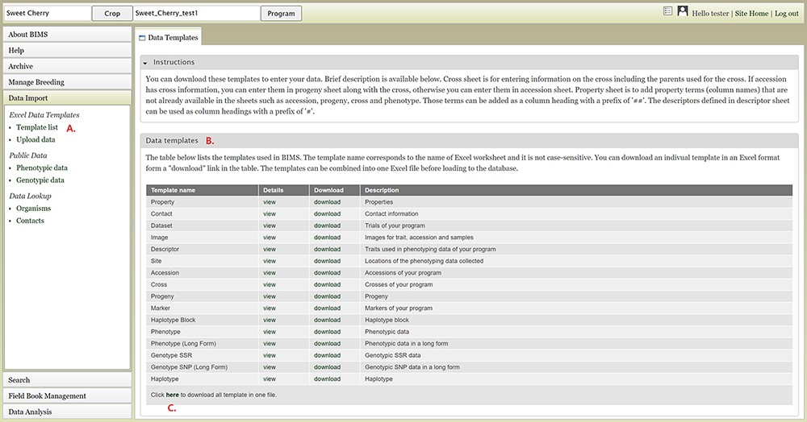
Figure 3. BIMS interface for downloading data templates. A. Template list section under Data Import menu. B. Data ...
Notes:
Figure 3. BIMS interface for downloading data templates. A. Template list section under Data Import menu. B. Data templates section that lists all the data templates with hyperlinks to view and download. C. Link where users can also download all the templates as a single Excel file.
Unless provided in the caption above, the following copyright applies to the content of this slide: © The Author(s) 2021. Published by Oxford University Press.This is an Open Access article distributed under the terms of the Creative Commons Attribution License (http://creativecommons.org/licenses/by/4.0/), which permits unrestricted reuse, distribution, and reproduction in any medium, provided the original work is properly cited.

