Slide 1
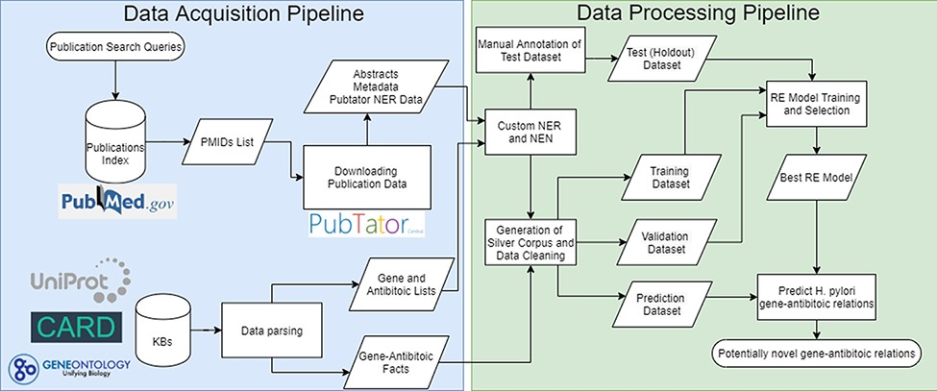
Figure 1. Complete flowchart of the developed pipeline which is divided as data acquisition on the left and data ...
Notes:
Figure 1. Complete flowchart of the developed pipeline which is divided as data acquisition on the left and data processing on the right. PMIDs—PubMed IDentifiers; NER—Named Entity Recognition; NEN—Named Entity Normalization.
Unless provided in the caption above, the following copyright applies to the content of this slide: © The Author(s) 2022. Published by Oxford University Press.This is an Open Access article distributed under the terms of the Creative Commons Attribution License (https://creativecommons.org/licenses/by/4.0/), which permits unrestricted reuse, distribution, and reproduction in any medium, provided the original work is properly cited.

Slide 2
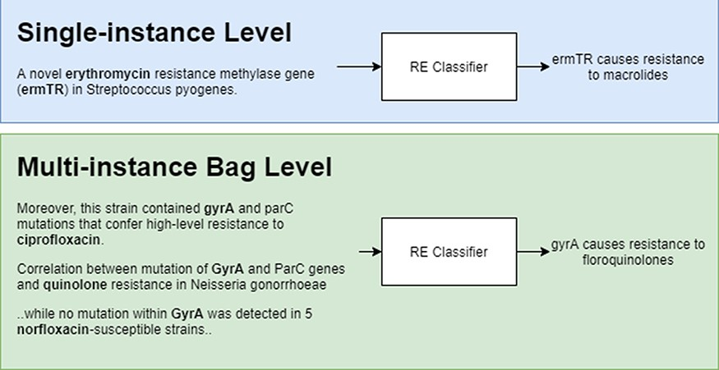
Figure 2. Single-instance vs multi-instance RE.
Notes:
Figure 2. Single-instance vs multi-instance RE.
Unless provided in the caption above, the following copyright applies to the content of this slide: © The Author(s) 2022. Published by Oxford University Press.This is an Open Access article distributed under the terms of the Creative Commons Attribution License (https://creativecommons.org/licenses/by/4.0/), which permits unrestricted reuse, distribution, and reproduction in any medium, provided the original work is properly cited.

Slide 3
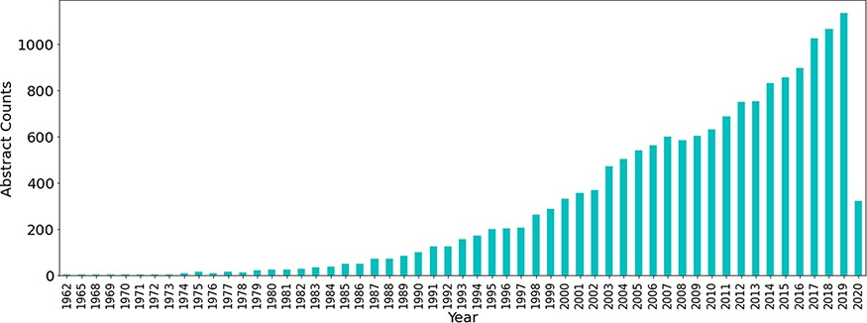
Figure 3. Number of publications related to antibiotic resistance till Q1 of 2020.
Notes:
Figure 3. Number of publications related to antibiotic resistance till Q1 of 2020.
Unless provided in the caption above, the following copyright applies to the content of this slide: © The Author(s) 2022. Published by Oxford University Press.This is an Open Access article distributed under the terms of the Creative Commons Attribution License (https://creativecommons.org/licenses/by/4.0/), which permits unrestricted reuse, distribution, and reproduction in any medium, provided the original work is properly cited.

Slide 4
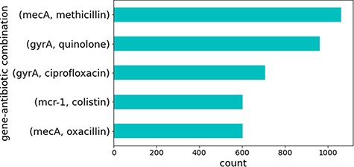
Figure 4. Top five gene identifiers and antibiotic combinations found in sentences.
Notes:
Figure 4. Top five gene identifiers and antibiotic combinations found in sentences.
Unless provided in the caption above, the following copyright applies to the content of this slide: © The Author(s) 2022. Published by Oxford University Press.This is an Open Access article distributed under the terms of the Creative Commons Attribution License (https://creativecommons.org/licenses/by/4.0/), which permits unrestricted reuse, distribution, and reproduction in any medium, provided the original work is properly cited.

Slide 5
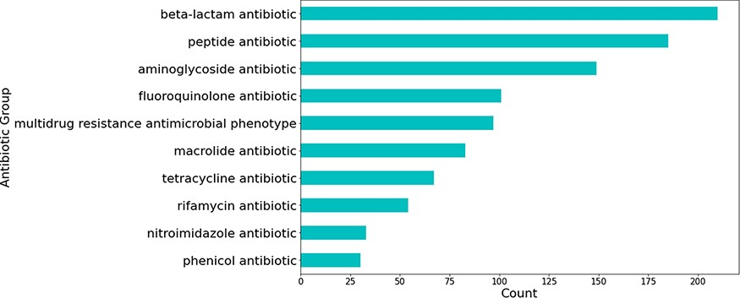
Figure 5. Number of predicted gene-antibiotic resistance associations linked to H. pylori for the top 10 antibiotic ...
Notes:
Figure 5. Number of predicted gene-antibiotic resistance associations linked to H. pylori for the top 10 antibiotic groups.
Unless provided in the caption above, the following copyright applies to the content of this slide: © The Author(s) 2022. Published by Oxford University Press.This is an Open Access article distributed under the terms of the Creative Commons Attribution License (https://creativecommons.org/licenses/by/4.0/), which permits unrestricted reuse, distribution, and reproduction in any medium, provided the original work is properly cited.

Slide 6
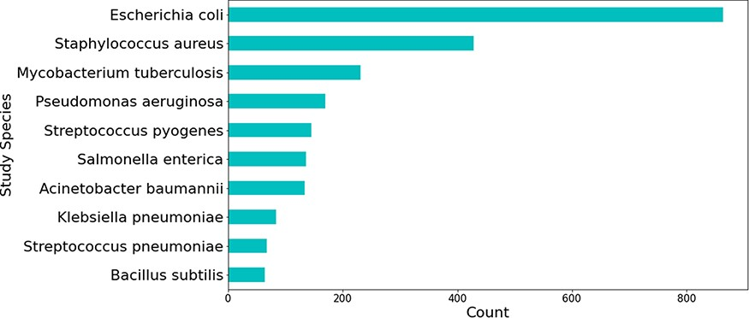
Figure 6. Top 10 bacterial species which were the main organism understudy in publications mentioning genes linked to ...
Notes:
Figure 6. Top 10 bacterial species which were the main organism understudy in publications mentioning genes linked to H. pylori.
Unless provided in the caption above, the following copyright applies to the content of this slide: © The Author(s) 2022. Published by Oxford University Press.This is an Open Access article distributed under the terms of the Creative Commons Attribution License (https://creativecommons.org/licenses/by/4.0/), which permits unrestricted reuse, distribution, and reproduction in any medium, provided the original work is properly cited.

Slide 7
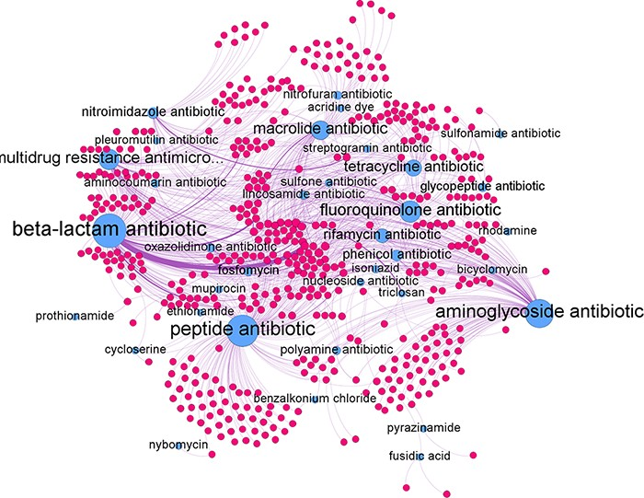
Figure 7. Network graph of all predicted gene-antibiotic group relations for antibiotic resistance in H. pylori, with ...
Notes:
Figure 7. Network graph of all predicted gene-antibiotic group relations for antibiotic resistance in H. pylori, with blue nodes represent the antibiotic groups and red nodes represent the individual genes.
Unless provided in the caption above, the following copyright applies to the content of this slide: © The Author(s) 2022. Published by Oxford University Press.This is an Open Access article distributed under the terms of the Creative Commons Attribution License (https://creativecommons.org/licenses/by/4.0/), which permits unrestricted reuse, distribution, and reproduction in any medium, provided the original work is properly cited.

Slide 8
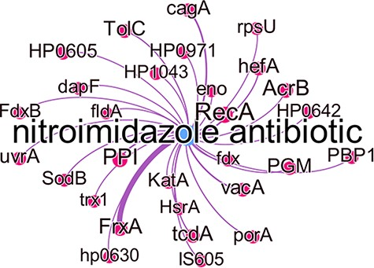
Figure 8. Subgraph of the nitroimidazole antibiotic group with predicted gene relations where the edge thickness is ...
Notes:
Figure 8. Subgraph of the nitroimidazole antibiotic group with predicted gene relations where the edge thickness is proportional to the number of times this association was predicted.
Unless provided in the caption above, the following copyright applies to the content of this slide: © The Author(s) 2022. Published by Oxford University Press.This is an Open Access article distributed under the terms of the Creative Commons Attribution License (https://creativecommons.org/licenses/by/4.0/), which permits unrestricted reuse, distribution, and reproduction in any medium, provided the original work is properly cited.

