Slide 1
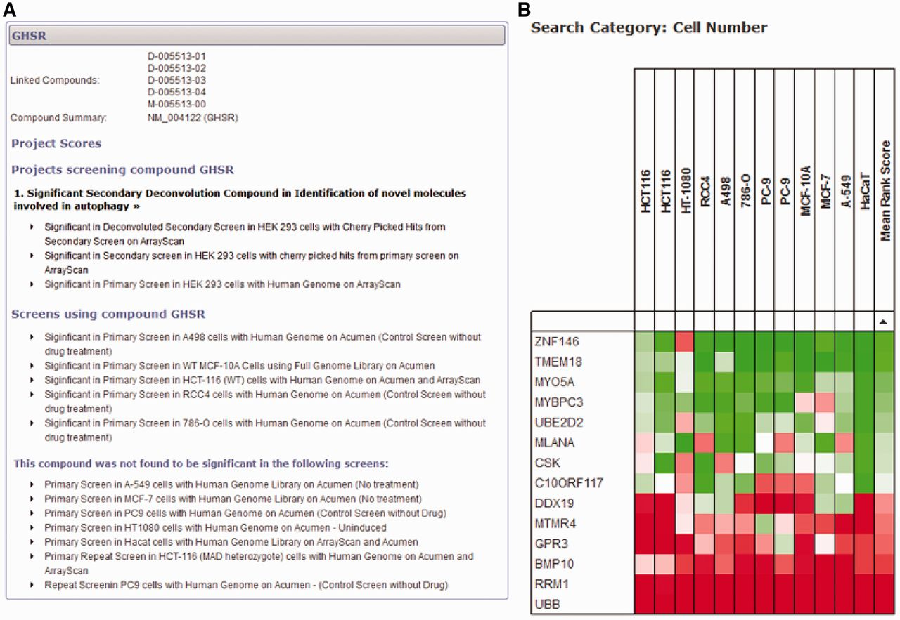
Figure 4. Gene-centred query of the HTS-DB. (A) A detailed query of the HTS-DB showing all details available for a ...
Notes:
Figure 4. Gene-centred query of the HTS-DB. (A) A detailed query of the HTS-DB showing all details available for a particular gene, GHSR. This example shows the siRNA targeted against this gene was a significant hit in an Autophagy project, and was successfully taken forward to the secondary deconvolution stage within this project. It also lists additional screens in other cell lines where the gene scored significantly. These lists can be extended to show detail of the originating dataset for more information. (B) Example output from the HTS-DB Batch Query mode. This example shows the cell viability scores across 12 genome-wide screens for siRNA reagents targeting 14 genes. The effect on cell viability of siRNA knockdown of a number of genes across different screens and cell lines can be readily assessed, where, in this case, several genes show consistently low viability scores across multiple cell lines (RRM1, UBB), several show consistently high viability scores across multiple cell lines (TMEM18, ZNF146) and some show variability in their scores (CR10ORF117).
Unless provided in the caption above, the following copyright applies to the content of this slide: © The Author(s) 2013. Published by Oxford University Press.This is an Open Access article distributed under the terms of the Creative Commons Attribution License (http://creativecommons.org/licenses/by/3.0/), which permits unrestricted reuse, distribution, and reproduction in any medium, provided the original work is properly cited.

