Slide 1
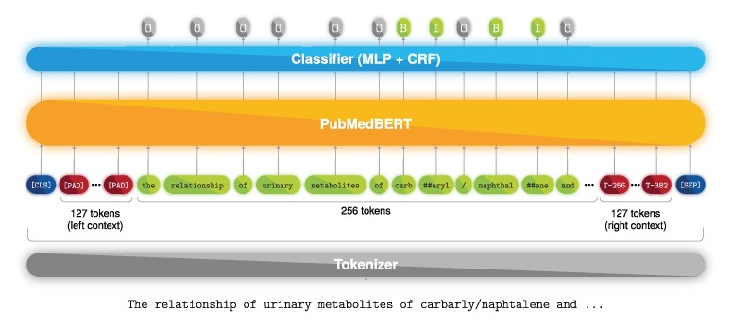
Figure 1. Named entity recognition deep learning model. Example text from PMC 1 253 656.
Notes:
Figure 1. Named entity recognition deep learning model. Example text from PMC 1 253 656.
Unless provided in the caption above, the following copyright applies to the content of this slide: © The Author(s) 2022. Published by Oxford University Press.This is an Open Access article distributed under the terms of the Creative Commons Attribution-NonCommercial License (https://creativecommons.org/licenses/by-nc/4.0/), which permits non-commercial re-use, distribution, and reproduction in any medium, provided the original work is properly cited. For commercial re-use, please contact journals.permissions@oup.com

Slide 2
Figure 2. Diagram showing how token sequences are shifted in order to be fed into BERT.
Notes:
Figure 2. Diagram showing how token sequences are shifted in order to be fed into BERT.
Unless provided in the caption above, the following copyright applies to the content of this slide: © The Author(s) 2022. Published by Oxford University Press.This is an Open Access article distributed under the terms of the Creative Commons Attribution-NonCommercial License (https://creativecommons.org/licenses/by-nc/4.0/), which permits non-commercial re-use, distribution, and reproduction in any medium, provided the original work is properly cited. For commercial re-use, please contact journals.permissions@oup.com

Slide 3
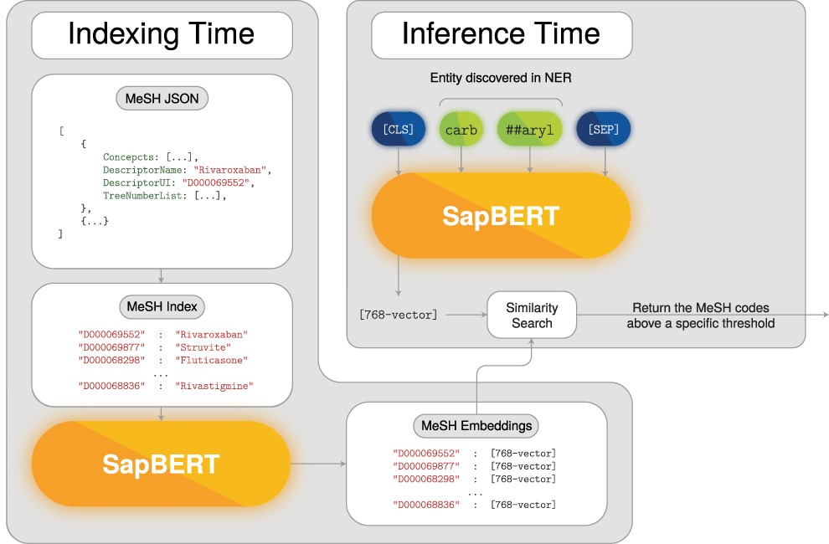
Figure 3. Named entity normalization deep-learning model.
Notes:
Figure 3. Named entity normalization deep-learning model.
Unless provided in the caption above, the following copyright applies to the content of this slide: © The Author(s) 2022. Published by Oxford University Press.This is an Open Access article distributed under the terms of the Creative Commons Attribution-NonCommercial License (https://creativecommons.org/licenses/by-nc/4.0/), which permits non-commercial re-use, distribution, and reproduction in any medium, provided the original work is properly cited. For commercial re-use, please contact journals.permissions@oup.com

Slide 4
Figure 4. Performance comparison between the use or absence of a CRF mask. The measurements were taken during the five ...
Notes:
Figure 4. Performance comparison between the use or absence of a CRF mask. The measurements were taken during the five initial training epochs of the exactly same model and training configuration. The only variable that changed was the CRF mask.
Unless provided in the caption above, the following copyright applies to the content of this slide: © The Author(s) 2022. Published by Oxford University Press.This is an Open Access article distributed under the terms of the Creative Commons Attribution-NonCommercial License (https://creativecommons.org/licenses/by-nc/4.0/), which permits non-commercial re-use, distribution, and reproduction in any medium, provided the original work is properly cited. For commercial re-use, please contact journals.permissions@oup.com

Slide 5
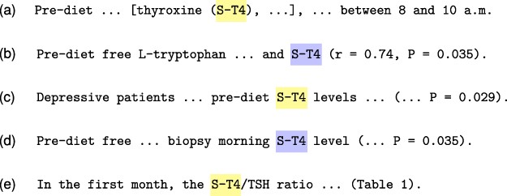
Figure 8. Example of the tagging inconsistency problem from the document PMC 555 756. Our model correctly predicted the ...
Notes:
Figure 8. Example of the tagging inconsistency problem from the document PMC 555 756. Our model correctly predicted the entity ST-4 for Sentences (b) and (d), but failed to predict the remainder ST-4 mentions in Sentences (a), (c) and (e), which renders a final document annotation that appears to be contradictory.
Unless provided in the caption above, the following copyright applies to the content of this slide: © The Author(s) 2022. Published by Oxford University Press.This is an Open Access article distributed under the terms of the Creative Commons Attribution-NonCommercial License (https://creativecommons.org/licenses/by-nc/4.0/), which permits non-commercial re-use, distribution, and reproduction in any medium, provided the original work is properly cited. For commercial re-use, please contact journals.permissions@oup.com

Slide 6
Figure 9. Example of a chemical mention embedded in a protein mention from document PMC 2 096 715. Our model predicted ...
Notes:
Figure 9. Example of a chemical mention embedded in a protein mention from document PMC 2 096 715. Our model predicted cholesterol on both sentences as an chemical entity. However, in Sentence (a) the word cholesterol should not be identified because, according to the annotation guidelines, the chemical term appears within a protein mention.
Unless provided in the caption above, the following copyright applies to the content of this slide: © The Author(s) 2022. Published by Oxford University Press.This is an Open Access article distributed under the terms of the Creative Commons Attribution-NonCommercial License (https://creativecommons.org/licenses/by-nc/4.0/), which permits non-commercial re-use, distribution, and reproduction in any medium, provided the original work is properly cited. For commercial re-use, please contact journals.permissions@oup.com

Slide 7
Figure 5. Two examples of entity recognition errors due to tokenization boundaries. Blue boxes represent gold standard ...
Notes:
Figure 5. Two examples of entity recognition errors due to tokenization boundaries. Blue boxes represent gold standard entity annotations, and the yellow boxes highlight characters that cannot be disentangled from the true annotations due to tokenization. The first error (a) occurs in the document PMC 3 661 362, where Na+ and K+ are gold-standard entity mentions. However, the PubMedBERT tokenizer produces the tokens INa and IK, which makes it impossible to correctly predict Na+ and K+ using a token-level tagging schema. The ‘closest’ predictions would be INa+ and IK+, which would be incorrect according to strict evaluation. The second example (b) was extracted from PMC 2 952 795 containing a similar issue with the term Ocarboxylate, where Oc forms a single token.
Unless provided in the caption above, the following copyright applies to the content of this slide: © The Author(s) 2022. Published by Oxford University Press.This is an Open Access article distributed under the terms of the Creative Commons Attribution-NonCommercial License (https://creativecommons.org/licenses/by-nc/4.0/), which permits non-commercial re-use, distribution, and reproduction in any medium, provided the original work is properly cited. For commercial re-use, please contact journals.permissions@oup.com

Slide 8
Figure 6. An example of a potential inconsistent annotation found in the document PMC 2 254 971. In the first sentence ...
Notes:
Figure 6. An example of a potential inconsistent annotation found in the document PMC 2 254 971. In the first sentence (a), the curators considered propidium iodide as a chemical as well as its short form PI. However, as shown with the yellow box, the term PI in the second sentence (b) was not annotated, which made us suspect if it was a missed annotation.
Unless provided in the caption above, the following copyright applies to the content of this slide: © The Author(s) 2022. Published by Oxford University Press.This is an Open Access article distributed under the terms of the Creative Commons Attribution-NonCommercial License (https://creativecommons.org/licenses/by-nc/4.0/), which permits non-commercial re-use, distribution, and reproduction in any medium, provided the original work is properly cited. For commercial re-use, please contact journals.permissions@oup.com

Slide 9
Figure 7. Example of an annotation with incorrect span from document PMC 5 096 026. The term polypyridy was mistakenly ...
Notes:
Figure 7. Example of an annotation with incorrect span from document PMC 5 096 026. The term polypyridy was mistakenly annotated instead of polypyridyl, since the last character was not included in the entity mention span.
Unless provided in the caption above, the following copyright applies to the content of this slide: © The Author(s) 2022. Published by Oxford University Press.This is an Open Access article distributed under the terms of the Creative Commons Attribution-NonCommercial License (https://creativecommons.org/licenses/by-nc/4.0/), which permits non-commercial re-use, distribution, and reproduction in any medium, provided the original work is properly cited. For commercial re-use, please contact journals.permissions@oup.com

