Slide 1
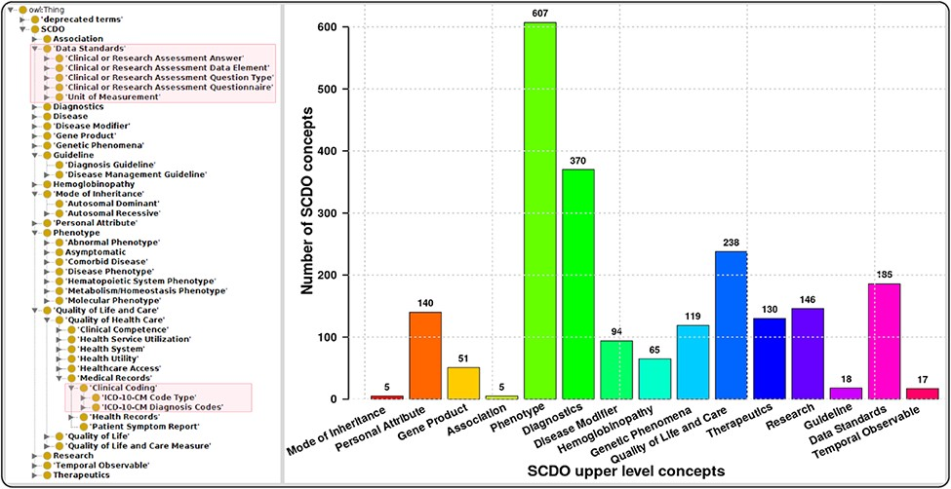
Figure 1. The SCDO tree view showing the hierarchical representation of knowledge on SCD with two main new concepts ...
Notes:
Figure 1. The SCDO tree view showing the hierarchical representation of knowledge on SCD with two main new concepts highlighted in the boxes on the left, and a bar graph showing the number of concepts under the different upper-level terms.
Unless provided in the caption above, the following copyright applies to the content of this slide: © The Author(s) 2022. Published by Oxford University Press.This is an Open Access article distributed under the terms of the Creative Commons Attribution License (https://creativecommons.org/licenses/by/4.0/), which permits unrestricted reuse, distribution, and reproduction in any medium, provided the original work is properly cited.

