Slide 1
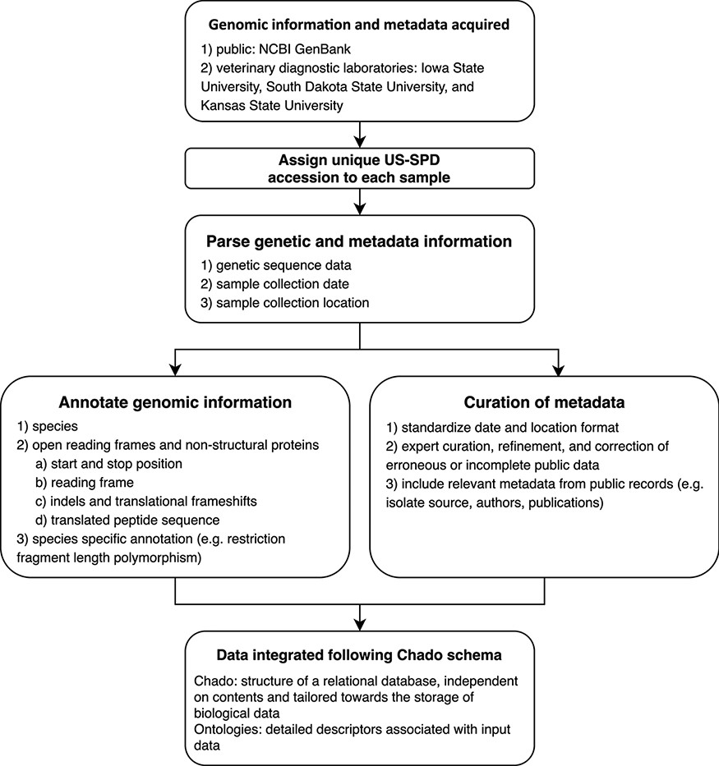
Figure 1. Conceptual model describing the automated pipeline implemented in the US Swine Pathogen Database that takes ...
Notes:
Figure 1. Conceptual model describing the automated pipeline implemented in the US Swine Pathogen Database that takes raw sequence data to fully anonymized and annotated virus sequence record in the relational database.
Unless provided in the caption above, the following copyright applies to the content of this slide: Published by Oxford University Press 2021. This work is written by (a) US Government employee(s) and is in the public domain in the US.This work is written by (a) US Government employee(s) and is in the public domain in the US.

