Slide 1
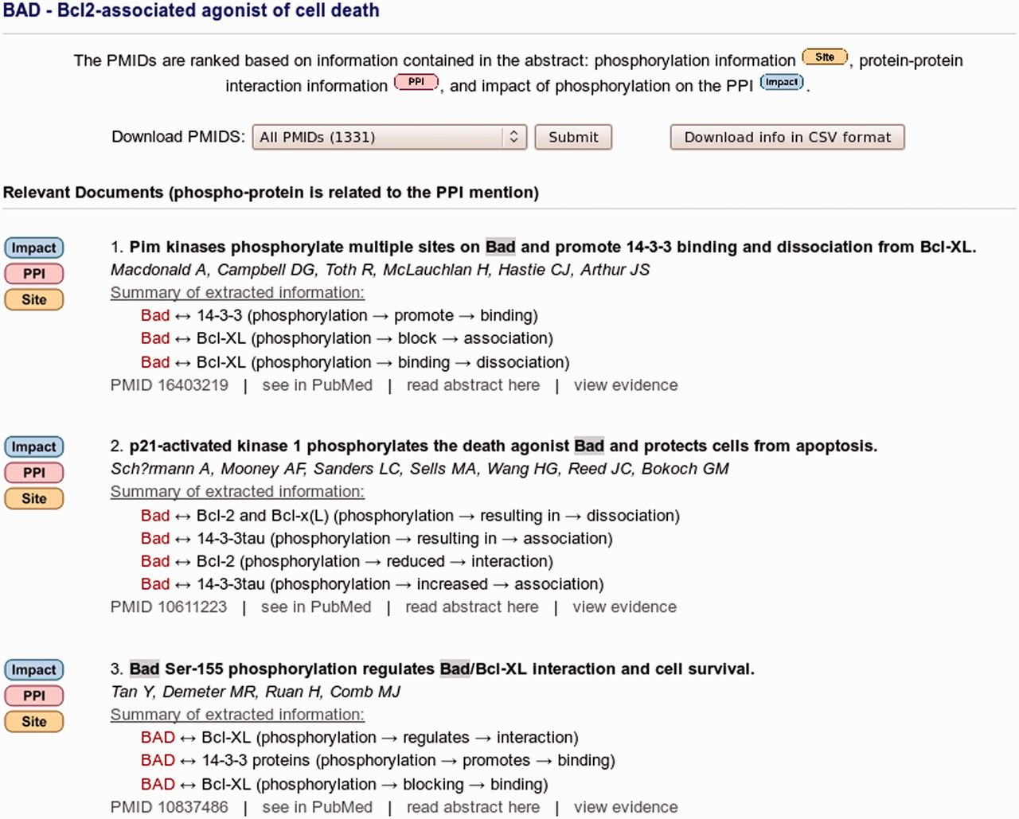
Figure 2 eFIP ranking and result summary of abstracts for protein BAD. A total of 1331 abstracts are linked to protein ...
Notes:
Figure 2 eFIP ranking and result summary of abstracts for protein BAD. A total of 1331 abstracts are linked to protein BAD as determined by eGRAB, among which 369 mention phosphorylation information (ranked and partially shown). The ‘Impact’, ‘PPI’ and ‘Site’ images on the left point to the type of information are found in the abstract. The title, authors and a summary of the interactions involving the phosphorylated forms of BAD are displayed. A spreadsheet summary file can be downloaded by clicking on the ‘Download info in CSV format’ button.
Unless provided in the caption above, the following copyright applies to the content of this slide: © The Author(s) 2012. Published by Oxford University Press.This is an Open Access article distributed under the terms of the Creative Commons Attribution License (http://creativecommons.org/licenses/by-nc/3.0/), which permits non-commercial reuse, distribution, and reproduction in any medium, provided the original work is properly cited. For commercial re-use, please contact journals.permissions@oup.com.

