Slide 1
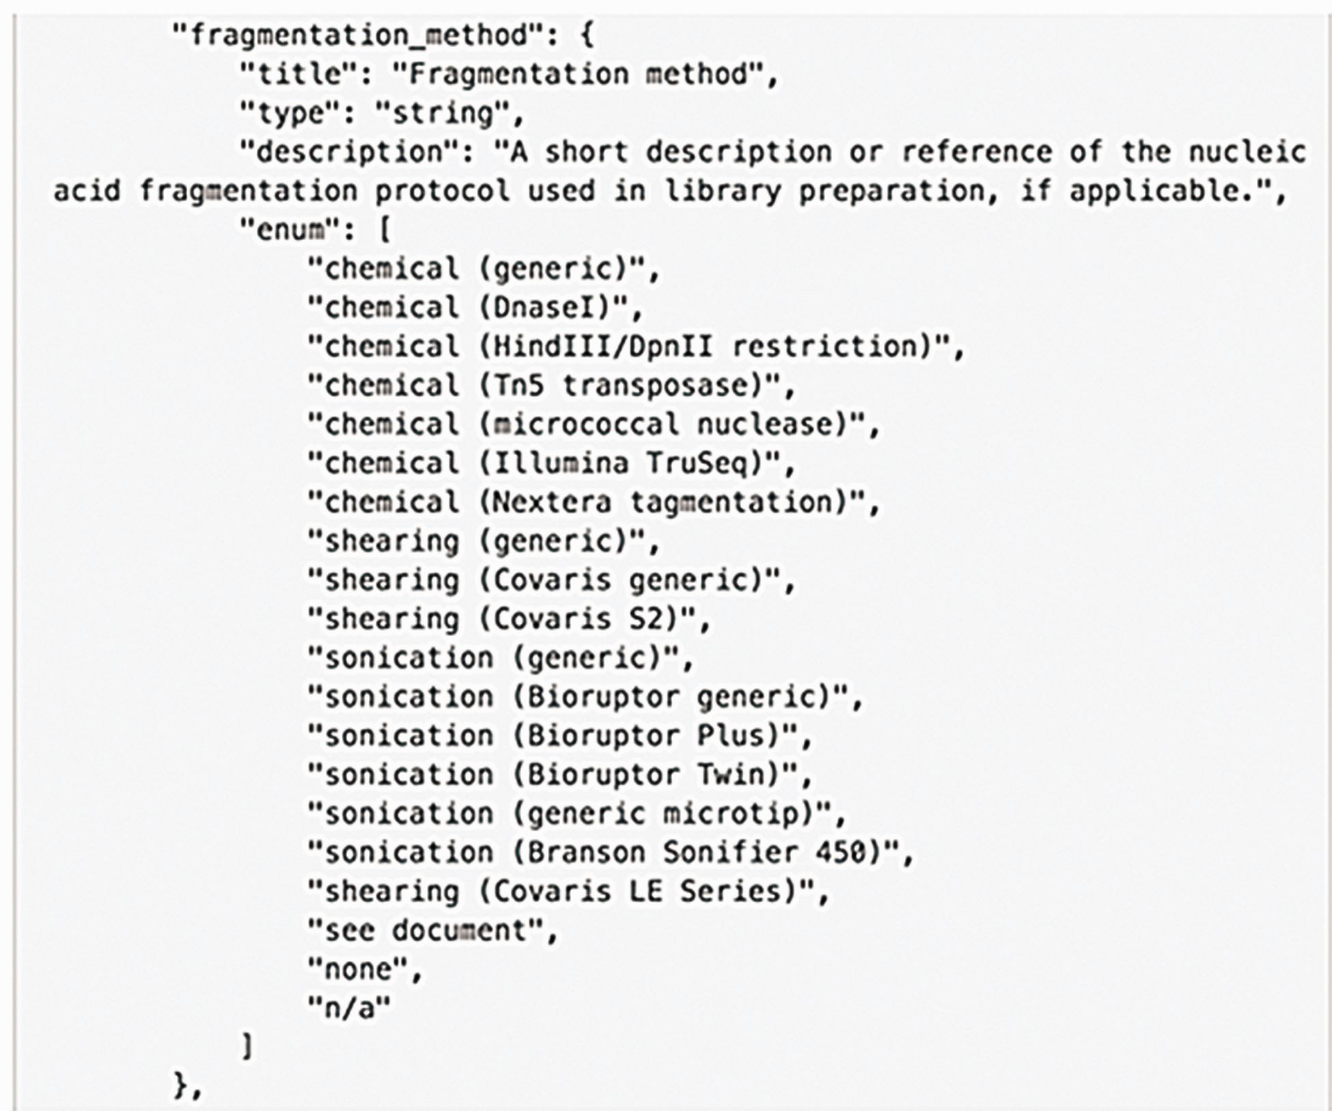
Figure 5 Example of an enumerated list in the schema. The metadata model is represented as a JSON object (this ...
Notes:
Figure 5 Example of an enumerated list in the schema. The metadata model is represented as a JSON object (this computational structure is the metadata data model) containing properties of specific metadata fields. An enumerated list is a list of allowed values for that property. It prevents typos or multiple spellings of a single item to maintain consistent data. Values added for this property are checked against the list when the data are added.
Unless provided in the caption above, the following copyright applies to the content of this slide: © The Author(s) 2016. Published by Oxford University Press. This is an Open Access article distributed under the terms of the Creative Commons Attribution License ( http://creativecommons.org/licenses/by/4.0/ ), which permits unrestricted reuse, distribution, and reproduction in any medium, provided the original work is properly cited.

