Slide 1
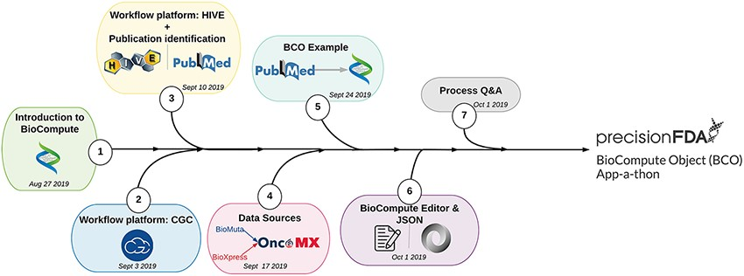
Figure 3. User BCO training process.
Notes:
Figure 3. User BCO training process. The BioCompute training unit (1) introduced participants to the concept of BioCompute, (2) offered hands-on exercises with two genome analysis platforms (HIVE and CGC), (3) familiarized participants with a prominent literature resource (PubMed), (4) introduced the concept of data sources [through the OncoMX knowledgebase (https://www.oncomx.org/)], (5) described the process of finding a suitable publication with an associated open source pipeline, (6) introduced the JSON language as a suitable segue into training users on the BCO Portal (previously BCO Editor) and (7) provided users with a Q&amp;A opportunity prior to final submission of BCOs to the precisionFDA BCO App-a-thon.
Unless provided in the caption above, the following copyright applies to the content of this slide: © Oxford University Press 2021.This is an Open Access article distributed under the terms of the Creative Commons Attribution License (http://creativecommons.org/licenses/by/4.0/), which permits unrestricted reuse, distribution, and reproduction in any medium, provided the original work is properly cited.

