Slide 1
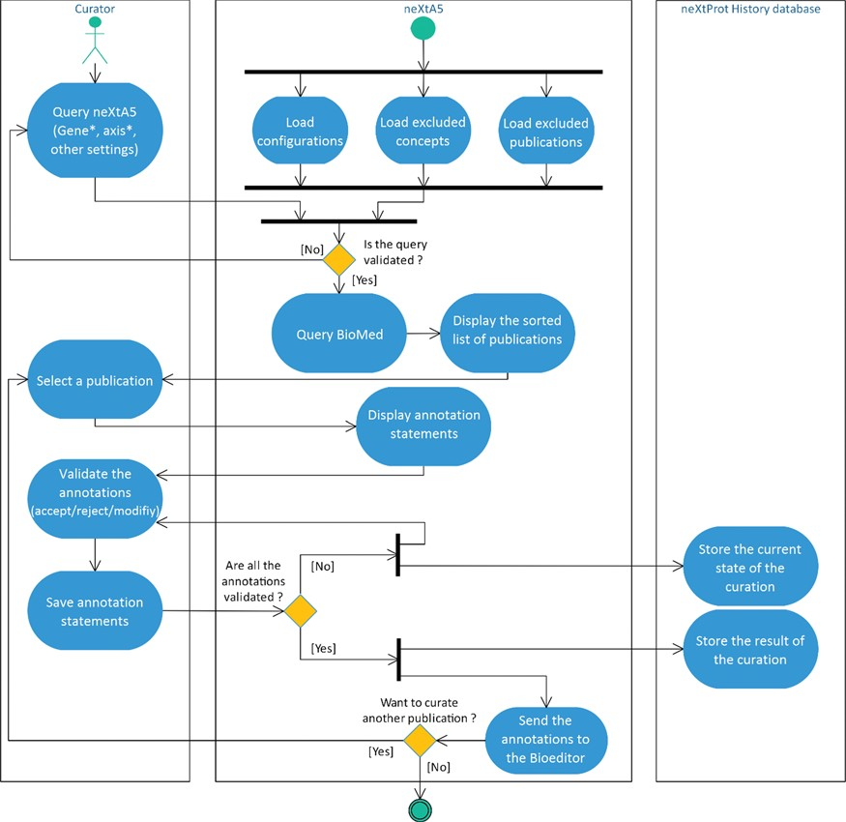
Figure 1 Activity diagram of the literature curation process using neXtA₅.
Notes:
Figure 1 Activity diagram of the literature curation process using neXtA5.
Unless provided in the caption above, the following copyright applies to the content of this slide: © The Author(s) 2018. Published by Oxford University Press.This is an Open Access article distributed under the terms of the Creative Commons Attribution License (http://creativecommons.org/licenses/by/4.0/), which permits unrestricted reuse, distribution, and reproduction in any medium, provided the original work is properly cited.

Slide 2
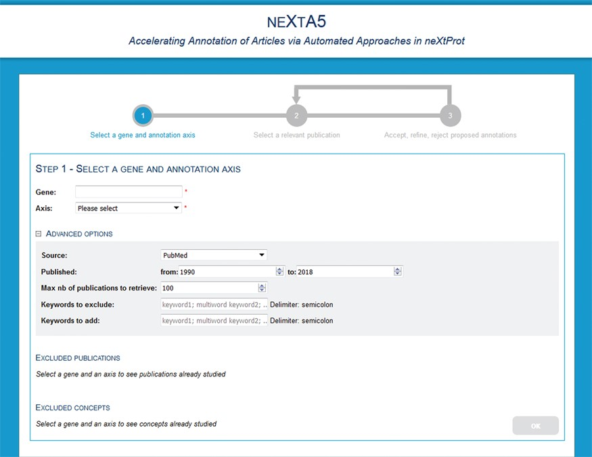
Figure 2 neXtA₅ user interface for query page.
Notes:
Figure 2 neXtA5 user interface for query page.
Unless provided in the caption above, the following copyright applies to the content of this slide: © The Author(s) 2018. Published by Oxford University Press.This is an Open Access article distributed under the terms of the Creative Commons Attribution License (http://creativecommons.org/licenses/by/4.0/), which permits unrestricted reuse, distribution, and reproduction in any medium, provided the original work is properly cited.

Slide 3
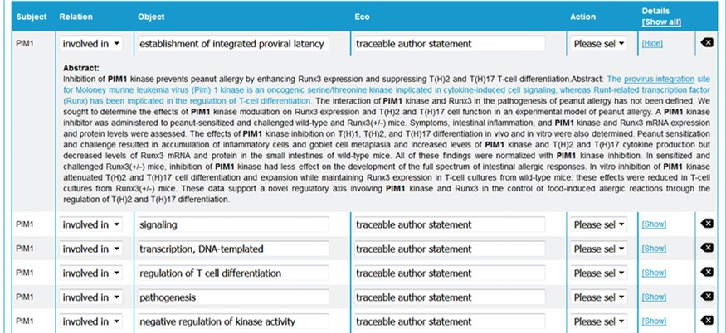
Figure 3 neXtA₅ user interface for curation. From the abstract of an article, neXtA₅ extracts ...
Notes:
Figure 3 neXtA5 user interface for curation. From the abstract of an article, neXtA5 extracts relevant concepts and displays a list of potential annotations. Here, the annotations related to PIM1 for the BPs and extracted from the abstract of (32) are shown.
Unless provided in the caption above, the following copyright applies to the content of this slide: © The Author(s) 2018. Published by Oxford University Press.This is an Open Access article distributed under the terms of the Creative Commons Attribution License (http://creativecommons.org/licenses/by/4.0/), which permits unrestricted reuse, distribution, and reproduction in any medium, provided the original work is properly cited.

Slide 4
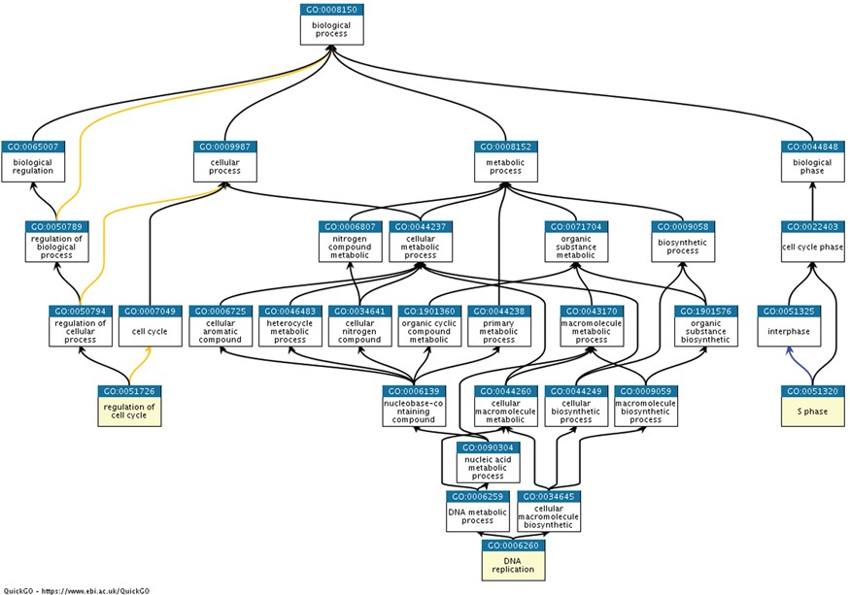
Figure 4 Ancestor charts of the GO terms from semantic classification 2, shown in Table 2 [S phase (GO:0051320), DNA ...
Notes:
Figure 4 Ancestor charts of the GO terms from semantic classification 2, shown in Table 2 [S phase (GO:0051320), DNA replication (GO:0006260) and regulation of cell cycle (GO:0051726)], using https://www.ebi.ac.uk/QuickGO/.
Unless provided in the caption above, the following copyright applies to the content of this slide: © The Author(s) 2018. Published by Oxford University Press.This is an Open Access article distributed under the terms of the Creative Commons Attribution License (http://creativecommons.org/licenses/by/4.0/), which permits unrestricted reuse, distribution, and reproduction in any medium, provided the original work is properly cited.

Slide 5
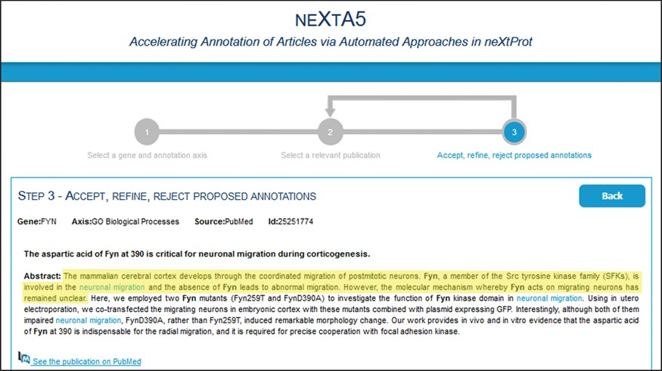
Figure 5 neXtA₅ user interface for curation. One of the guidelines for the curators to select relevant ...
Notes:
Figure 5 neXtA5 user interface for curation. One of the guidelines for the curators to select relevant documents was to not consider statements from titles and from the introductory part of the abstract. Here, the introduction of the abstract of (37) related to FYN function (BP axis) is highlighted in yellow.
Unless provided in the caption above, the following copyright applies to the content of this slide: © The Author(s) 2018. Published by Oxford University Press.This is an Open Access article distributed under the terms of the Creative Commons Attribution License (http://creativecommons.org/licenses/by/4.0/), which permits unrestricted reuse, distribution, and reproduction in any medium, provided the original work is properly cited.

Slide 6
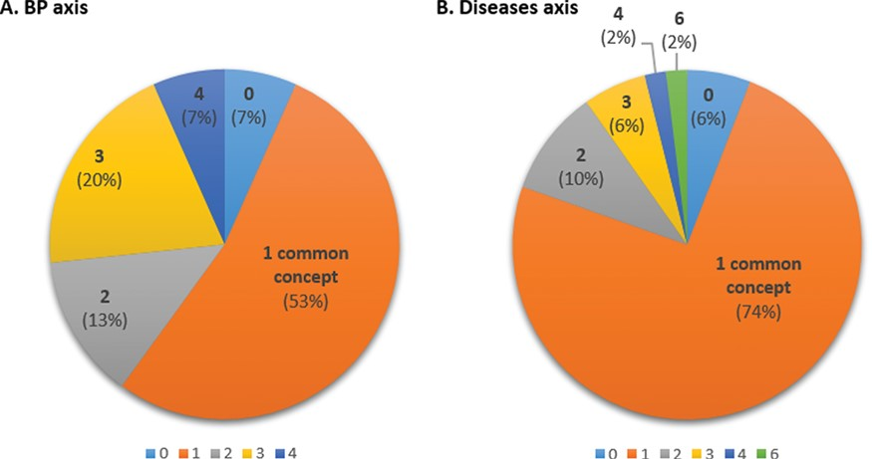
Figure 6 Inter-curator agreement with respect to concepts in BP (A) and D (B) axes showing the proportion of common ...
Notes:
Figure 6 Inter-curator agreement with respect to concepts in BP (A) and D (B) axes showing the proportion of common concepts found by both curators. The number indicated is the number of common concepts identified by both curators (0–4 for BP; 0–6 for Ds).
Unless provided in the caption above, the following copyright applies to the content of this slide: © The Author(s) 2018. Published by Oxford University Press.This is an Open Access article distributed under the terms of the Creative Commons Attribution License (http://creativecommons.org/licenses/by/4.0/), which permits unrestricted reuse, distribution, and reproduction in any medium, provided the original work is properly cited.

