Slide 1
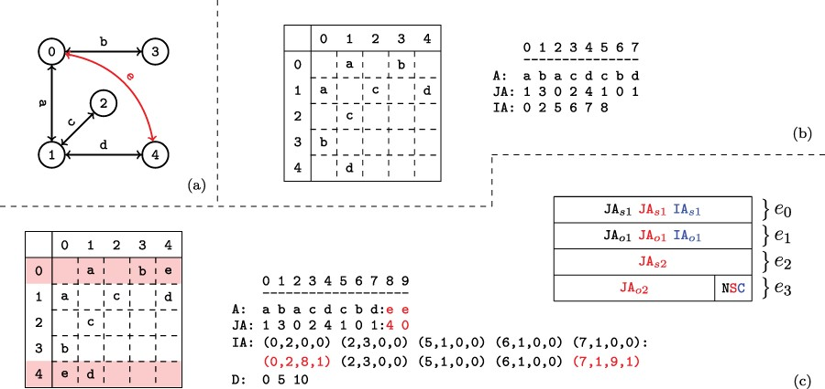
Fig. 2 Versioned compressed sparse row (CSR) format. (a) A sample two version network in which the first version ...
Notes:
Fig. 2 Versioned compressed sparse row (CSR) format. (a) A sample two version network in which the first version consists of the black edges and the second version includes an additional edge shown in red. (b) The adjacency matrix and three arrays used to represent the first version of the network. (c) The adjacency matrix and arrays used to store both versions of the network in the proposed data structure and the memory layout for the elements of the augmented $\textit{IA}$ array. For the adjacency matrix, the colons denote where the second version’s data has been appended. For the memory layout, each $\textit{IA}$ element is comprised of four segments $(e_{0..3})$. Note that the type flags $(e_4)$ are stored in the least significant bits of $e_3$. The subscripts $o$ and $s$ refer to a starting index and length respectively in the $A$ and $\textit{JA}$ arrays. The last bits of $e_3$ are used to store a set of flags denoting the row status: normal, split or compressed. These are used to describe how the rest of the entries in $\textit{IA}$ should be interpreted. The meaning of each $(e_{0..3})$ value is color coded based on the flag. Note that only one interpretation is active for each entry of $\textit{IA}$ at a time.
Unless provided in the caption above, the following copyright applies to the content of this slide: © The Author(s) 2020. Published by Oxford University Press.This is an Open Access article distributed under the terms of the Creative Commons Attribution License (http://creativecommons.org/licenses/by/4.0/), which permits unrestricted reuse, distribution, and reproduction in any medium, provided the original work is properly cited.

