Slide 1
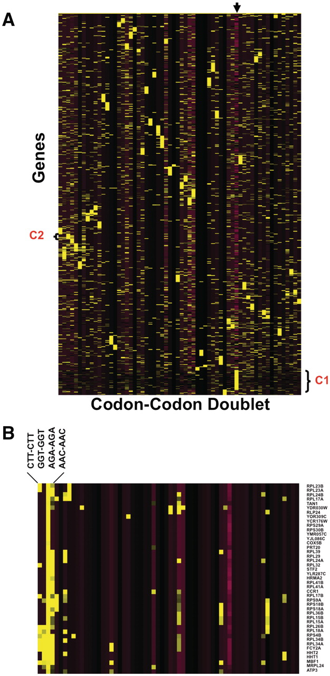
Figure 4 Heat Map identifies groups of genes over-represented with specific codon–codon doublets. Z-scores, describing ...
Notes:
Figure 4 Heat Map identifies groups of genes over-represented with specific codon–codon doublets. Z-scores, describing whether a gene is over- or under-represented with a codon doublet of identical codons, were hierarchically clustered using CLUSTER software. 5780 gene sequences were filtered to remove any gene sequences that did not register at least one Z-score >2 or <−2, leaving 4561 genes for clustering. The clustered data was visualized using TREEVIEW, with yellow and purple boxes depicting over-represented and under-represented doublets, respectively. The genes are organized vertically based on their similarity to each other across all codon–codon doublets, as defined by the clustering algorithm. Similarly, the codon–codon doublets are organized horizontally based on similarity to each other, as defined by the clustering algorithm. (A): The arrow marks the column containing the gene length Z-score, with yellow and purple boxes representing genes larger or smaller than the genome average, respectively. The average genome size is 1401 base pairs with a standard deviation of 1122 base pairs. We have also denoted cluster I (C1), specific to larger than average genes and B) blown up cluster II (C2) for viewing (B).
Unless provided in the caption above, the following copyright applies to the content of this slide: © The Author(s) 2012. Published by Oxford University Press.This is an Open Access article distributed under the terms of the Creative Commons Attribution Non-Commercial License (http://creativecommons.org/licenses/by-nc/3.0), which permits unrestricted non-commercial use, distribution, and reproduction in any medium, provided the original work is properly cited.

