Slide 1
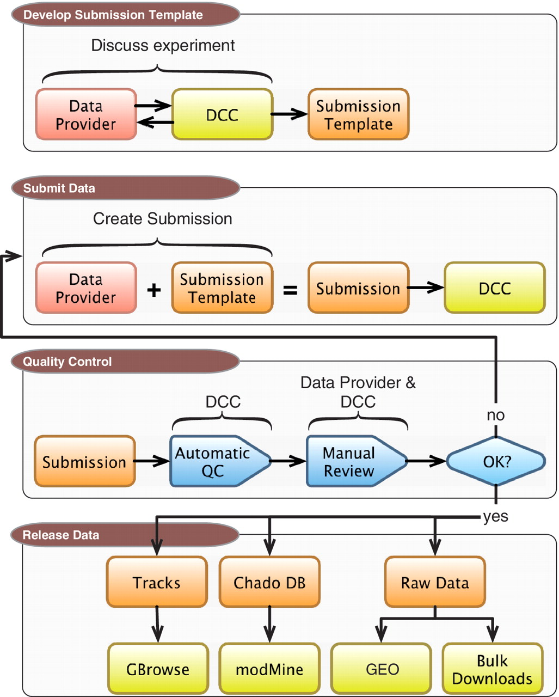
Figure 1. DCC workflow. Submitting data to the modENCODE DCC can be divided into four parts. It begins with discussions ...
Notes:
Figure 1. DCC workflow. Submitting data to the modENCODE DCC can be divided into four parts. It begins with discussions between a data provider and a DCC curator to determine the required metadata and data formats for a given category of submission. Once the submission template is made, the data provider can prepare and submit a data set to the DCC. The data set undergoes a series of automated and manual QC checks. If the submission does not pass these steps, it is returned to the data provider and/or the DCC curator for modification. Once a submission satisfies all requirements, and is approved by the DCC and data submitter, it is distributed to the community through the GBrowse genome browser, modMine query interface, graphical submission filtering tool and the public repositories of FB, WB and GEO.
Unless provided in the caption above, the following copyright applies to the content of this slide: © The Author(s) 2011. Published by Oxford University Press.This is Open Access article distributed under the terms of the Creative Commons Attribution Non-Commercial License (http://creativecommons.org/licenses/by-nc/2.5), which permits unrestricted non-commercial use, distribution, and reproduction in any medium, provided the original work is properly cited.

