Slide 1
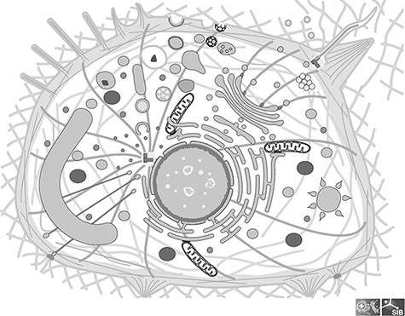
Figure 1. Image of a generic cell from the Clade Eumetazoa; This cell illustrates all the cellular components found in ...
Notes:
Figure 1. Image of a generic cell from the Clade Eumetazoa; This cell illustrates all the cellular components found in any Eumetazoan, although in reality no cell carries all of them; All components are individual groups in the SVG file, which can be hidden or colored.
Unless provided in the caption above, the following copyright applies to the content of this slide: © The Author(s) 2022. Published by Oxford University Press.This is an Open Access article distributed under the terms of the Creative Commons Attribution License (https://creativecommons.org/licenses/by/4.0/), which permits unrestricted reuse, distribution, and reproduction in any medium, provided the original work is properly cited.

