Slide 1
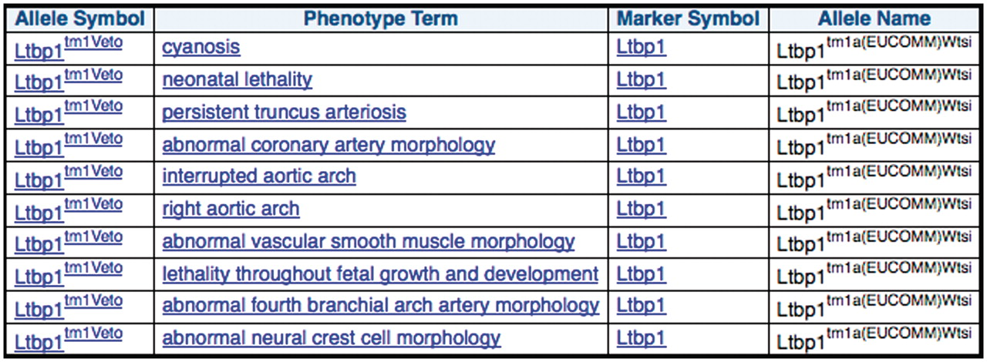
Figure 5. MGI curated phenotype data for other mutant alleles of the same gene for each of the mouse lines produced ...
Notes:
Figure 5. MGI curated phenotype data for other mutant alleles of the same gene for each of the mouse lines produced from EUCOMM ES cell resources.
Unless provided in the caption above, the following copyright applies to the content of this slide: © The Author(s) 2011. Published by Oxford University Press.This is Open Access article distributed under the terms of the Creative Commons Attribution Non-Commercial License (http://creativecommons.org/licenses/by-nc/2.5), which permits unrestricted non-commercial use, distribution, and reproduction in any medium, provided the original work is properly cited.

Slide 2
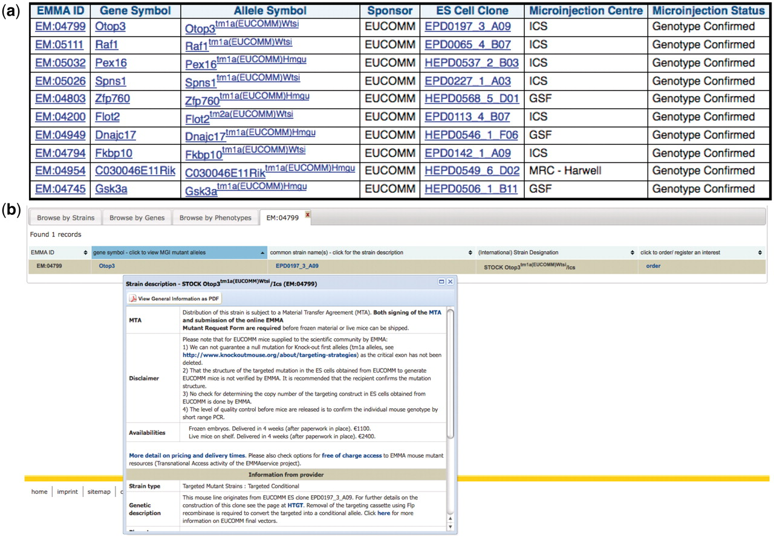
Figure 4. Distributed EMMA lines that have passed Southern blot quality control at a distribution center: (a) results ...
Notes:
Figure 4. Distributed EMMA lines that have passed Southern blot quality control at a distribution center: (a) results of a query involving the dataset from the mouse distribution dataset at the European Mouse Mutant Archive (EMMA) and the IKMC mouse production dataset, (b) further detail of one of the mouse lines at the main EMMA website after linking from one of the above results.
Unless provided in the caption above, the following copyright applies to the content of this slide: © The Author(s) 2011. Published by Oxford University Press.This is Open Access article distributed under the terms of the Creative Commons Attribution Non-Commercial License (http://creativecommons.org/licenses/by-nc/2.5), which permits unrestricted non-commercial use, distribution, and reproduction in any medium, provided the original work is properly cited.

Slide 3
Figure 3. IKMC mice available from the EMMA Repository and details of the vector used to make the knockout. This query ...
Notes:
Figure 3. IKMC mice available from the EMMA Repository and details of the vector used to make the knockout. This query involves the IKMC mouse production and IKMC targeted products dataset.
Unless provided in the caption above, the following copyright applies to the content of this slide: © The Author(s) 2011. Published by Oxford University Press.This is Open Access article distributed under the terms of the Creative Commons Attribution Non-Commercial License (http://creativecommons.org/licenses/by-nc/2.5), which permits unrestricted non-commercial use, distribution, and reproduction in any medium, provided the original work is properly cited.

Slide 4
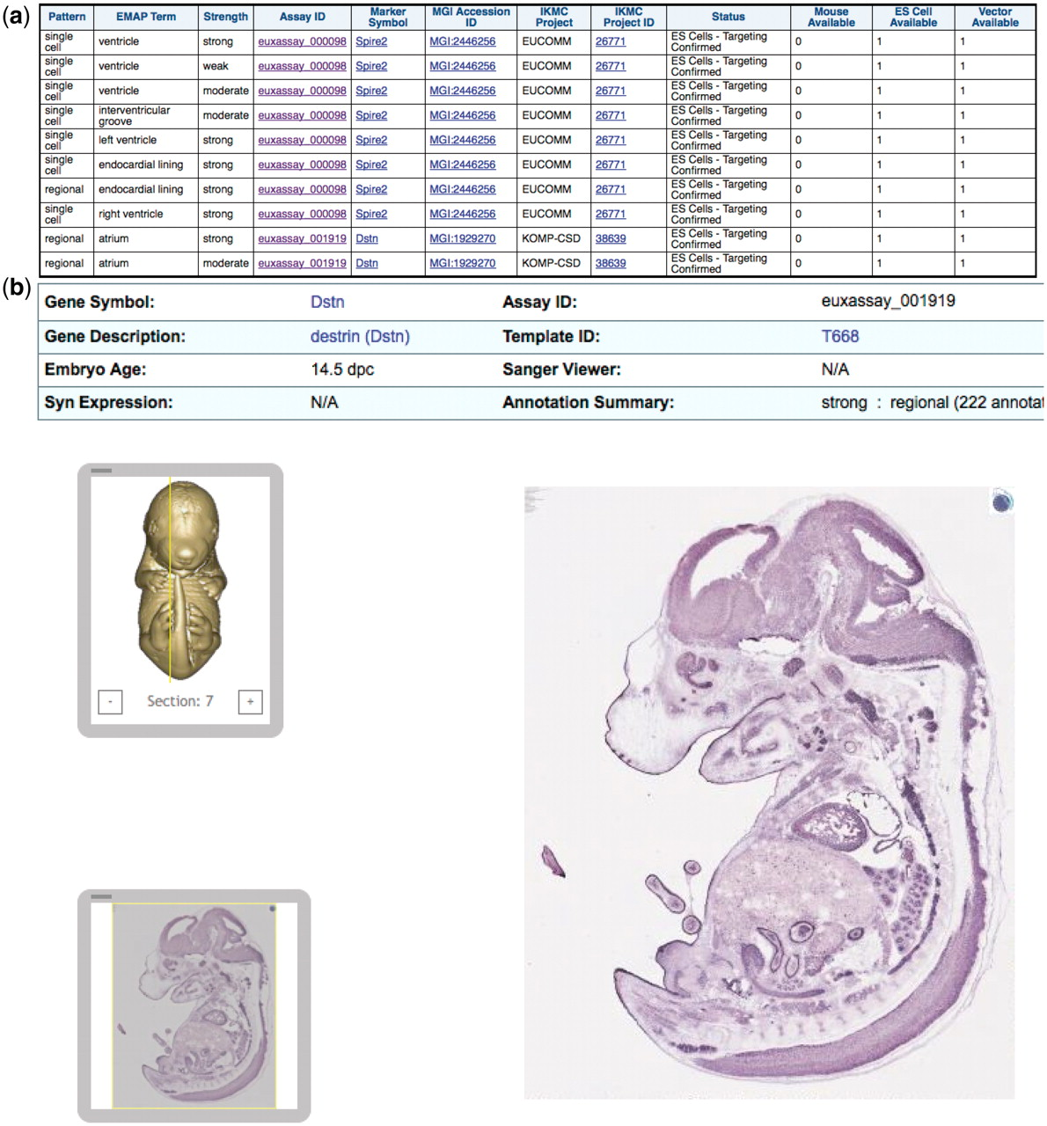
Figure 2. IKMC resources for genes expressed in embryonic heart or sub-structures according to the Eurexpress in situ ...
Notes:
Figure 2. IKMC resources for genes expressed in embryonic heart or sub-structures according to the Eurexpress in situ expression database: (a) results of a query involving the in situ expression dataset from Eurexpress and the IKMC projects/alleles dataset, (b) further detail of the expression patterns at the main Eurexpress website after linking from one of the Assay ID results above.
Unless provided in the caption above, the following copyright applies to the content of this slide: © The Author(s) 2011. Published by Oxford University Press.This is Open Access article distributed under the terms of the Creative Commons Attribution Non-Commercial License (http://creativecommons.org/licenses/by-nc/2.5), which permits unrestricted non-commercial use, distribution, and reproduction in any medium, provided the original work is properly cited.

Slide 5
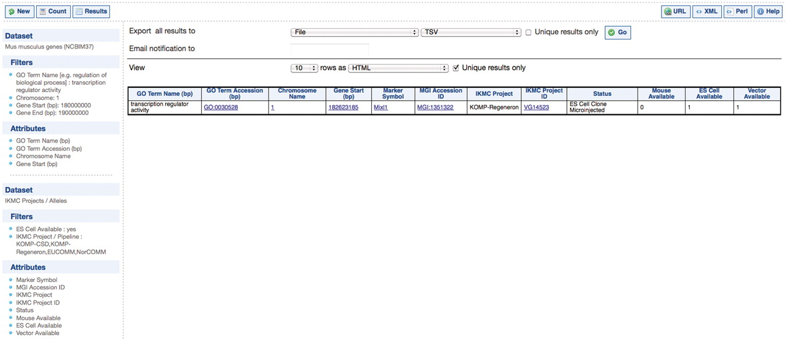
Figure 1. IKMC resources for genes encoding transcription factors on Chromosome 1 between 180 and 190 Mbp. This query ...
Notes:
Figure 1. IKMC resources for genes encoding transcription factors on Chromosome 1 between 180 and 190 Mbp. This query involves the Mus musculus genes dataset from Ensembl and the IKMC projects/alleles dataset.
Unless provided in the caption above, the following copyright applies to the content of this slide: © The Author(s) 2011. Published by Oxford University Press.This is Open Access article distributed under the terms of the Creative Commons Attribution Non-Commercial License (http://creativecommons.org/licenses/by-nc/2.5), which permits unrestricted non-commercial use, distribution, and reproduction in any medium, provided the original work is properly cited.

