Slide 1
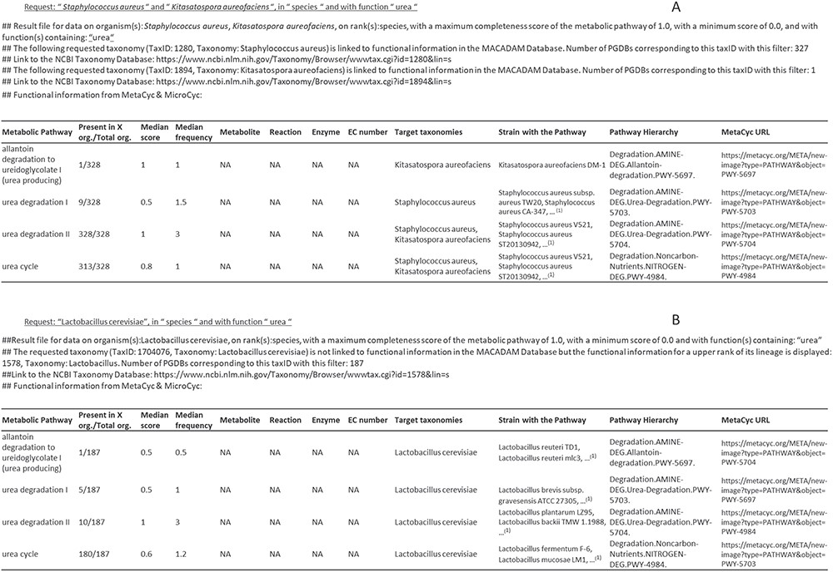
Figure 6 Examples of output files corresponding to requests on MACADAM. (A) The user has searched for all metabolic ...
Notes:
Figure 6 Examples of output files corresponding to requests on MACADAM. (A) The user has searched for all metabolic pathways in S. aureus and K. aureofaciens, using the term ‘urea’ in the function field text. (B) The user has searched for all metabolic pathways in Lactobacillus cerevisiae using the term ‘urea’ in the function field text. Since there is no data on this organism in MACADAM, the information was searched for higher up in the taxonomy hierarchy, i.e. Lactobacillus. (1)List of organisms in MACADAM with the targeted metabolic pathway.
Unless provided in the caption above, the following copyright applies to the content of this slide: © The Author(s) 2019. Published by Oxford University Press.This is an Open Access article distributed under the terms of the Creative Commons Attribution License (http://creativecommons.org/licenses/by/4.0/), which permits unrestricted reuse, distribution, and reproduction in any medium, provided the original work is properly cited.

