Slide 1
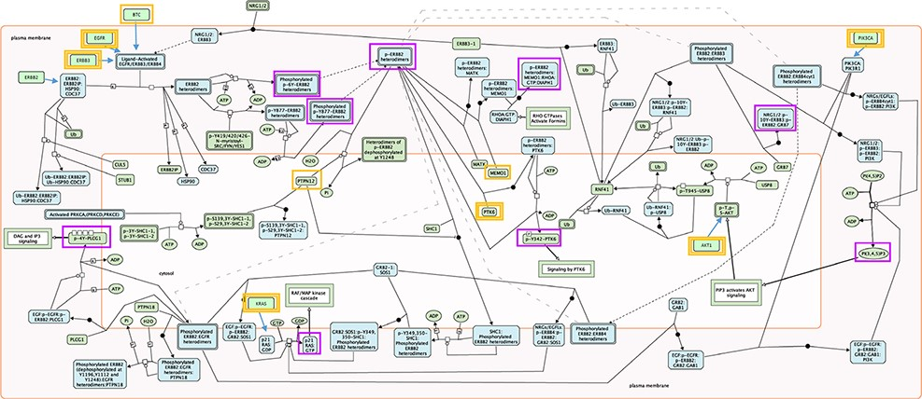
Figure 1. Root inputs and key outputs selected for Reactome pathway ‘Signaling by ERBB2’. Root inputs are circled ...
Notes:
Figure 1. Root inputs and key outputs selected for Reactome pathway ‘Signaling by ERBB2’. Root inputs are circled orange, with double border if they are in Cancer Gene Census list. Key outputs are circled purple. If root inputs are not directly shown in the diagram they have been redrawn and connected with the root complex/set.
Unless provided in the caption above, the following copyright applies to the content of this slide: © The Author(s) 2022. Published by Oxford University Press.This is an Open Access article distributed under the terms of the Creative Commons Attribution License (https://creativecommons.org/licenses/by/4.0/), which permits unrestricted reuse, distribution, and reproduction in any medium, provided the original work is properly cited.

