Slide 1
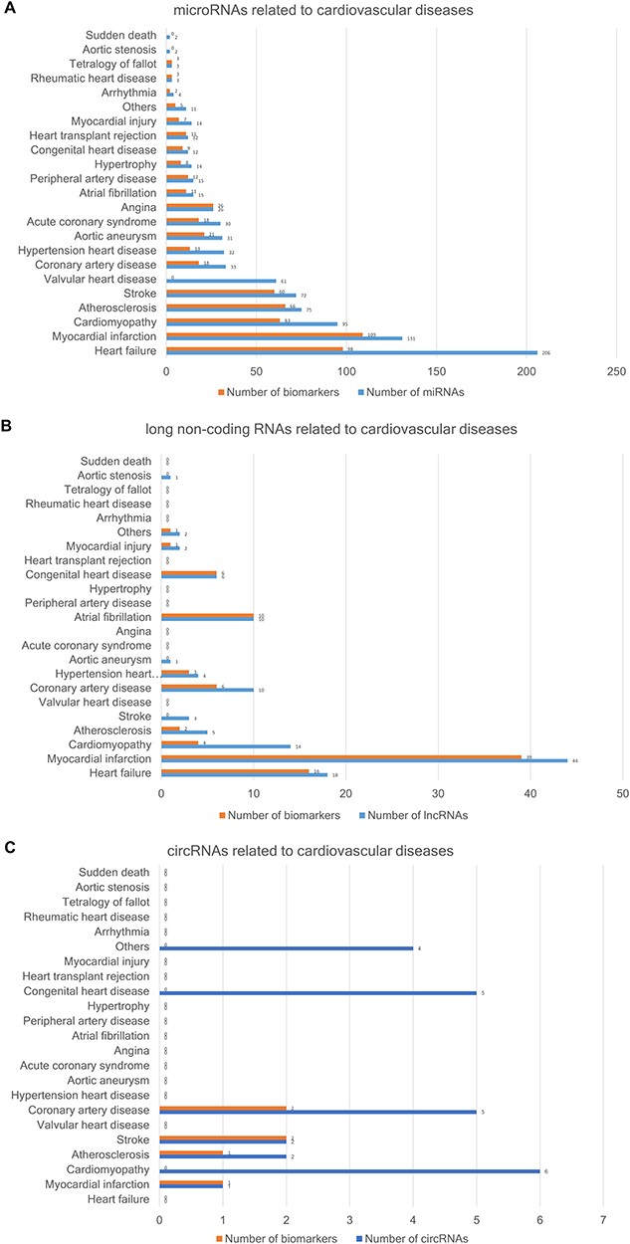
Figure 3 The number of ncRNAs related to CVDs. (A) The number of miRNAs. (B) The number of lncRNAs. (C) The number of ...
Notes:
Figure 3 The number of ncRNAs related to CVDs. (A) The number of miRNAs. (B) The number of lncRNAs. (C) The number of circRNAs.
Unless provided in the caption above, the following copyright applies to the content of this slide: © The Author(s) 2020. Published by Oxford University Press.This is an Open Access article distributed under the terms of the Creative Commons Attribution License (http://creativecommons.org/licenses/by/4.0/), which permits unrestricted reuse, distribution, and reproduction in any medium, provided the original work is properly cited.

Slide 2
Figure 2 The implementation and overview of the CVDncR database.
Notes:
Figure 2 The implementation and overview of the CVDncR database.
Unless provided in the caption above, the following copyright applies to the content of this slide: © The Author(s) 2020. Published by Oxford University Press.This is an Open Access article distributed under the terms of the Creative Commons Attribution License (http://creativecommons.org/licenses/by/4.0/), which permits unrestricted reuse, distribution, and reproduction in any medium, provided the original work is properly cited.

Slide 3
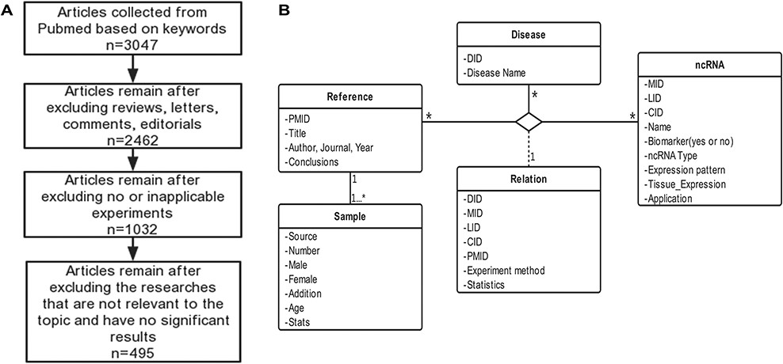
Figure 1 Schematic workflow of CVDncR. (A) The workflow of data filtering. (B) The E-R model of the CVDncR database.
Notes:
Figure 1 Schematic workflow of CVDncR. (A) The workflow of data filtering. (B) The E-R model of the CVDncR database.
Unless provided in the caption above, the following copyright applies to the content of this slide: © The Author(s) 2020. Published by Oxford University Press.This is an Open Access article distributed under the terms of the Creative Commons Attribution License (http://creativecommons.org/licenses/by/4.0/), which permits unrestricted reuse, distribution, and reproduction in any medium, provided the original work is properly cited.

Slide 4
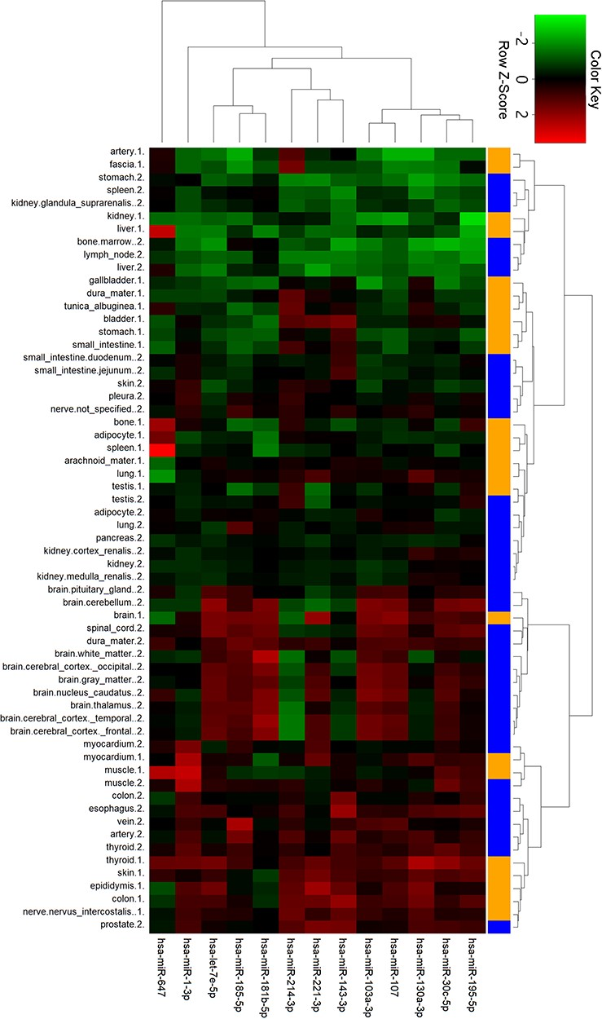
Figure 6 Cluster analysis of miRNA tissue expression profiles in ternary network. The orange and blue codes on the ...
Notes:
Figure 6 Cluster analysis of miRNA tissue expression profiles in ternary network. The orange and blue codes on the right side represent the tissue samples from two male bodies, i.e., a patient with myeloma and a male under a natural death.
Unless provided in the caption above, the following copyright applies to the content of this slide: © The Author(s) 2020. Published by Oxford University Press.This is an Open Access article distributed under the terms of the Creative Commons Attribution License (http://creativecommons.org/licenses/by/4.0/), which permits unrestricted reuse, distribution, and reproduction in any medium, provided the original work is properly cited.

Slide 5
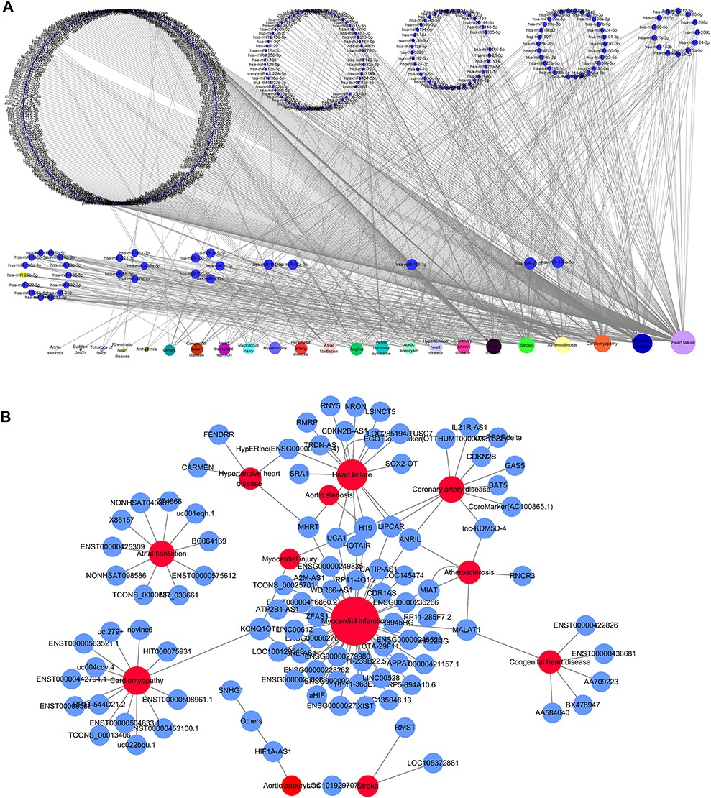
Figure 4 Network distribution of ncRNAs related to CVDs. (A) Overview of the miRNA–CVD network; the bottom row shows ...
Notes:
Figure 4 Network distribution of ncRNAs related to CVDs. (A) Overview of the miRNA–CVD network; the bottom row shows the diseases, and the size of the circles is proportional to the number of associated miRNAs. (B) Overview of the lncRNA–CVD network; red circles represent diseases, blue circles are lncRNAs and the size of the circles is proportional to the number of associated lncRNAs.
Unless provided in the caption above, the following copyright applies to the content of this slide: © The Author(s) 2020. Published by Oxford University Press.This is an Open Access article distributed under the terms of the Creative Commons Attribution License (http://creativecommons.org/licenses/by/4.0/), which permits unrestricted reuse, distribution, and reproduction in any medium, provided the original work is properly cited.

Slide 6
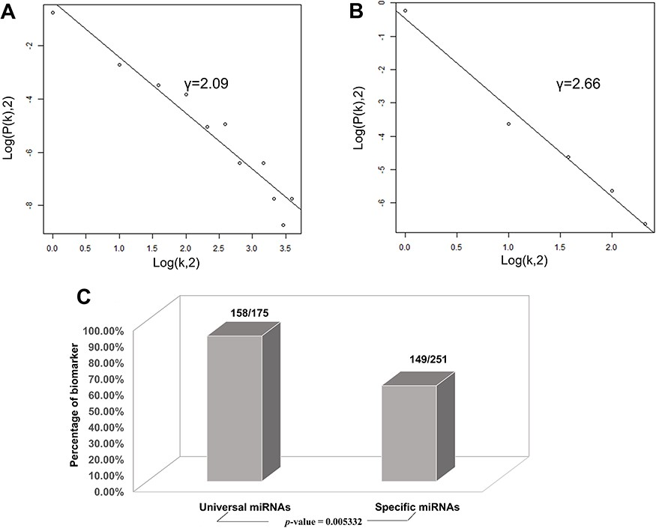
Figure 5 Correlations and distribution of miRNAs and lncRNAs related to CVDs. The x-coordinate K is the number of ...
Notes:
Figure 5 Correlations and distribution of miRNAs and lncRNAs related to CVDs. The x-coordinate K is the number of related CVDs, and the y-coordinate is the proportion of ncRNAs (miRNAs or lncRNAs). (A) Scale-free feature of lncRNAs related to CVDs. (B) Scale-free feature of lncRNAs related to CVDs. (C) Percentage of biomarkers in universal miRNAs and specific miRNAs.
Unless provided in the caption above, the following copyright applies to the content of this slide: © The Author(s) 2020. Published by Oxford University Press.This is an Open Access article distributed under the terms of the Creative Commons Attribution License (http://creativecommons.org/licenses/by/4.0/), which permits unrestricted reuse, distribution, and reproduction in any medium, provided the original work is properly cited.

