Slide 1
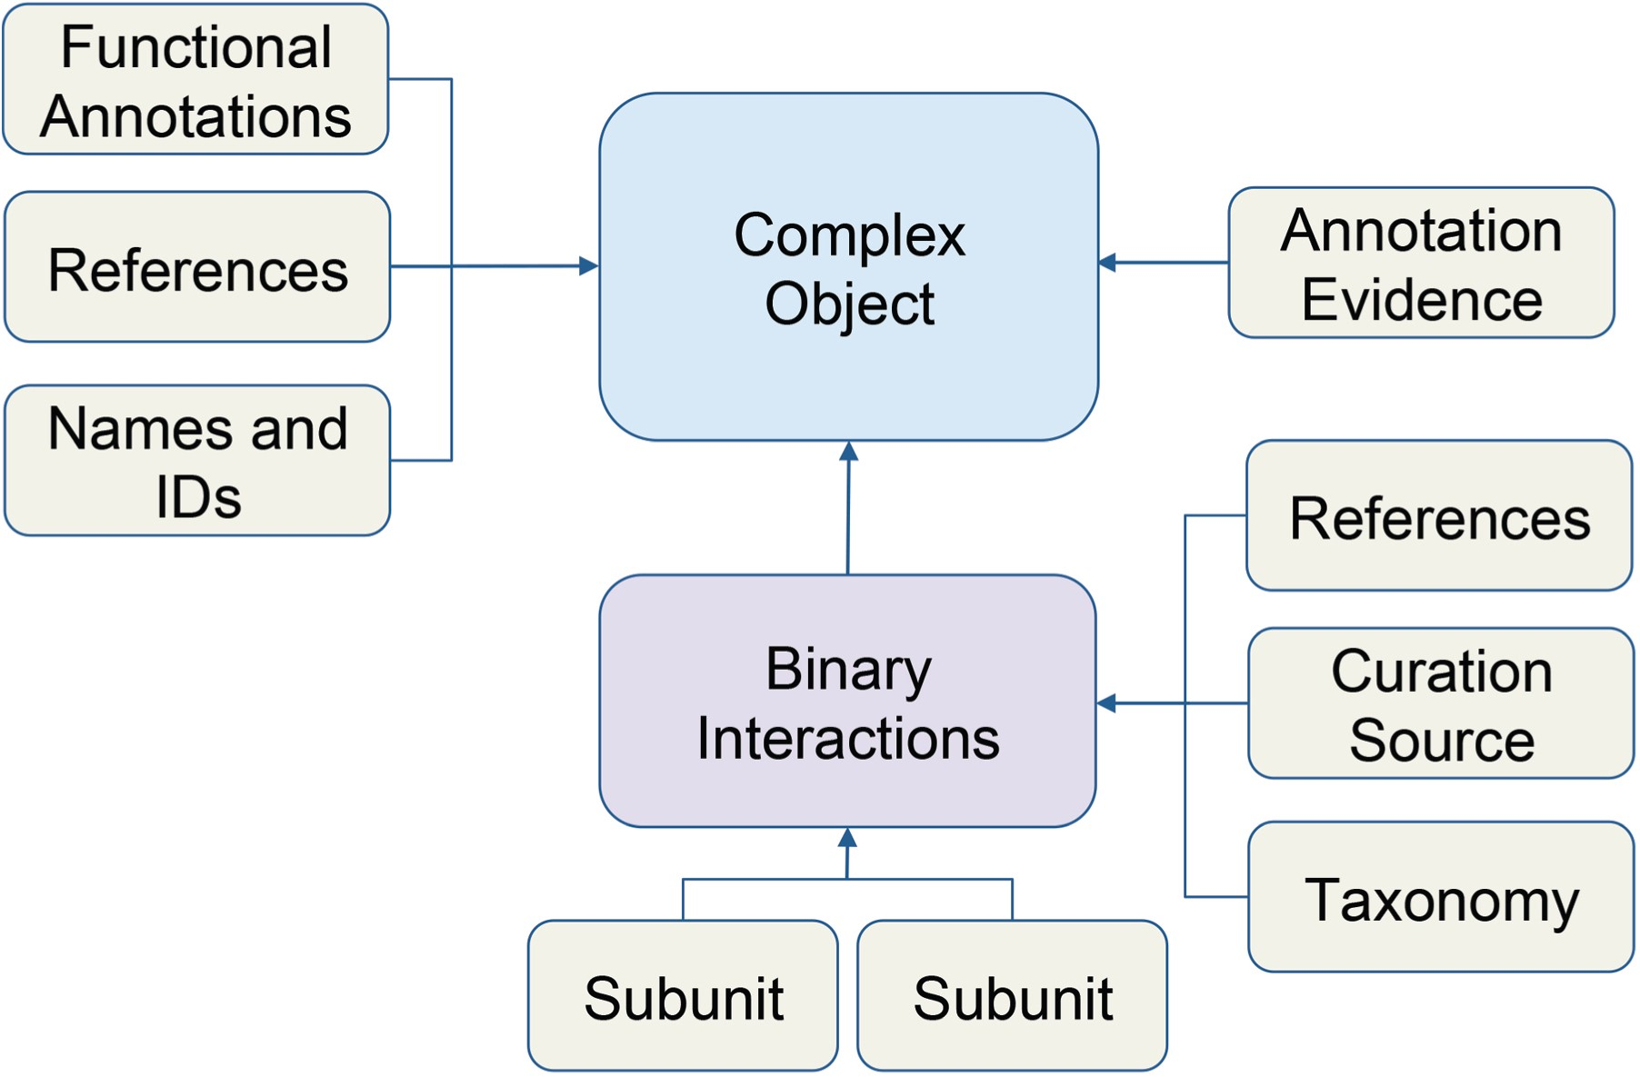
Figure 1 Schematic of macromolecular complex data object. Data for macromolecular complexes were expertly collected ...
Notes:
Figure 1 Schematic of macromolecular complex data object. Data for macromolecular complexes were expertly collected and curated from published literature. Each box represents a data type stored in the database. Arrows indicate how data is related to the complex object.
Unless provided in the caption above, the following copyright applies to the content of this slide: © The Author(s) 2019. Published by Oxford University Press.This is an Open Access article distributed under the terms of the Creative Commons Attribution License (http://creativecommons.org/licenses/by/4.0/), which permits unrestricted reuse, distribution, and reproduction in any medium, provided the original work is properly cited.

Slide 2
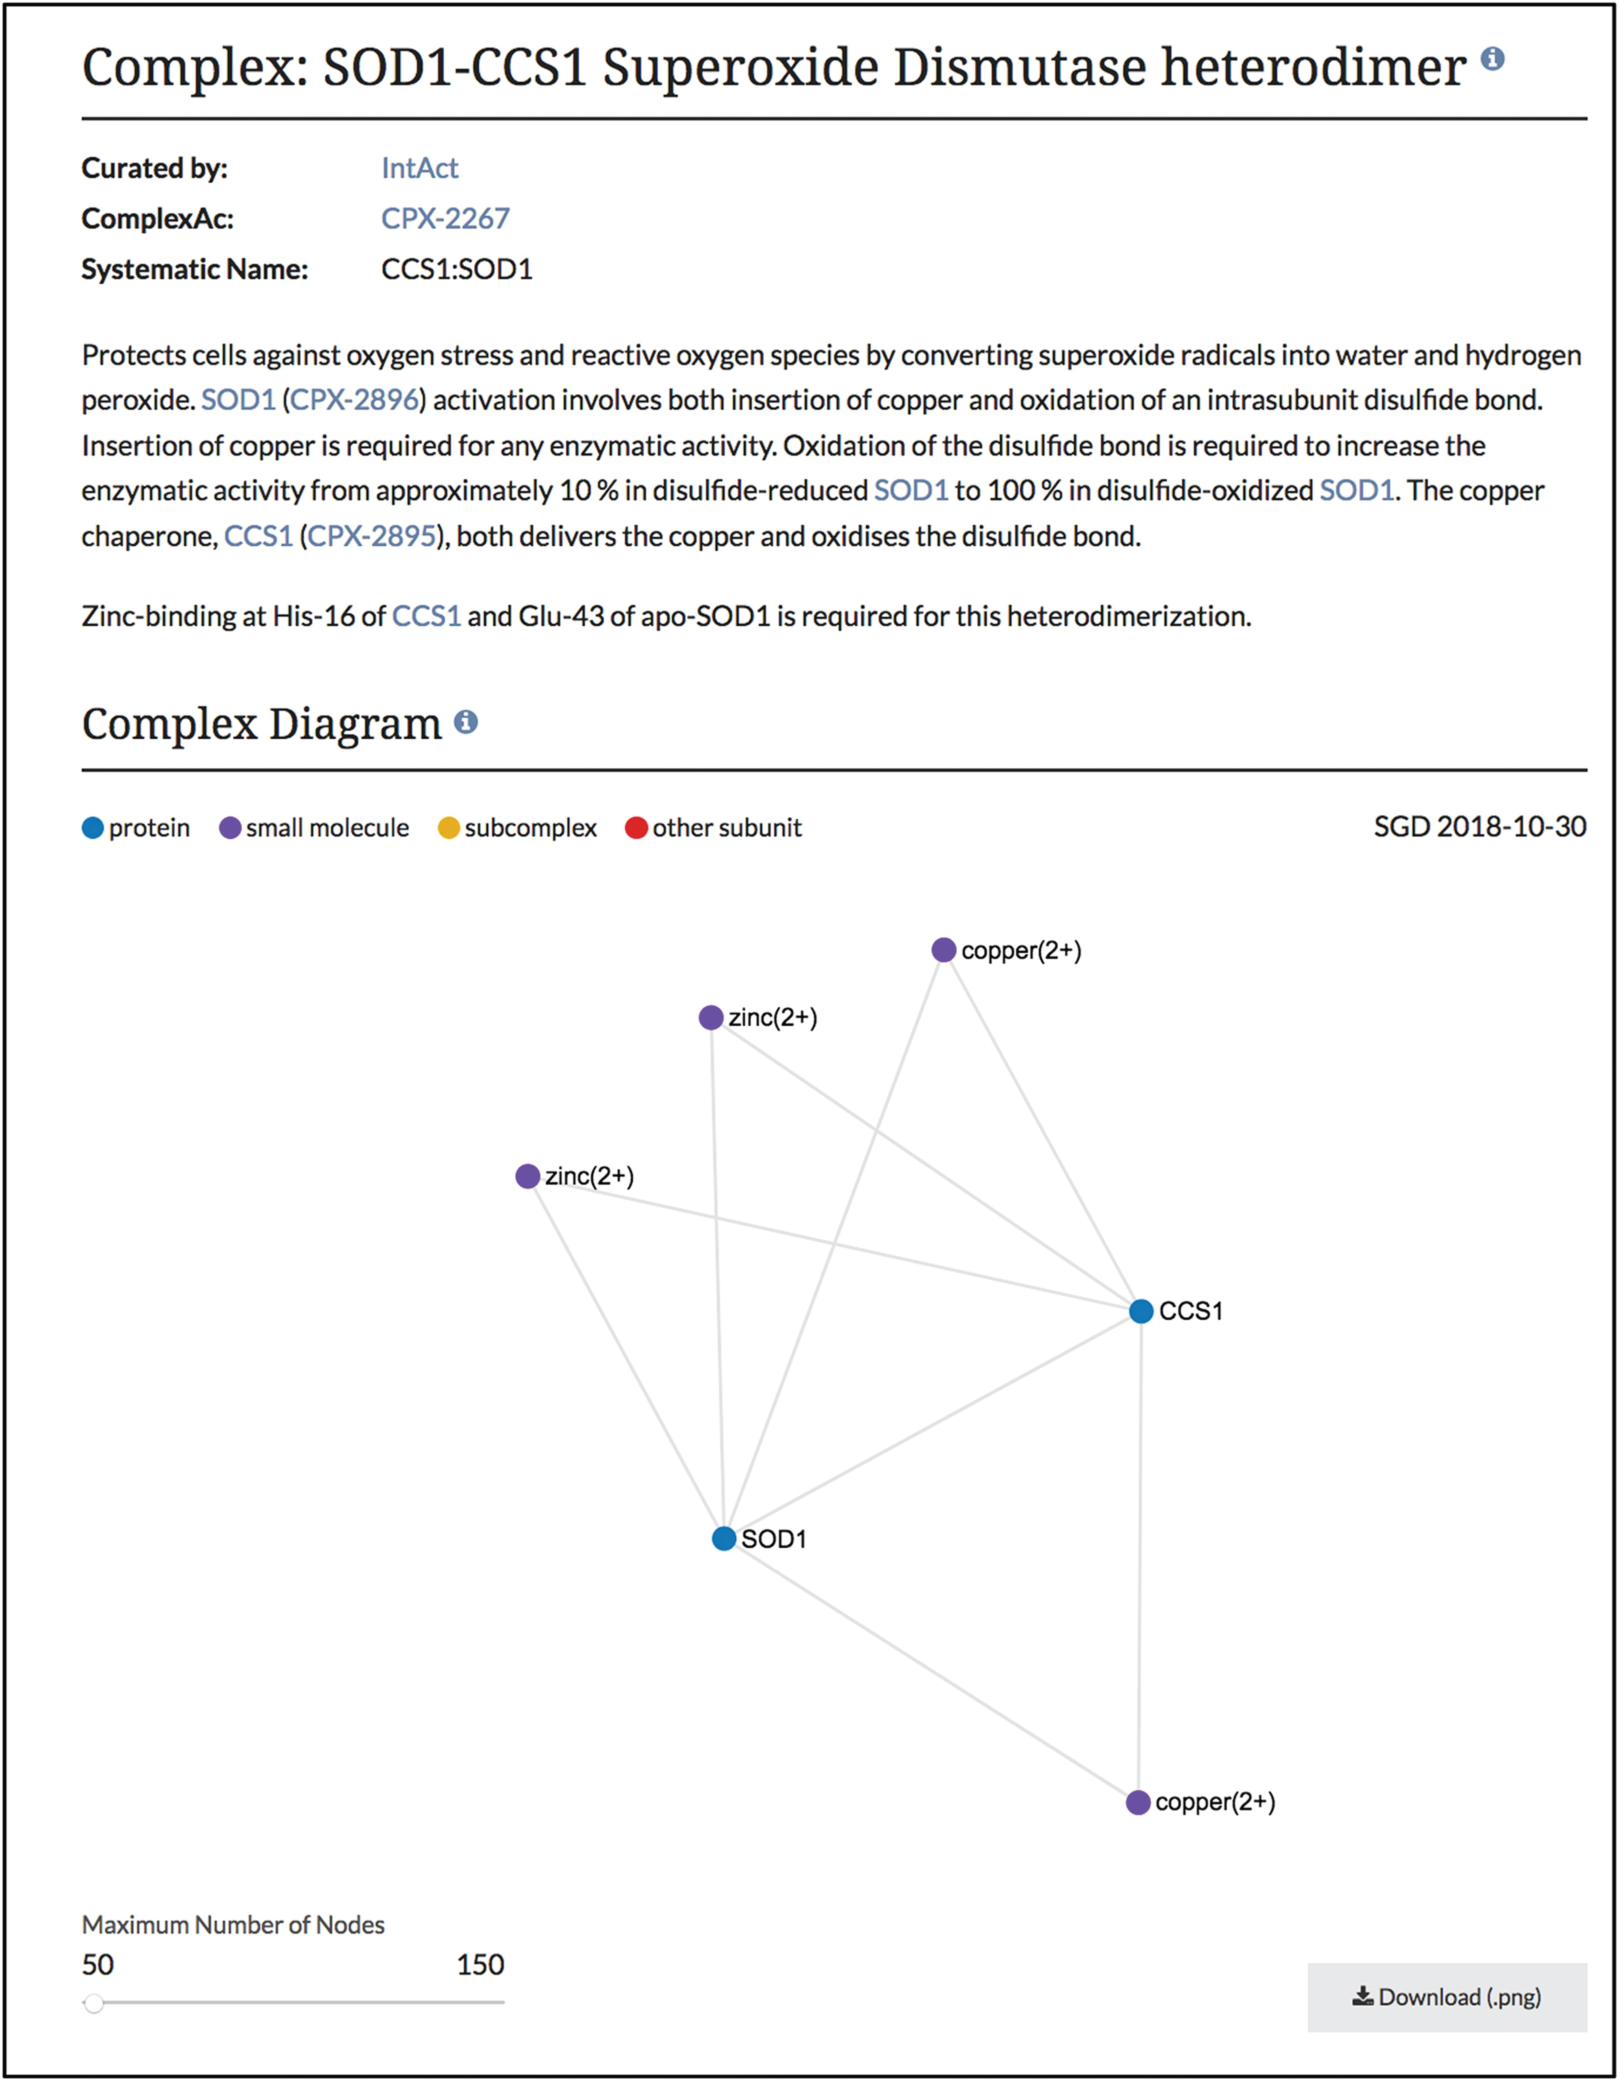
Figure 2 Summary and diagram sections of SOD1-CCS1 superoxide dismutase heterodimer page. Summary section that ...
Notes:
Figure 2 Summary and diagram sections of SOD1-CCS1 superoxide dismutase heterodimer page. Summary section that describes the function and composition of the SOD1-CCS1 superoxide dismutase complex. Individual interactions between subunits are shown in the Complex Diagram section. Complex diagrams can be downloaded as .png files. Complete page at www.yeastgenome.org/complex/CPX-2267.
Unless provided in the caption above, the following copyright applies to the content of this slide: © The Author(s) 2019. Published by Oxford University Press.This is an Open Access article distributed under the terms of the Creative Commons Attribution License (http://creativecommons.org/licenses/by/4.0/), which permits unrestricted reuse, distribution, and reproduction in any medium, provided the original work is properly cited.

Slide 3
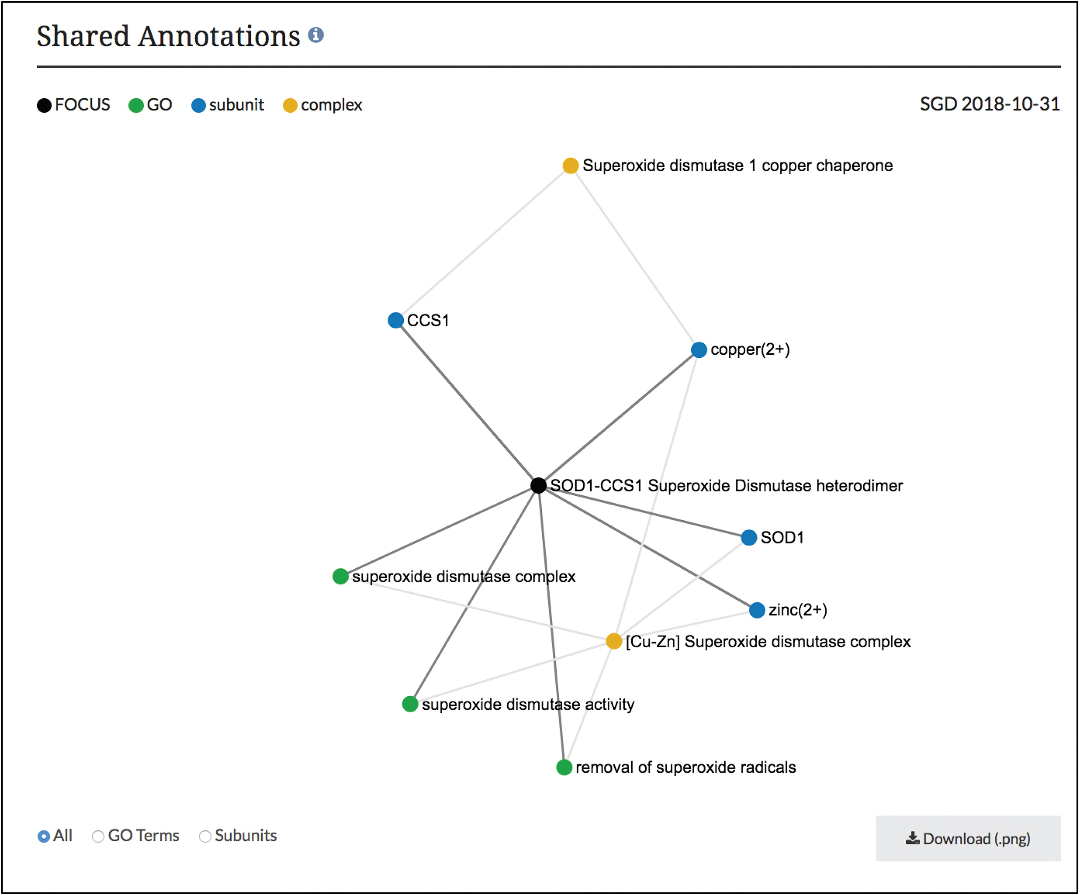
Figure 3 Network diagram of SOD1-CCS1 superoxide dismutase heterodimer page. GO annotations and complex subunits that ...
Notes:
Figure 3 Network diagram of SOD1-CCS1 superoxide dismutase heterodimer page. GO annotations and complex subunits that are shared between the focus complex and other complexes are shown as a network. Users can select to see shared GO terms or shared subunits individually or both. Images can be downloaded as .png files.
Unless provided in the caption above, the following copyright applies to the content of this slide: © The Author(s) 2019. Published by Oxford University Press.This is an Open Access article distributed under the terms of the Creative Commons Attribution License (http://creativecommons.org/licenses/by/4.0/), which permits unrestricted reuse, distribution, and reproduction in any medium, provided the original work is properly cited.

