Slide 1
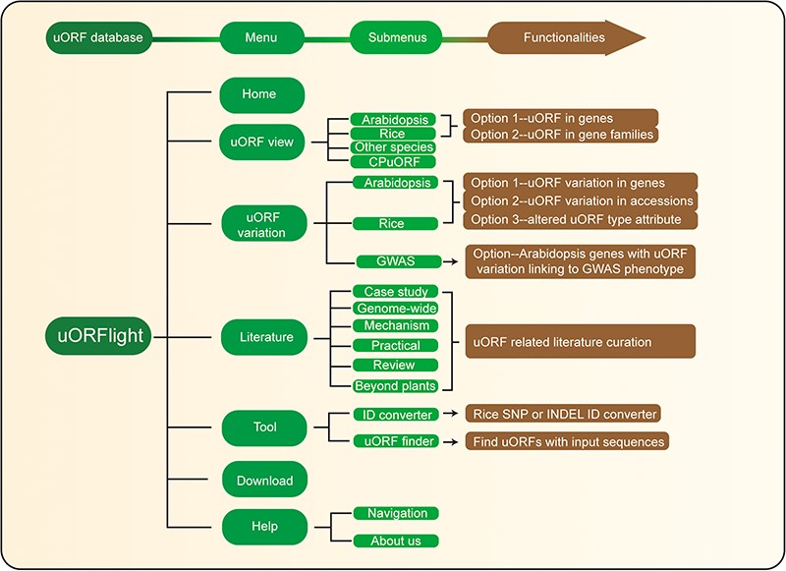
Figure 4 Database structure. Home menu contains the background information of uORFlight database including organisms, ...
Notes:
Figure 4 Database structure. Home menu contains the background information of uORFlight database including organisms, and definition of uORF attributes and variants. uORF view menu has four submenus to browse and search uORF, including in the reference genomes of Arabidopsis Col-0, rice Nipponbare and other species. CPuORF is also included in this menu. In Arabidopsis and rice submenus, Option 1 and Option 2 are provided to individually and bulk retrieve uORF information, respectively. uORF variation menu is used to compare uORF variation among different splicing models in the reference genome (Option 1) or among the selected accessions (Option 2) and to bulk retrieve genes with altered uORF types (Option 3). Literature menu curates plant uORF relevant literature into distinct groups. Tool menu provides ID converter and uORF finder with the former to transform SNP and INDEL variation identity used in different external databases, and with the later to search ATG or non-ATG initiated uORFs in a given cDNA sequence. Help menu contains Navigation submenu to explain the main conclusion on each result page.
Unless provided in the caption above, the following copyright applies to the content of this slide: © The Author(s) 2020. Published by Oxford University Press.This is an Open Access article distributed under the terms of the Creative Commons Attribution License (http://creativecommons.org/licenses/by/4.0/), which permits unrestricted reuse, distribution, and reproduction in any medium, provided the original work is properly cited.

