Slide 1
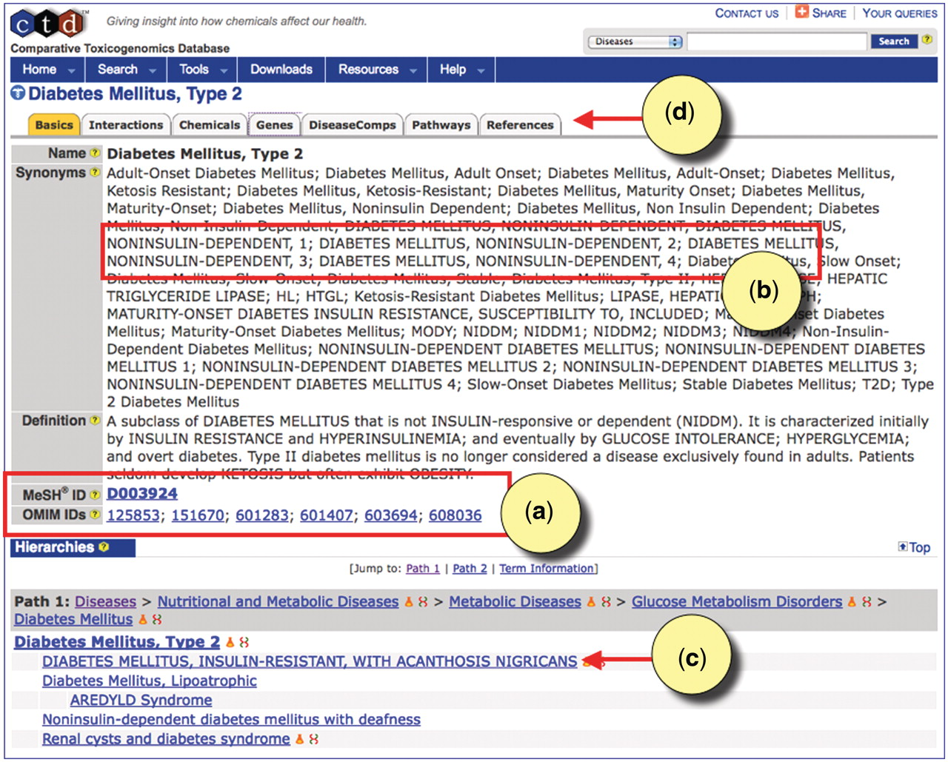
Figure 4. CTD's disease page for type 2 diabetes. (a) The disease page is anchored to the MeSH term ‘Diabetes Mellitus, ...
Notes:
Figure 4. CTD's disease page for type 2 diabetes. (a) The disease page is anchored to the MeSH term ‘Diabetes Mellitus, Type 2’ (MESH: D003924). Equivalent OMIM diseases are merged to the MeSH page in MEDIC. All accession IDs are hyperlinked to their respective databases. (b) Merged OMIM terms and synonyms are easily recognizable by their capitalization. (c) OMIM terms can be leaf nodes beneath MeSH terms, and users can see the hierarchy in which the terms fall by following the Paths. (d) CTD-curated data for type 2 diabetes can be seen by clicking on the appropriate data-tabs.
Unless provided in the caption above, the following copyright applies to the content of this slide: © The Author(s) 2012. Published by Oxford University Press.This is an Open Access article distributed under the terms of the Creative Commons Attribution Non-Commercial License (http://creativecommons.org/licenses/by-nc/3.0), which permits unrestricted non-commercial use, distribution, and reproduction in any medium, provided the original work is properly cited.

