Slide 1
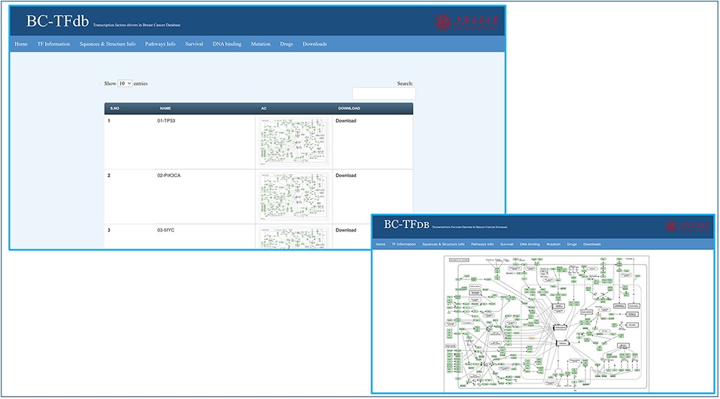
Figure 4. Representative tutorial image of the Pathway information tab upon online access. The bottom panel views a ...
Notes:
Figure 4. Representative tutorial image of the Pathway information tab upon online access. The bottom panel views a sample pathway of TP53.
Unless provided in the caption above, the following copyright applies to the content of this slide: © Crown copyright 2021.This Open Access article contains public sector information licensed under the Open Government Licence v3.0 (http://www.nationalarchives.gov.uk/doc/open-government-licence/version/3/).

