Slide 1
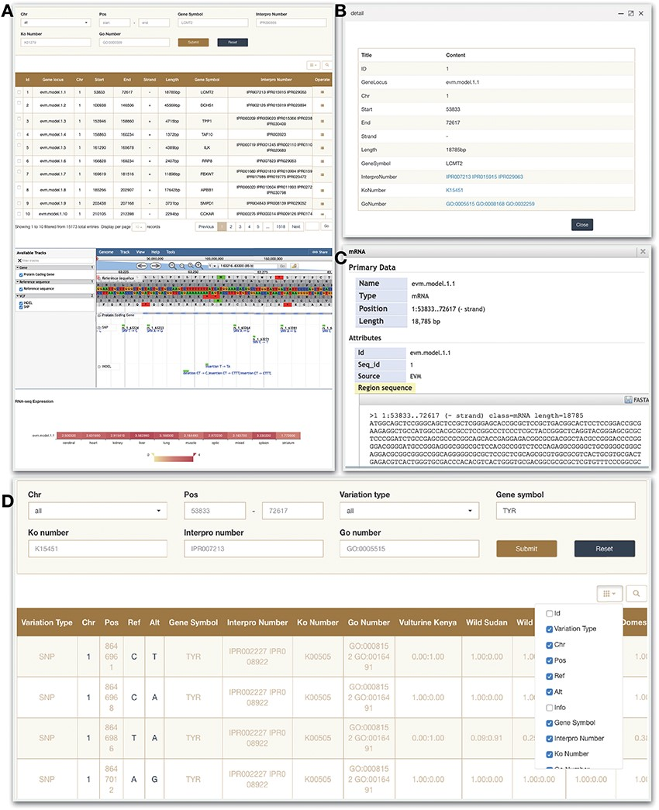
Figure 4. Gene and Variation modules. (A) Gene search module. (B) Click on operate button shows the detailed ...
Notes:
Figure 4. Gene and Variation modules. (A) Gene search module. (B) Click on operate button shows the detailed information. (C) Click on sequence in the JBrowse to view detailed information. (D) Variation module.
Unless provided in the caption above, the following copyright applies to the content of this slide: © The Author(s) 2021. Published by Oxford University Press.This is an Open Access article distributed under the terms of the Creative Commons Attribution License (http://creativecommons.org/licenses/by/4.0/), which permits unrestricted reuse, distribution, and reproduction in any medium, provided the original work is properly cited.

