Slide 1
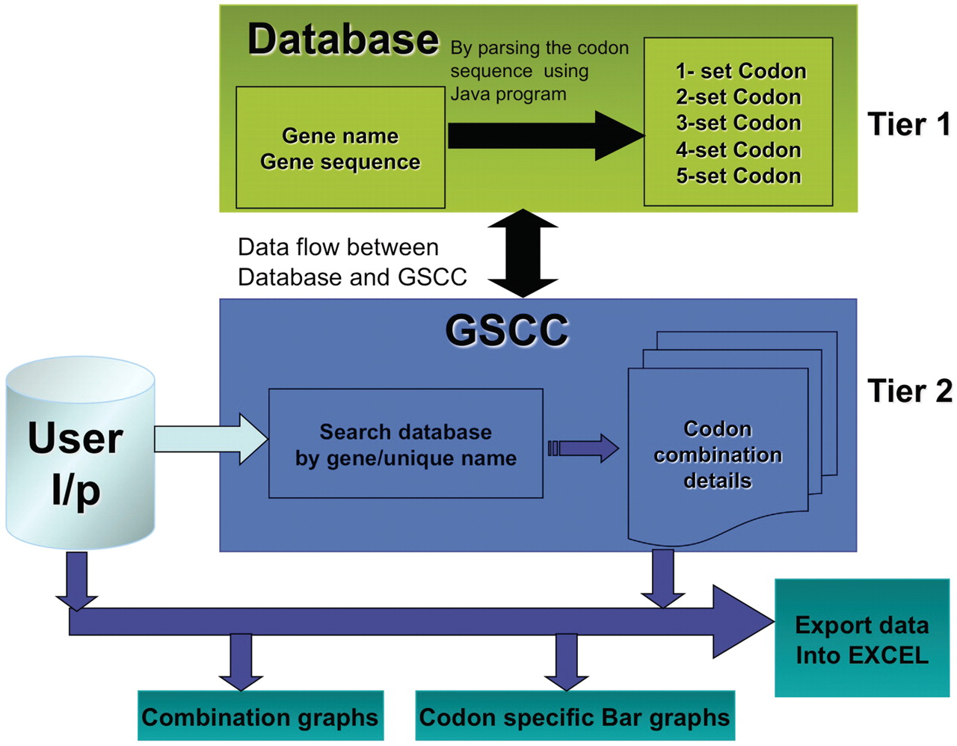
Figure 1 GSCC core architecture. Overview of the GSCC two tier architecture. Tier 1: The database contains the main ...
Notes:
Figure 1 GSCC core architecture. Overview of the GSCC two tier architecture. Tier 1: The database contains the main gene names and codon gene sequences of 5780 genes taken from S. cerevisiae. Using the codon gene sequence information, we quantitated the number of individual codons as well as all two set, three set, four set and five set codon combinations in each gene. Tier 2: The GSCC user visual interface takes user defined input (gene name or search string) and searches the database for a matching gene name with the given search string and then retrieves that gene's codon sequences (individual codons as well as all two set, three set, four set and five set codon combinations). Users can visualize the codon sequences as bar graphs and as combination graphs. (Refer to Figure 3 for combination graphs). Users can also export the codon information into Excel.
Unless provided in the caption above, the following copyright applies to the content of this slide: © The Author(s) 2012. Published by Oxford University Press.This is an Open Access article distributed under the terms of the Creative Commons Attribution Non-Commercial License (http://creativecommons.org/licenses/by-nc/3.0), which permits unrestricted non-commercial use, distribution, and reproduction in any medium, provided the original work is properly cited.

Slide 2
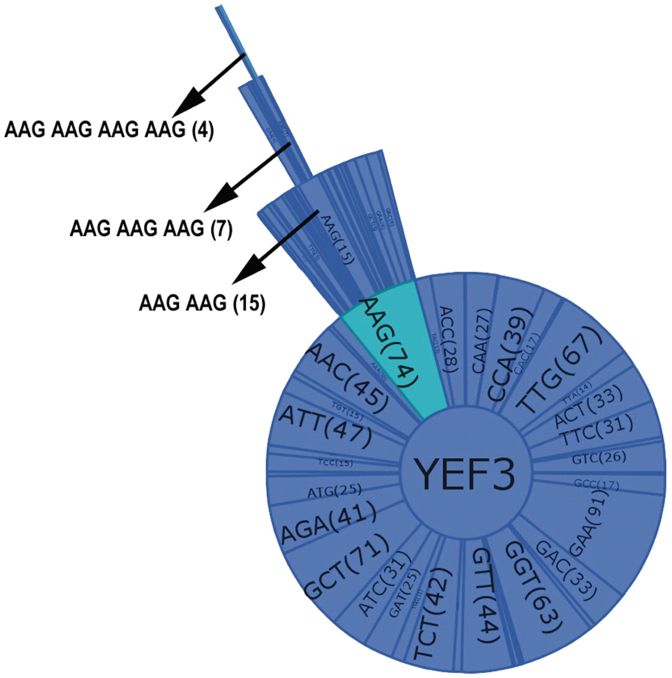
Figure 3 Combination graph of YEF3. Each sector of the graph represents a codon with the name and the number of each ...
Notes:
Figure 3 Combination graph of YEF3. Each sector of the graph represents a codon with the name and the number of each codon in parenthesis. The selected codon combination (as shown by arrow in the Figure) also details the number of occurrences in each gene.
Unless provided in the caption above, the following copyright applies to the content of this slide: © The Author(s) 2012. Published by Oxford University Press.This is an Open Access article distributed under the terms of the Creative Commons Attribution Non-Commercial License (http://creativecommons.org/licenses/by-nc/3.0), which permits unrestricted non-commercial use, distribution, and reproduction in any medium, provided the original work is properly cited.

Slide 3
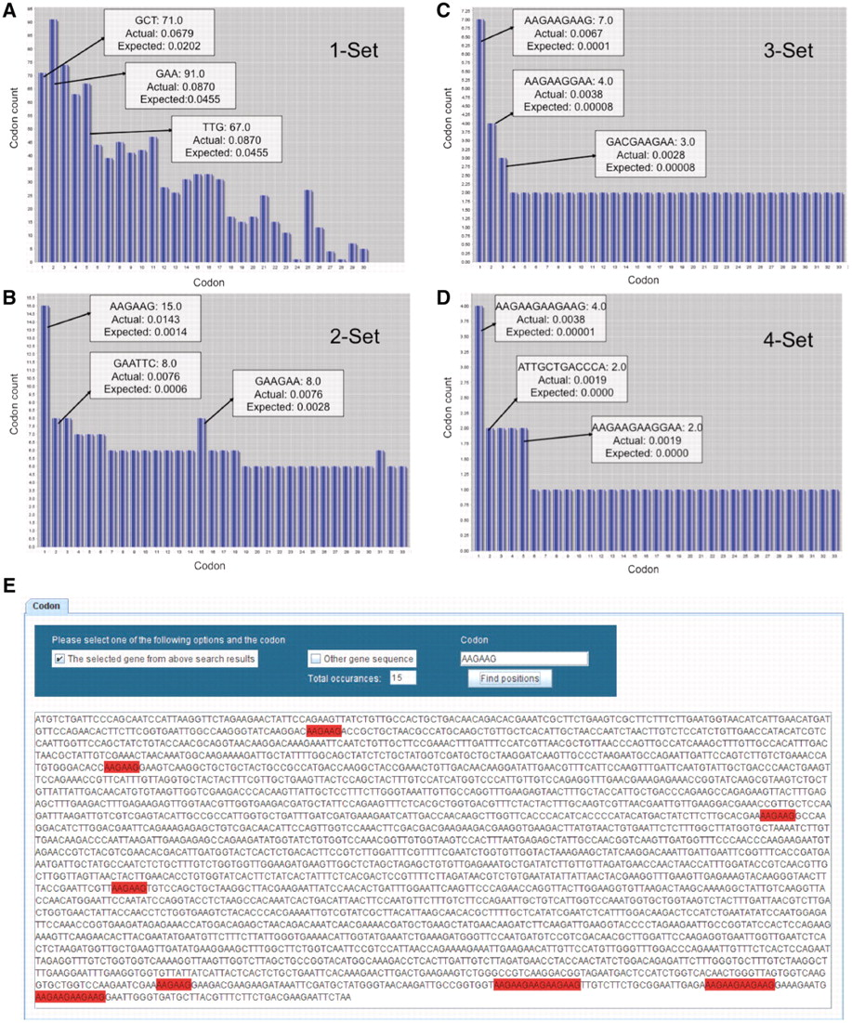
Figure 2 GSCC visual output demonstrating codon combinations in YEF3. Bar graphs (A–D) of single, double, triple, and ...
Notes:
Figure 2 GSCC visual output demonstrating codon combinations in YEF3. Bar graphs (A–D) of single, double, triple, and quadruple codon combinations in the YEF3 gene, respectively. Each bar represents a codon. When the user places the mouse pointer over the each bar (codon) in GSCC, it shows the quantitated values of the codon. In all the graphs, the bars are sorted in the descending order of (actual–expected frequency). Codon painting (E) takes user input information, consisting of individual codons or codon runs, and highlights these occurrences in the gene sequence.
Unless provided in the caption above, the following copyright applies to the content of this slide: © The Author(s) 2012. Published by Oxford University Press.This is an Open Access article distributed under the terms of the Creative Commons Attribution Non-Commercial License (http://creativecommons.org/licenses/by-nc/3.0), which permits unrestricted non-commercial use, distribution, and reproduction in any medium, provided the original work is properly cited.

Slide 4
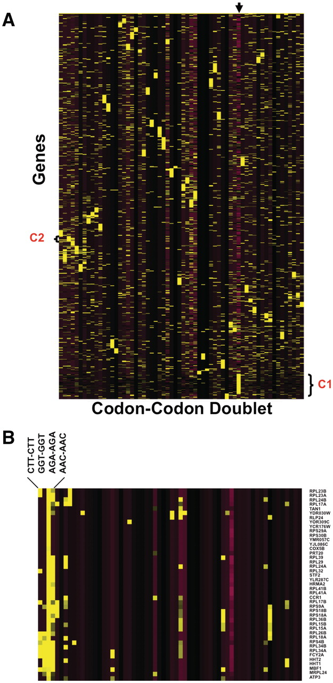
Figure 4 Heat Map identifies groups of genes over-represented with specific codon–codon doublets. Z-scores, describing ...
Notes:
Figure 4 Heat Map identifies groups of genes over-represented with specific codon–codon doublets. Z-scores, describing whether a gene is over- or under-represented with a codon doublet of identical codons, were hierarchically clustered using CLUSTER software. 5780 gene sequences were filtered to remove any gene sequences that did not register at least one Z-score >2 or <−2, leaving 4561 genes for clustering. The clustered data was visualized using TREEVIEW, with yellow and purple boxes depicting over-represented and under-represented doublets, respectively. The genes are organized vertically based on their similarity to each other across all codon–codon doublets, as defined by the clustering algorithm. Similarly, the codon–codon doublets are organized horizontally based on similarity to each other, as defined by the clustering algorithm. (A): The arrow marks the column containing the gene length Z-score, with yellow and purple boxes representing genes larger or smaller than the genome average, respectively. The average genome size is 1401 base pairs with a standard deviation of 1122 base pairs. We have also denoted cluster I (C1), specific to larger than average genes and B) blown up cluster II (C2) for viewing (B).
Unless provided in the caption above, the following copyright applies to the content of this slide: © The Author(s) 2012. Published by Oxford University Press.This is an Open Access article distributed under the terms of the Creative Commons Attribution Non-Commercial License (http://creativecommons.org/licenses/by-nc/3.0), which permits unrestricted non-commercial use, distribution, and reproduction in any medium, provided the original work is properly cited.

