Slide 1
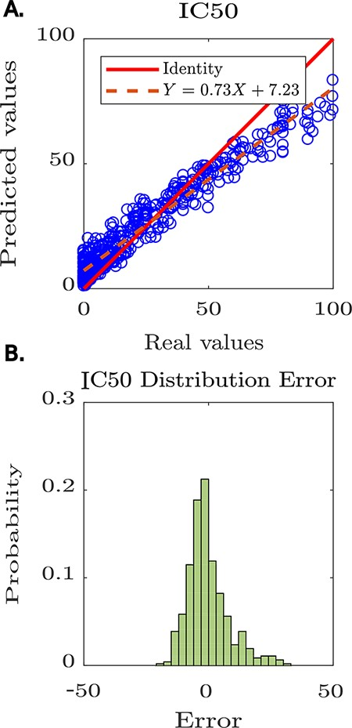
Figure 4. Predictive modelling of IC₅₀ for anti-HIV peptides using Peptipedia. A: scatter plot prediction vs ...
Notes:
Figure 4. Predictive modelling of IC50 for anti-HIV peptides using Peptipedia. A: scatter plot prediction vs reality, denoting the performance of the predictive model. In general, there is no tendency to over-adjust or under-adjust in any particular range, which shows that the cross-validation strategies were correctly applied. B: histogram of the error distribution. The probability of error analysis indicates no tendency for significant errors that adversely alter the model predictions. The errors are mainly concentrated between -5 and 5, which is quite acceptable considering the nature of the entered values, where the largest reach 100 and the smallest are close to zero.
Unless provided in the caption above, the following copyright applies to the content of this slide: © The Author(s) 2021. Published by Oxford University Press.This is an Open Access article distributed under the terms of the Creative Commons Attribution License (https://creativecommons.org/licenses/by/4.0/), which permits unrestricted reuse, distribution, and reproduction in any medium, provided the original work is properly cited.

