Slide 1
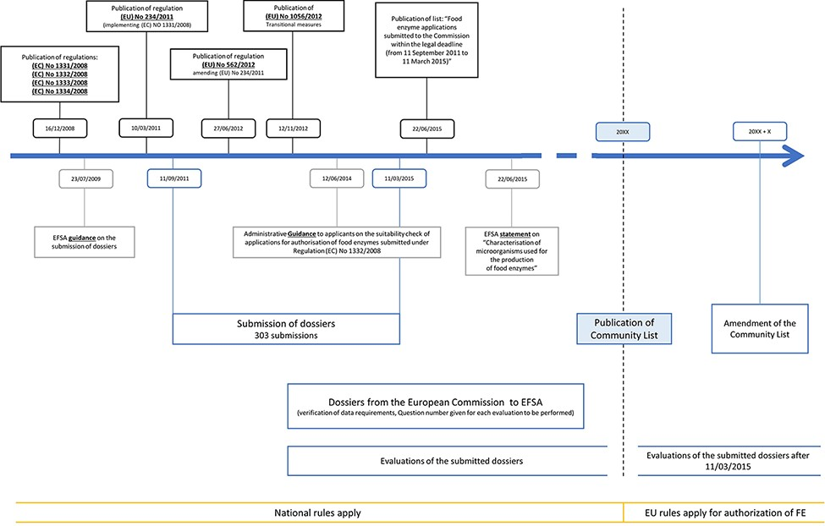
Figure 1. Timeline of the evaluation workflow followed by EFSA for FE preparations following the new harmonization ...
Notes:
Figure 1. Timeline of the evaluation workflow followed by EFSA for FE preparations following the new harmonization regulations, being 1331/2008, 1332/2008, 1333/2008 and 1334/2008. Additional relevant regulations, statements and amendments are also indicated.
Unless provided in the caption above, the following copyright applies to the content of this slide: © The Author(s) 2021. Published by Oxford University Press.This is an Open Access article distributed under the terms of the Creative Commons Attribution License (https://creativecommons.org/licenses/by/4.0/), which permits unrestricted reuse, distribution, and reproduction in any medium, provided the original work is properly cited.

Slide 2
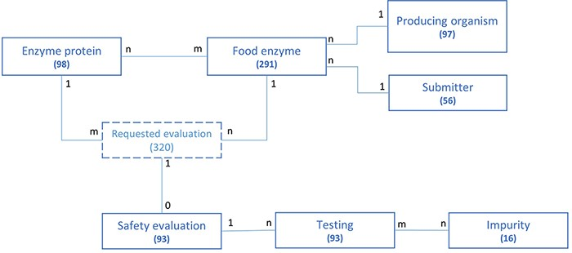
Figure 2. Schematic representation of the underlying data model structure of the web application, representing the ...
Notes:
Figure 2. Schematic representation of the underlying data model structure of the web application, representing the relationships between the different model objects. For each entity, the total number of corresponding entries in the database is given (valid at the time of submission). The numbers at each association indicate cardinalities.
Unless provided in the caption above, the following copyright applies to the content of this slide: © The Author(s) 2021. Published by Oxford University Press.This is an Open Access article distributed under the terms of the Creative Commons Attribution License (https://creativecommons.org/licenses/by/4.0/), which permits unrestricted reuse, distribution, and reproduction in any medium, provided the original work is properly cited.

Slide 3
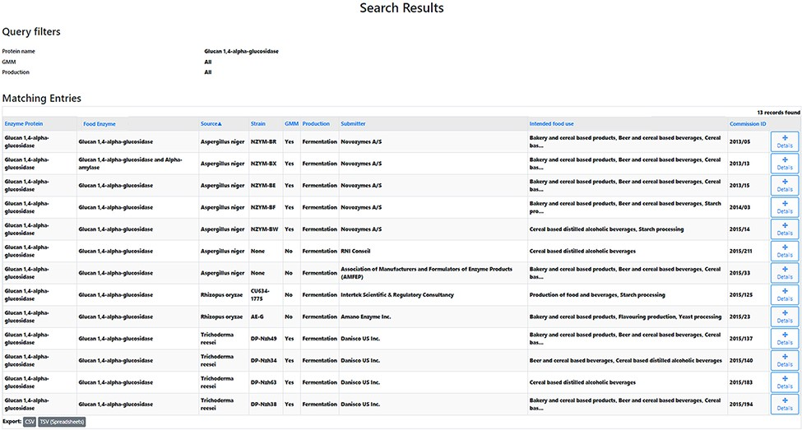
Figure 3. Search results research question 5.1. A list of 13 records is obtained. The table headers can be used to ...
Notes:
Figure 3. Search results research question 5.1. A list of 13 records is obtained. The table headers can be used to filter the obtained results. By selecting the ‘Details’ icon, the user is redirected to the detailed information of the selected FE. From those pages, amongst others, the EFSA status can be collected.
Unless provided in the caption above, the following copyright applies to the content of this slide: © The Author(s) 2021. Published by Oxford University Press.This is an Open Access article distributed under the terms of the Creative Commons Attribution License (https://creativecommons.org/licenses/by/4.0/), which permits unrestricted reuse, distribution, and reproduction in any medium, provided the original work is properly cited.

