Slide 1
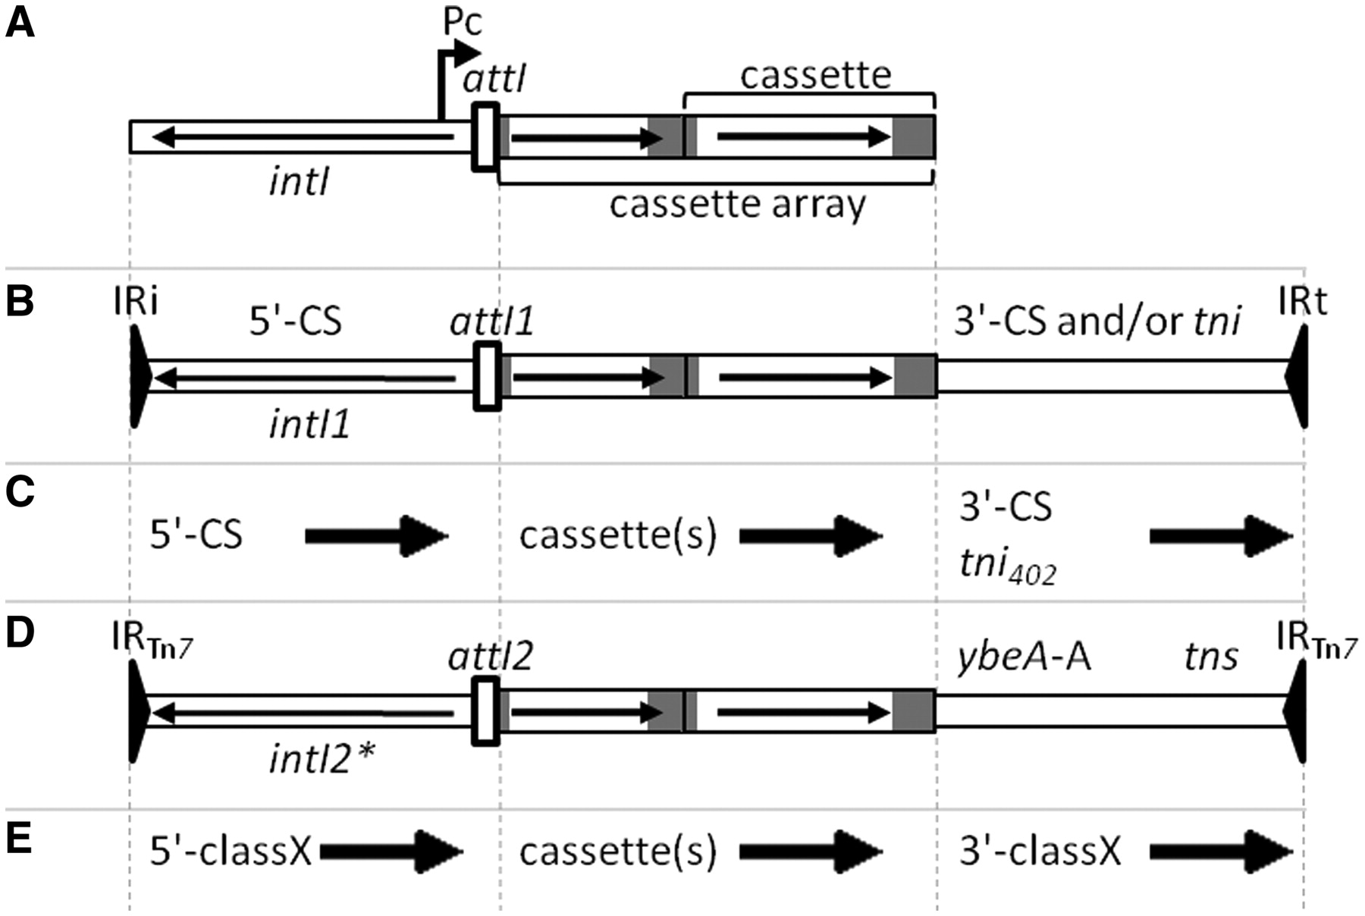
Figure 1. (A) General structure of an integron with intI, attI, Pc and a cassette array with two gene cassettes. ...
Notes:
Figure 1. (A) General structure of an integron with intI, attI, Pc and a cassette array with two gene cassettes. Horizontal arrows indicate the extent and direction of genes. Grey regions represent attC sites. (B) General structure of Class 1 MRI, which may include the 3'-CS and part of the tni region of Tn402 or a complete tni402 region. (C) Names used by RAC to indicate conserved regions flanking cassette arrays in the two types of Class 1 MRI. Arrows define the forward direction used in the RAC annotations, which in the case of the 5'-CS is opposite to that of intI1. (D) Structure of a Class 2 integron associated with Tn7. The intI2 gene is usually truncated, indicated by an asterisk. ybeA-A is a cassette remnant with a truncated attC site and is followed by the tns transposition genes of Tn7. (E) Names used by RAC to indicate regions flanking cassette arrays in a class X MRI, where X is 2–5.
Unless provided in the caption above, the following copyright applies to the content of this slide: © The Author(s) 2011. Published by Oxford University Press.This is an Open Access article distributed under the terms of the Creative Commons Attribution Non-Commercial License (http://creativecommons.org/licenses/by-nc/3.0), which permits unrestricted non-commercial use, distribution, and reproduction in any medium, provided the original work is properly cited.

